Slide 1





Classroom Collective Worship
Autumn 1 - 2021
your self your learning your future your community your world

Slide 2

New Beginnings
Week 1: 6th September

Slide 3

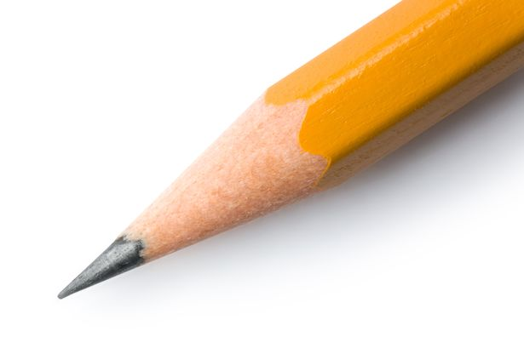
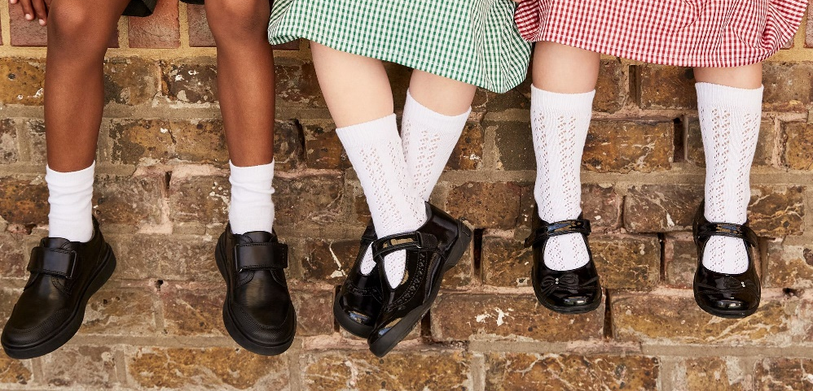
What new things have you experienced this week?
How does having new things make you feel?

Slide 4

On January the 1st, some people make resolutions about the year ahead. These might be things they want to achieve or things they want to change.
What three resolutions could you make for your new school year?

Slide 5
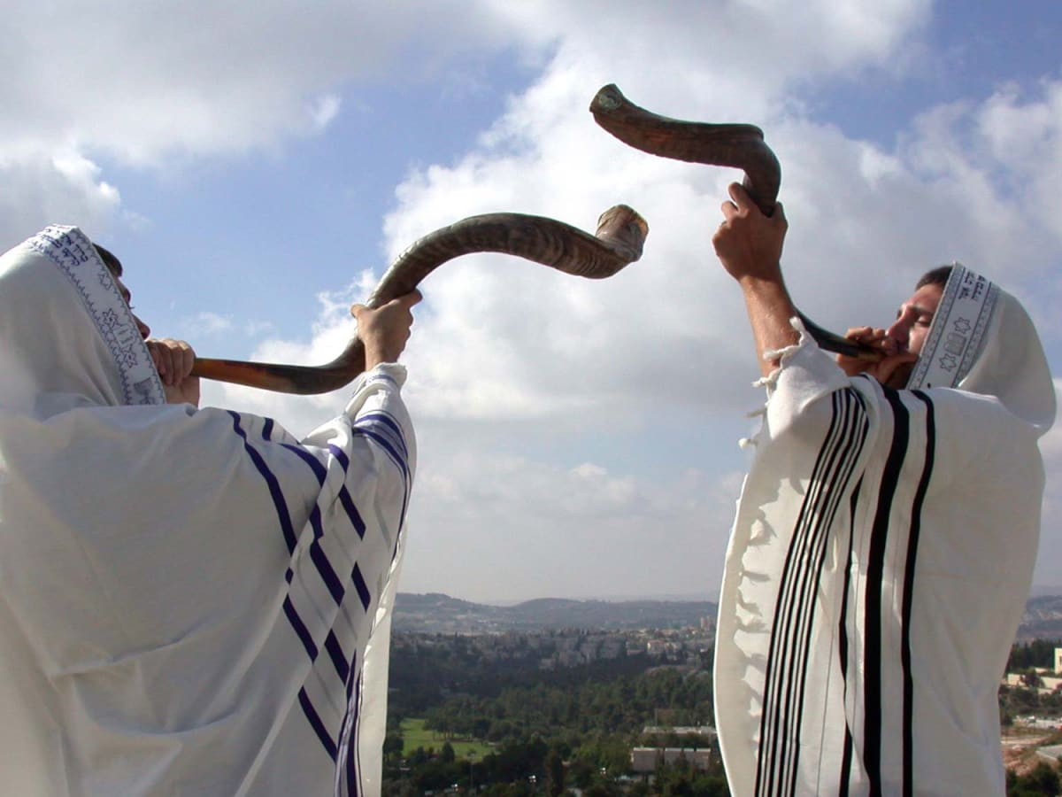
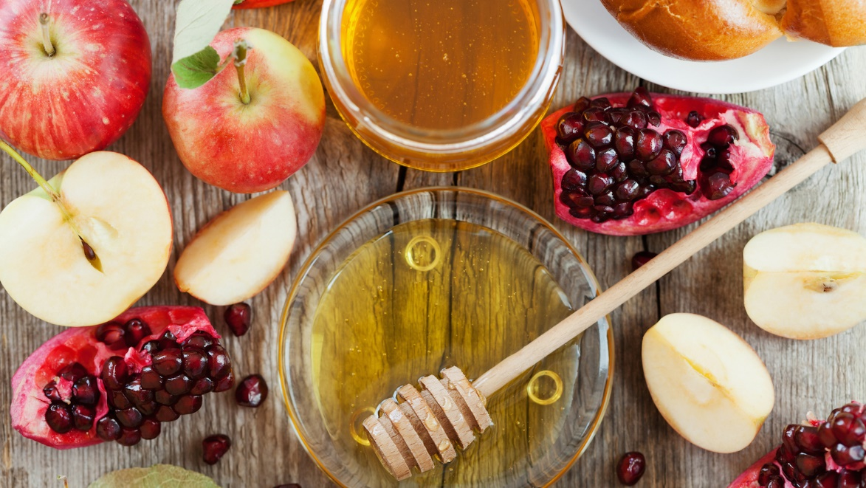
In 2021, Rosh Hashanah is from 6th to 8th September. It’s the Jewish new year festival and also celebrates the creation of the world.
Find out more about Rosh Hashanah here and here.

Slide 6

Forgiveness
Week 2: 13th September

Slide 7
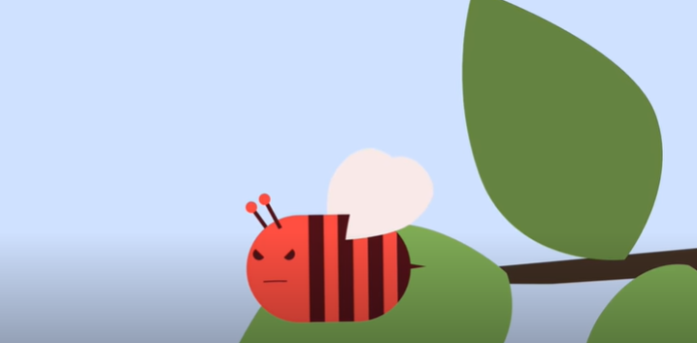
The Angry Bee
What happened to make the bee angry?
How did he feel before he forgave?
How did he feel after he forgave?

Slide 8
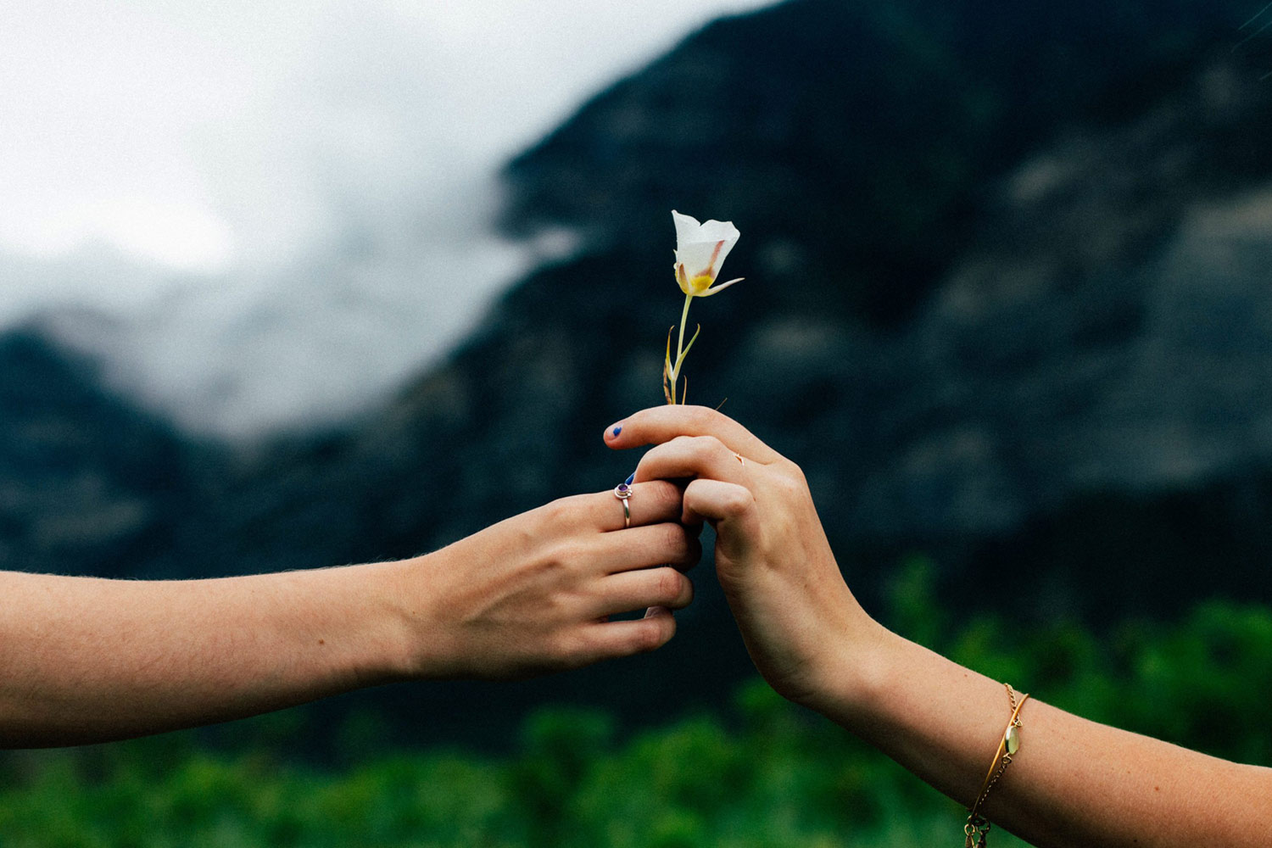
What is forgiveness?
Can you think of a time when you’ve had to forgive someone?
Is it always easy to forgive?
How can you show someone you forgive them?

Slide 9
Most religions teach people about the importance of forgiveness. In the Christian Bible, this is what Jesus said:
Peter came to Jesus and asked, “Lord, how many times shall I forgive my brother or sister who sins against me? Up to seven times?”
Jesus answered, “I tell you, not seven times, but seventy-seven times.
The Jewish festival of Yom Kippur is 15th – 16th September and focuses on forgiveness. Learn more here.
Why is it important to forgive others?

Slide 10
Peace and Mindfulness
Week 3: 20th September
Lots of activities here.

Slide 11
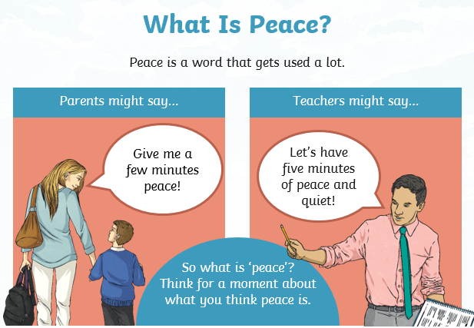

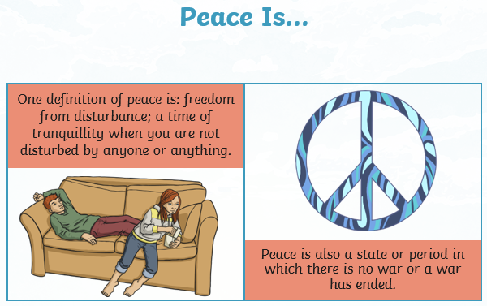
More information here.
What makes you feel peaceful? Places, people, things…

Slide 12
Get comfortable.
Close your eyes.
Take slow, deep breaths.
Stay silent.
Relax every part of your body.
Listen to the music.

Slide 13
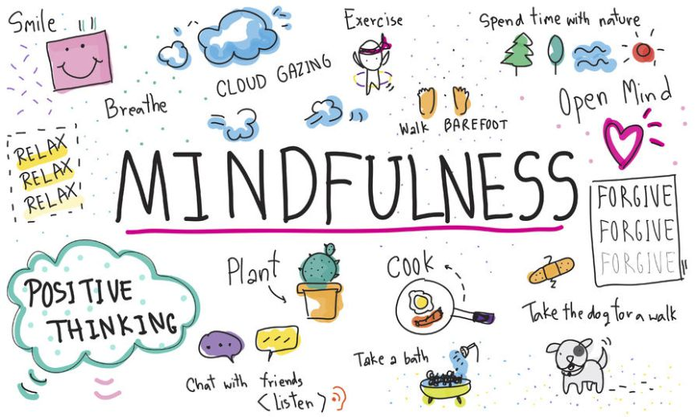
What is mindfulness? Learn more here.
What are your favourite ways to practise mindfulness?
Did you know, we have loads of mindfulness activities on our school website?

Slide 14
Taking Care of Your Body
Week 4: 27th September

Slide 15

Wednesday 29th September is World Heart Day
Why is our heart so important?
How can we look after our heart?

Slide 16
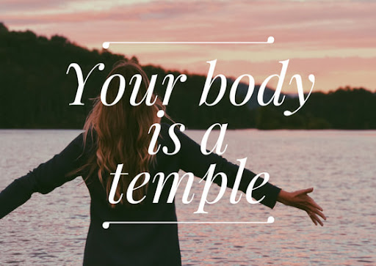
The Christian Bible says:
What do you think this means?
Let’s make a class list of how we can take care of our whole bodies.

Slide 17
Meditation can help us look after our mind which is just as important as looking after the rest of our body.
We all need to be calm and sensible so that everyone can give it a good go.
Let’s try it

Slide 18

Celebrating Diversity
Week 5: 4th October

Slide 19
October is Black History Month in the UK.
Find out some American history here.
Learn about a little girl called Ayanna Najuma.

Slide 20
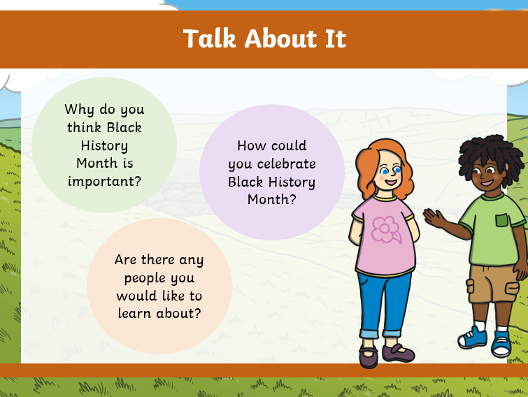
Read about Black History Month in the UK here.

Slide 21
What do you know about these famous black people?
Marcus Rashford
Stormzy
Kamala Harris
Aretha Franklin
Ade Adepitan
Will Smith
Barack Obama
Nicola Adams
Rihanna
Usain Bolt
Learn about some famous black people from history here.

Slide 22
Identity and Values
Week 6: 11th October

Slide 23
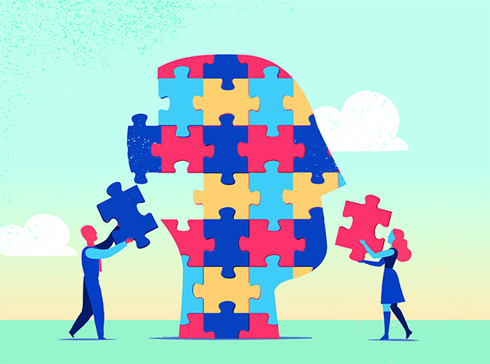
Let’s find out more about identity and values here.

Slide 24
What are your hobbies?
What is your culture, ethnicity, language, religion?
What is your personality like?
What are your likes and dislikes?
So, what are your values?
honesty teamwork friendliness independence creativity
generosity good manners determination leadership
resilience kindness loyalty patience trust

Slide 25
Before we start today: remember we all need to be kind and respectful to each other.
What is the same about all of us?
What makes you different to the person sitting next to you?
Would it be better if everyone was the same?

Slide 26

Global Hunger Awareness
Week 7: 18th October

Slide 27
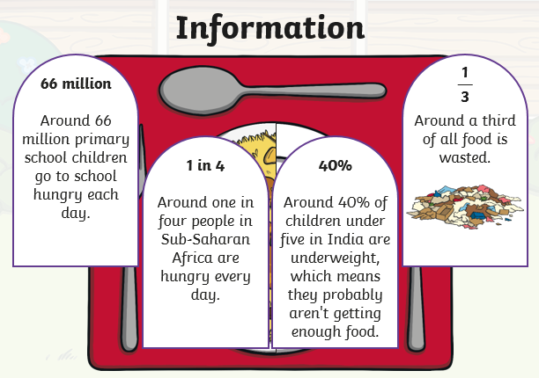
World Food Day – 16th October 2021
What is your favourite food?
What is hunger?
Where in the world might people not have enough to eat?

Slide 28
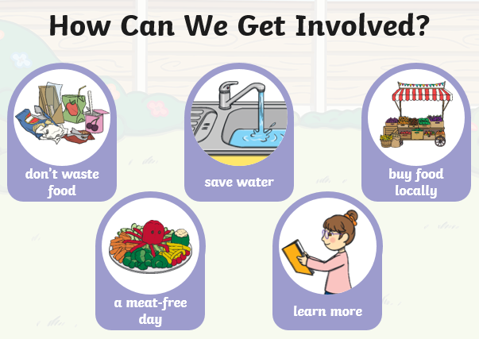
What can you do to help for World Food Day?
Donate to our Harvest collection to help people in Derby who don’t have enough to eat.

Slide 29
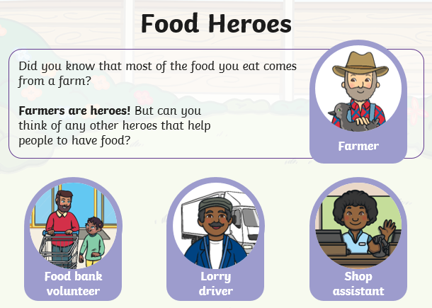
There are lots of people involved in food finding its way to us.
Take a few moments to be grateful for our food heroes.
Remember to thank them if you ever have the opportunity.
Next time you eat, pause to think about those less fortunate than you and be grateful for what you have.

