Slide 1





Classroom Collective Worship
Autumn 2 - 2021
your self your learning your future your community your world

Slide 2

Light to Meditate and Celebrate
Week 1: 1st November

Slide 3
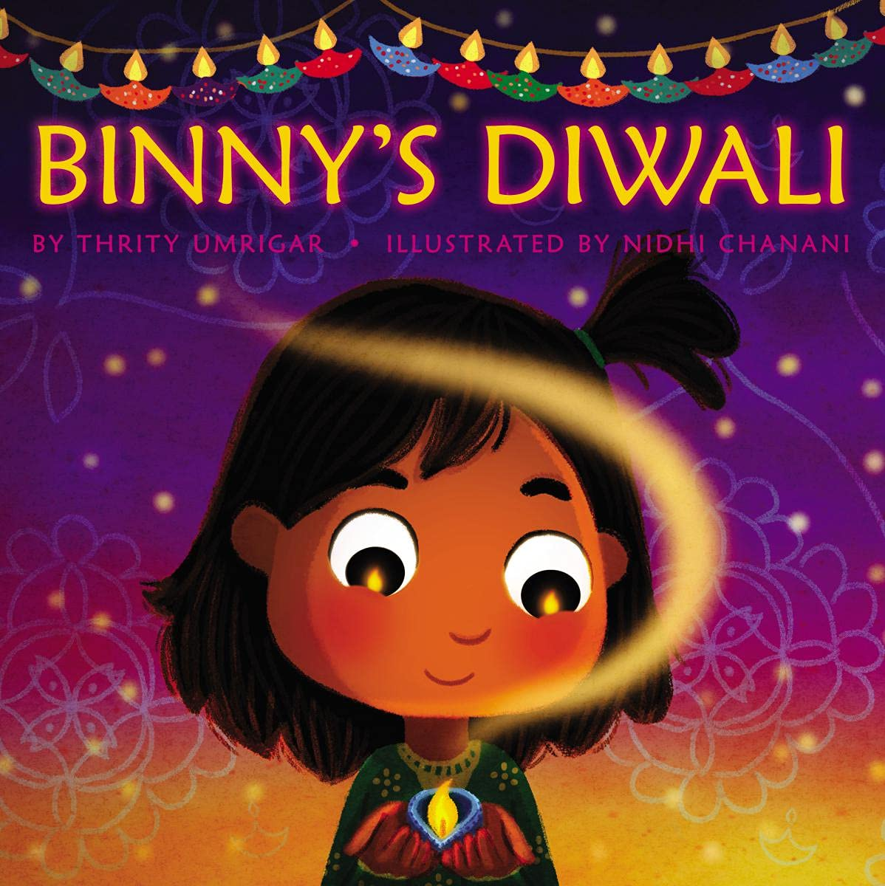
Story Time
Binny’s Diwali
by Thrity Umrigar

Slide 4
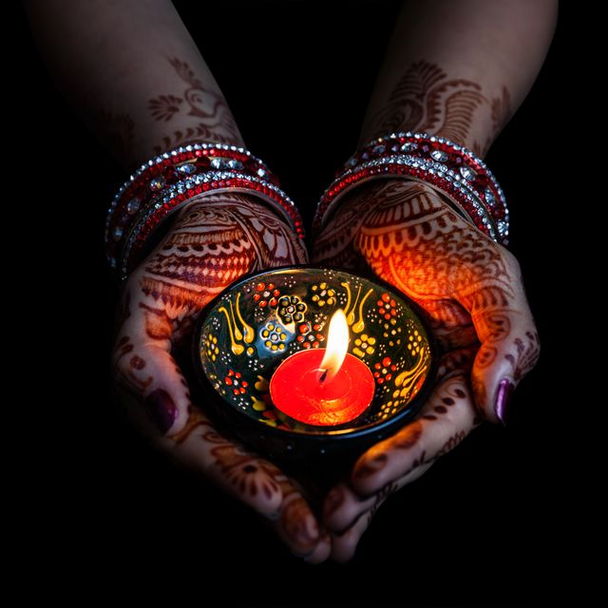
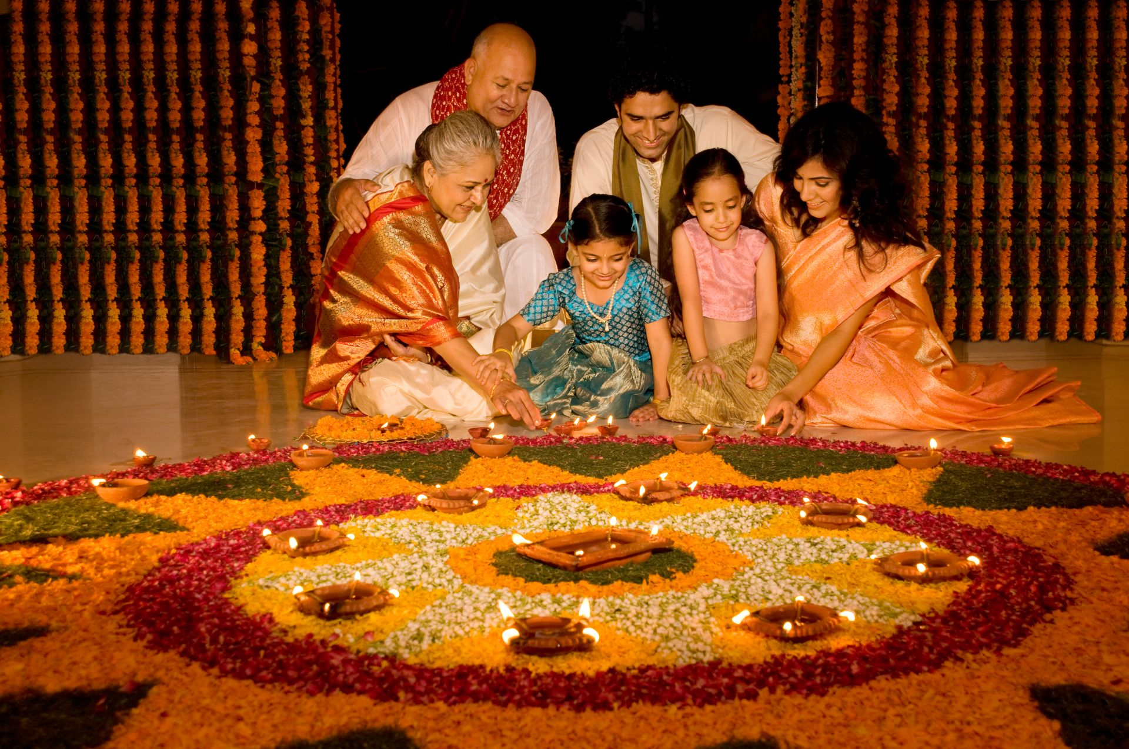
On Thursday, Hindus, Sikhs and Jains all over the world will be celebrating Diwali.
Watch this video to find out why light is so important during this festival.

Slide 5
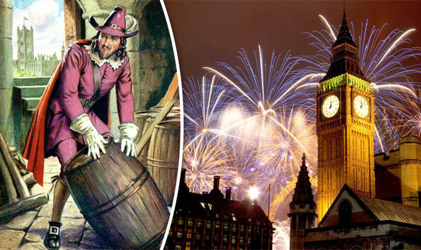
Remember, remember, the 5th of November
Gunpowder, treason and plot
I see no reason why gunpowder treason
Should ever be forgot!
Watch this video to learn all about why we have bonfires and fireworks on November 5th.

Slide 6
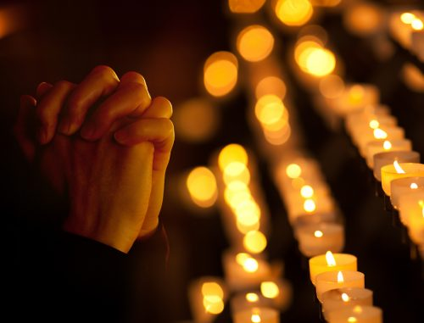
What festivals, other than Diwali and bonfire night, use light to celebrate?
How do you feel when you watch fireworks, bonfires or look at a candle or lights?
Many people light candles before praying. Take a few moments to be quiet and peaceful and to say a prayer if you wish.

Slide 7

Remembering
Week 2: 8th November

Slide 8


Story Time – Teacher’s Choice
The Memory Tree
by Britta Teckentrup
Coming to terms with the death of a loved one
The Invisible String
by Patrice Karst
When you love someone, you’re
always connected by your invisible strings

Slide 9
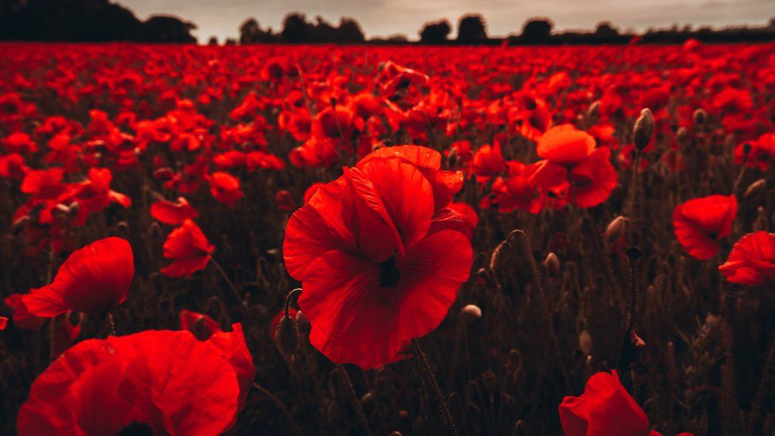
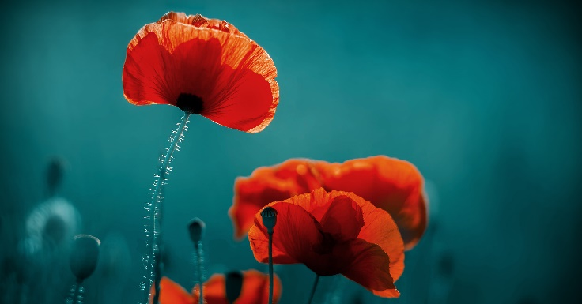
Thursday 11th November is Remembrance Day.
We think about all of the soldiers who fought in wars to help keep us safe.
At 11 o’clock on 11th day of 11th month, we stay silent for two minutes, remembering them.
Poppies are flowers that remind people about the soldiers who were injured or killed in lots of different wars.
Find out more here.

Slide 10
Why might you want to remember someone?
Can you give everyone else any advice about how you can remember people?
Praying or meditating
Having a special place to sit and reflect
Doing something they used to like
Talking about the person
Doing something creative

Slide 11
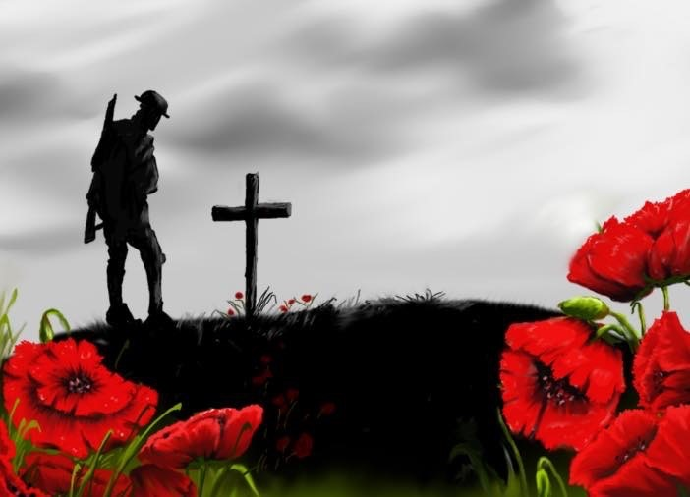
Where the Poppies Now Grow
A short story
Two minute video to remember

Slide 12
Kindness
Week 3: 15th November

Slide 13
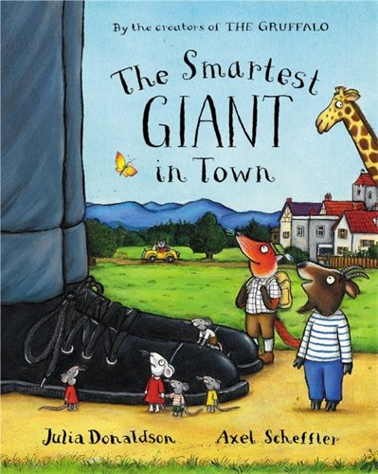
Story Time
The Smartest Giant in Town
by Julia Donaldson

Slide 14

As a class, let’s make a list of things we can do to be kind - at school, at home or in our community.
Which ones will you try to do this week?

Slide 15
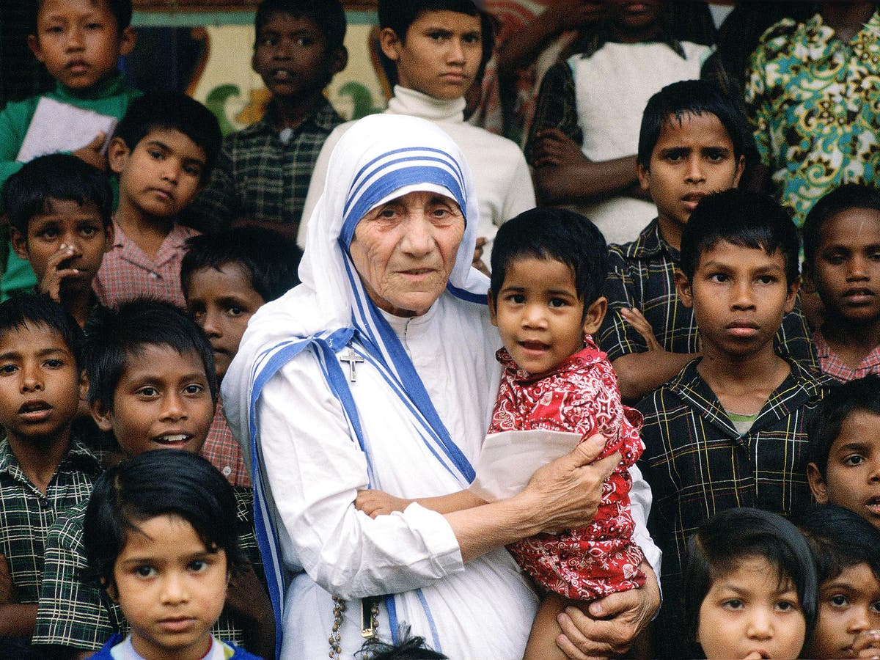
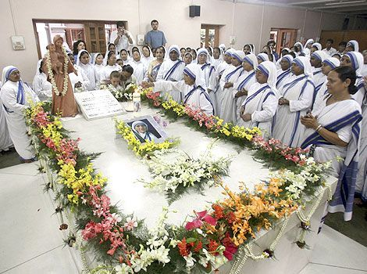
Mother Teresa, an Albanian nun who is now a saint, was known to be a very kind person. She said, “Let no one ever come to you without leaving better and happier. Be the living expression of God's kindness: kindness in your face, kindness in your eyes, kindness in your smile.”
She spent a lot of her life working with the poorest people of Calcutta, India, where our link school Topsia is. She is buried there in a convent called Mother House.
Lots more information about Mother Teresa can be found here or, if you have more time, in this video.

Slide 16
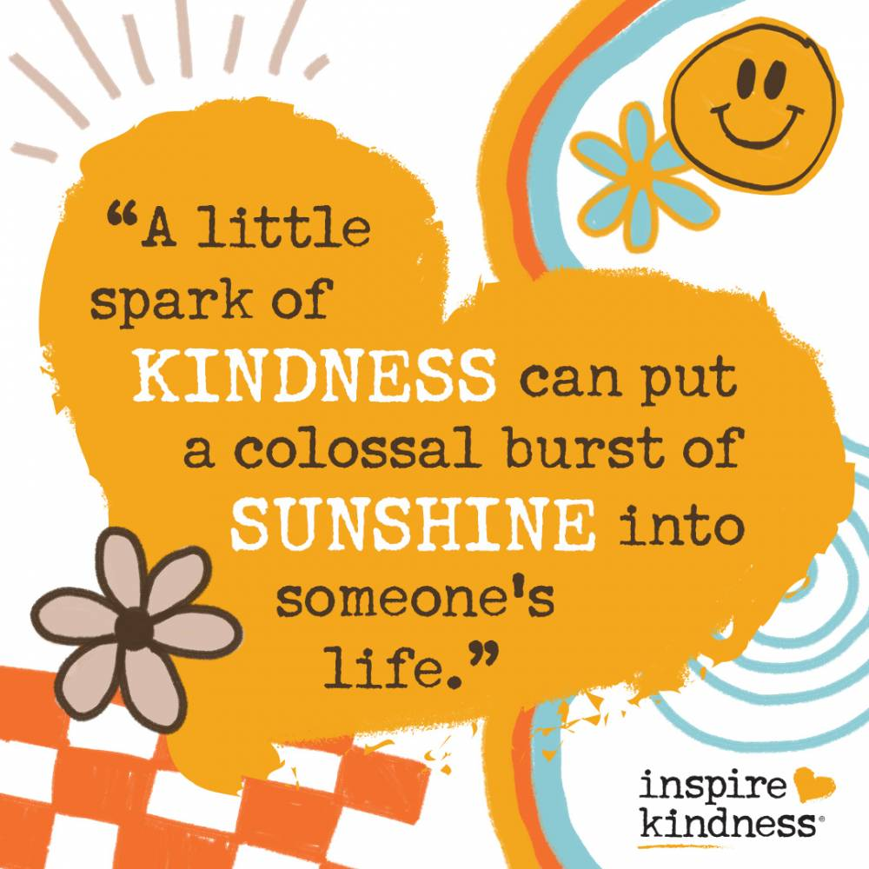
Have you done anything kind this week? How did it make you feel?
Has anyone done anything kind for you this week?
How did it make you feel?
What random acts of
kindness will you do next?

Slide 17

Being Thankful
Week 4: 22nd November

Slide 18

Story Time
Gratitude is My Superpower
by Alicia Ortego

Slide 19
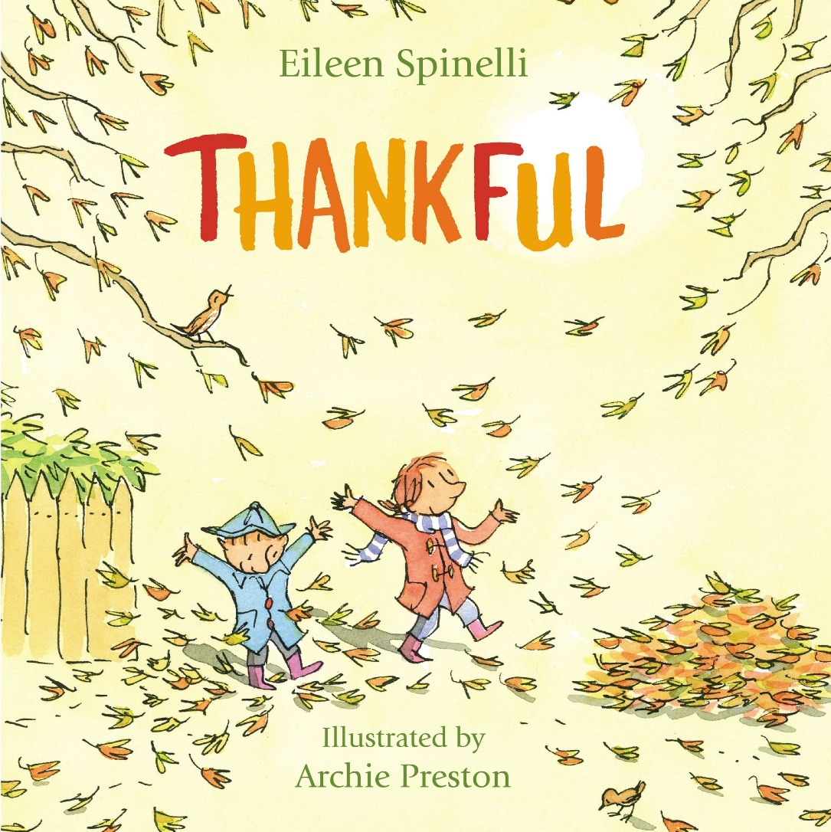
Thankful by Eileen Spinelli
Think of 10 things you are thankful for today?

Slide 20
Why is it important to say ‘thank you’?
How does it make the other person feel?
Think of three people you will say ‘thank you’ to today and think of something specific to thank them for.

Slide 21
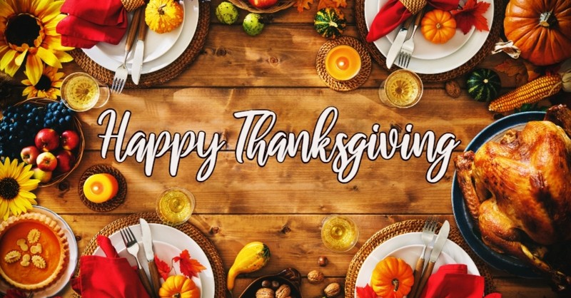
Did you say ‘thank you’ to those three people yesterday? Can you do it again today?
Today is Thanksgiving in America.
Here is a story about how families celebrate.

Slide 22
Freedom
Week 5: 29th November

Slide 23

Story Time
Henry’s Freedom Box
by Ellen Levine

Slide 24
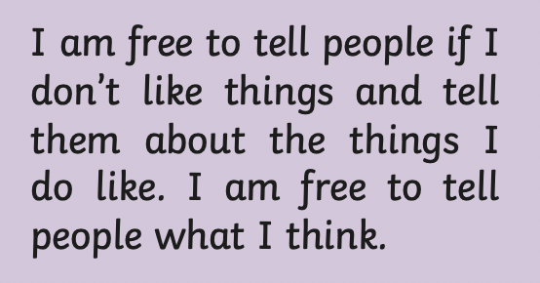
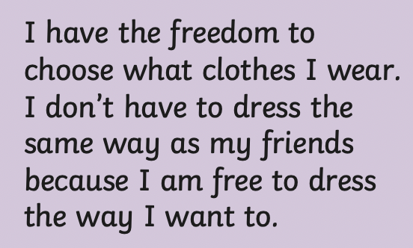
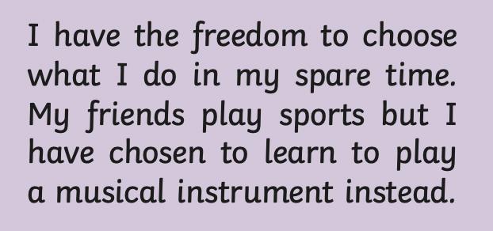
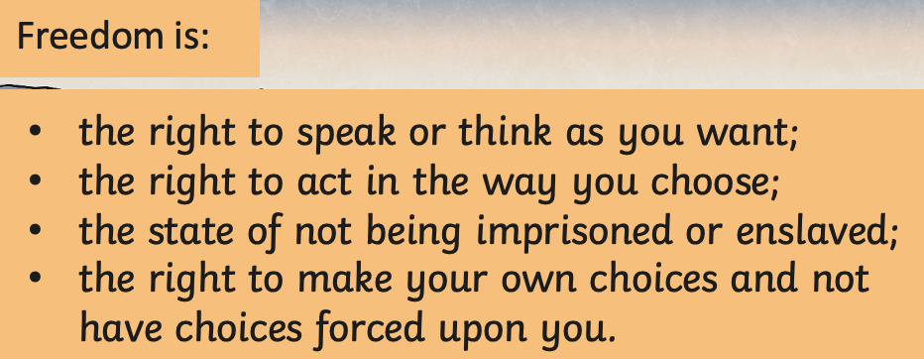
What is freedom? What does it mean to be free?
In what ways are you free?

Slide 25
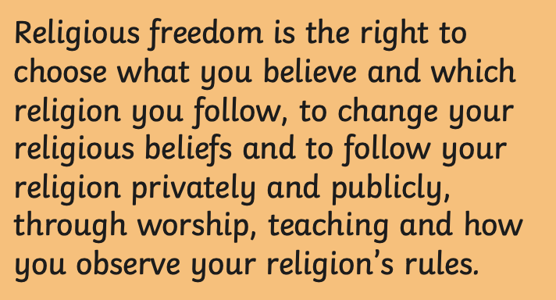
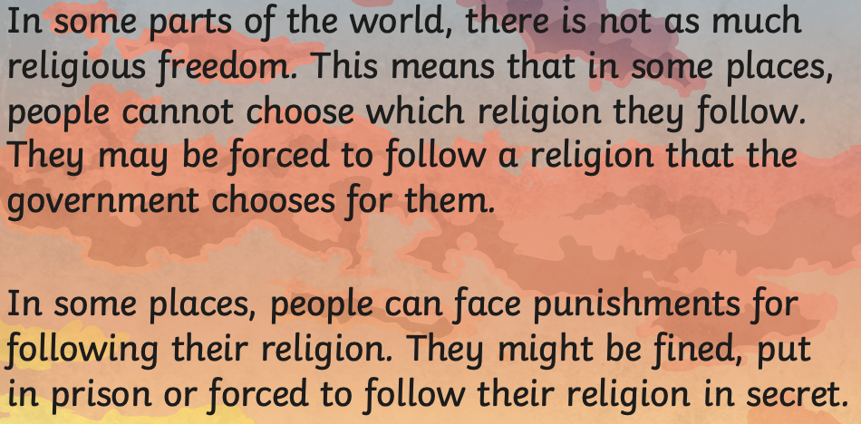
Religious Freedom
20th/21st century examples: Jews during WWII; Partition in India (Muslims vs non-Muslims); Myanmar’s Rohingya Muslims 2017, Boko Haram persecution of Christians in Nigeria.
How would it feel to have to keep your beliefs a secret?
How would it feel to have to follow a belief you didn’t choose?
How should we react to people with different beliefs to us?

Slide 26
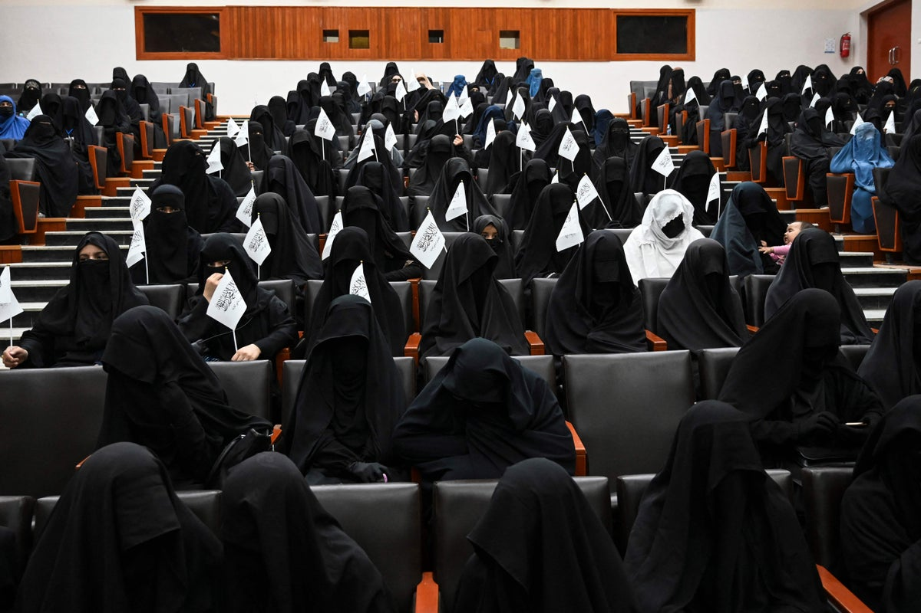
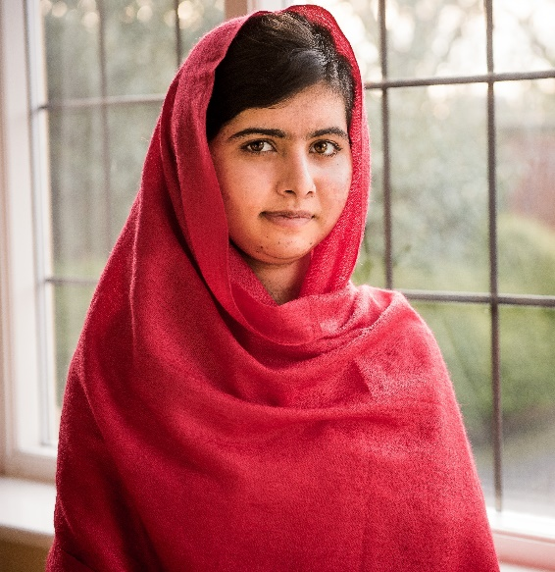
Education is a basic human right.
In Afghanistan in 1996, the Taliban stopped girls going to school.
Right now, the Taliban has taken control again and, whilst girls can go to school, they have to be educated away from boys.
Watch this video to learn all about a brave Pakistani girl called Malala Yousafzai who stood up to the Taliban about the rights of children and women.

Slide 27
Family
Week 6: 6th December

Slide 28
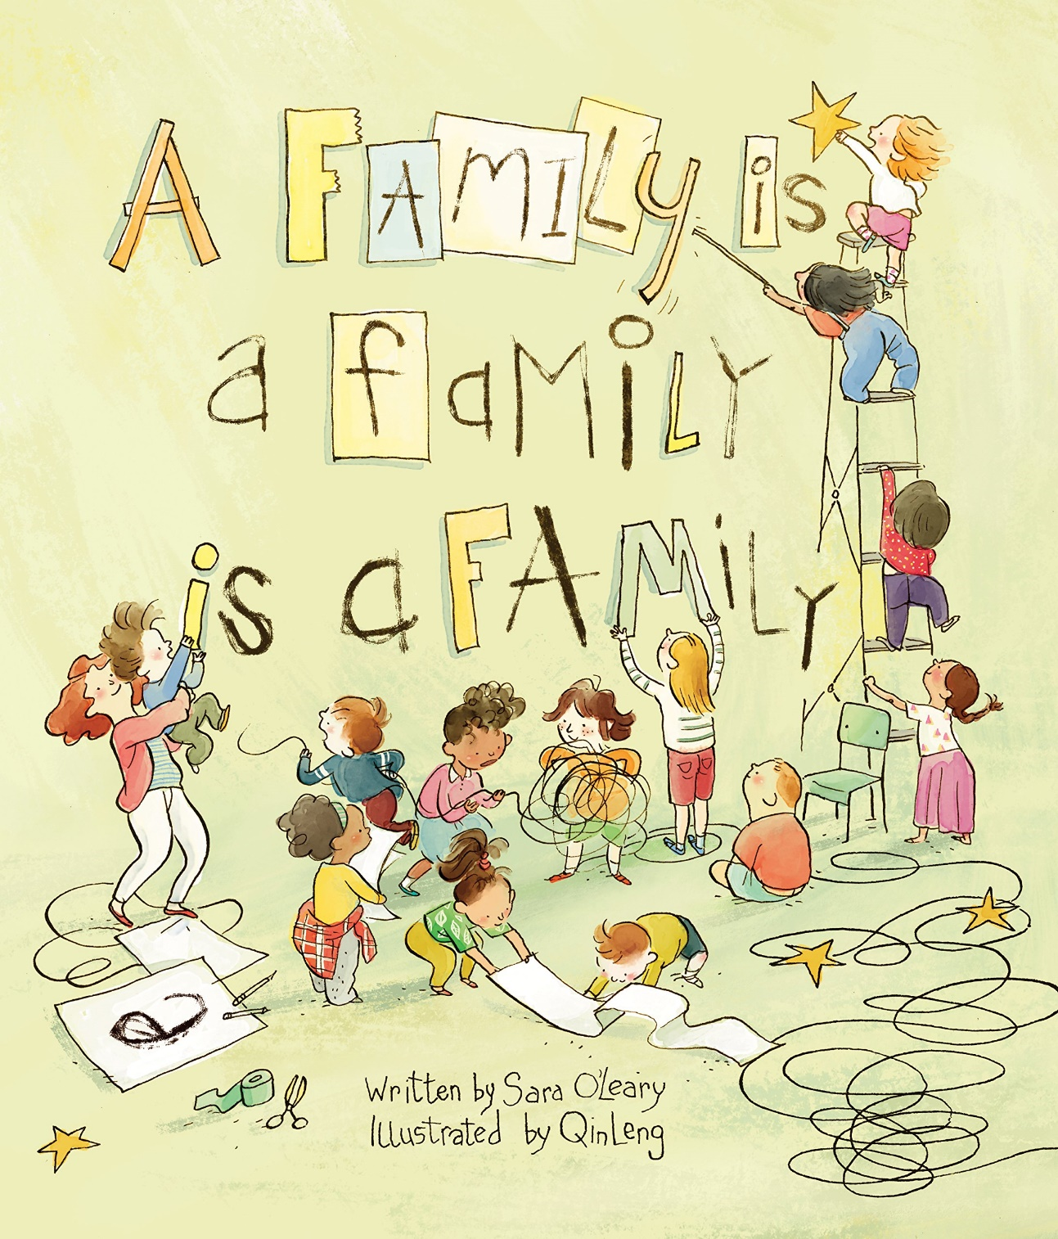
Story Time
A Family is a Family is a Family
by Sara O’Leary

Slide 29
Do all families look the same?
Who is in yours?
How did you decide?
The people who care about you?
The people you live with?
The people you love?
The people you spend your time with?
The people you’re related to?
Listen to the words of this song.

Slide 30
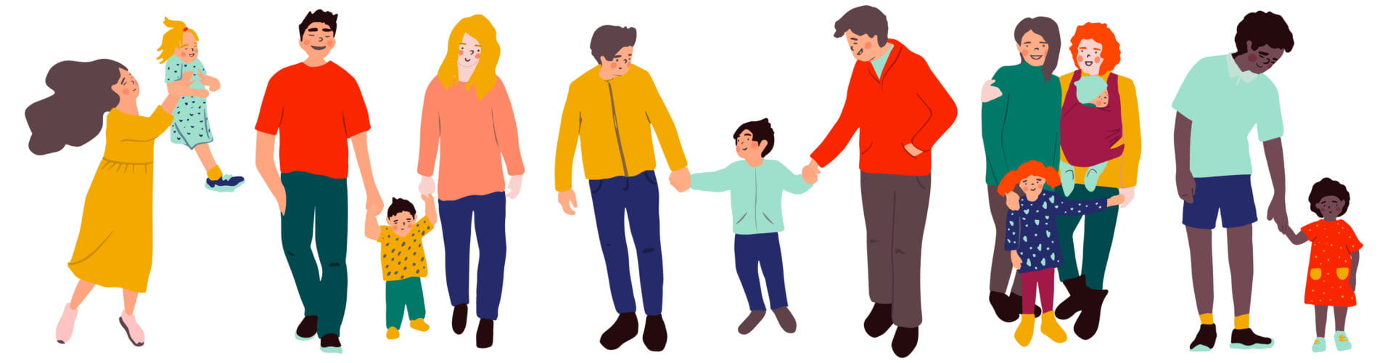
What is good about being in your family?
What do you like to do with your family?
Does everyone in your family always get along?
How can you fix it if you fall out with someone?

Slide 31
What is this DNA thread?
‘Our community’ can mean our class, our school or Derby.
Communities can be like families.
Watch this story, called Our Class is a Family.
What do we want our class family to be like?

Slide 32
Being Joyful
Week 7: 13th December

Slide 33
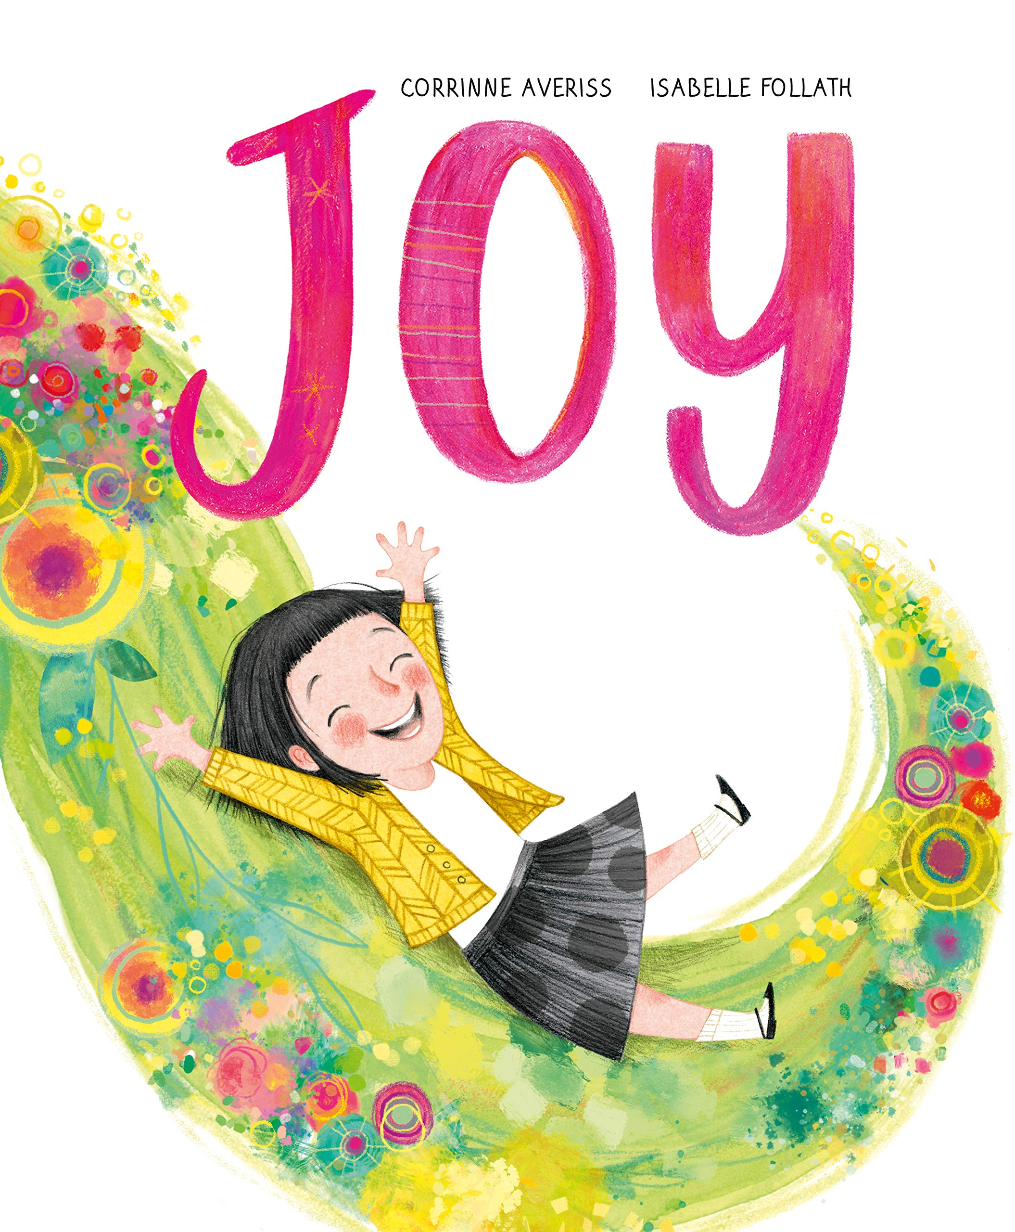
Story Time
Joy
by Corinne Averiss

Slide 34
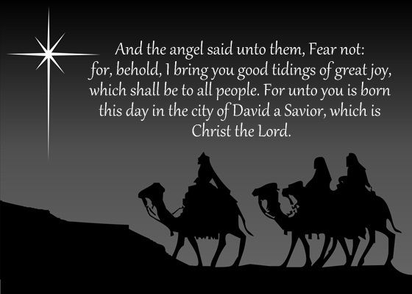
Christmas is a time of joy!
This is from the book of Luke, chapter 2, verse 10 in the Bible. Can you explain what the angel is talking about?
Why do Christians think Christmas is a time of joy?
Here is a short video of the story of Jesus’ birth.
Let’s have a Christmas sing-along to Joy to the World

Slide 35
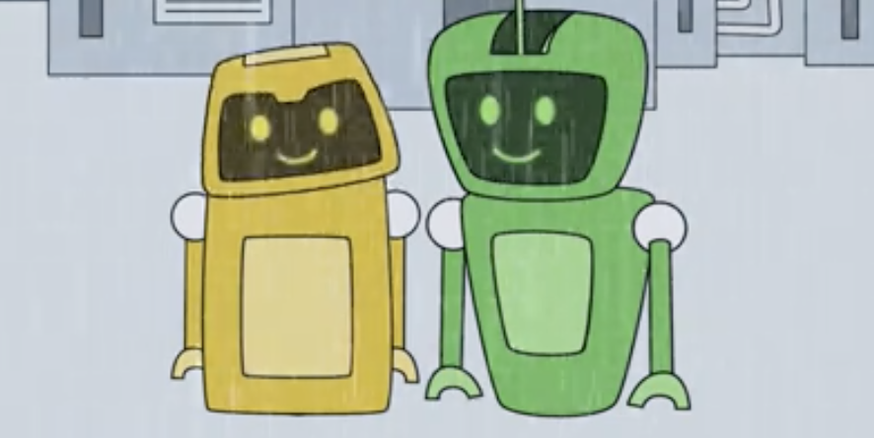
Sometimes things can make
us sad or steal our joy.
This video is all about two little robots: one chose to let the annoying/sad/bad things get on top of him and one chose to be joyful in every situation instead.
Which robot would you like to be like?

Slide 36
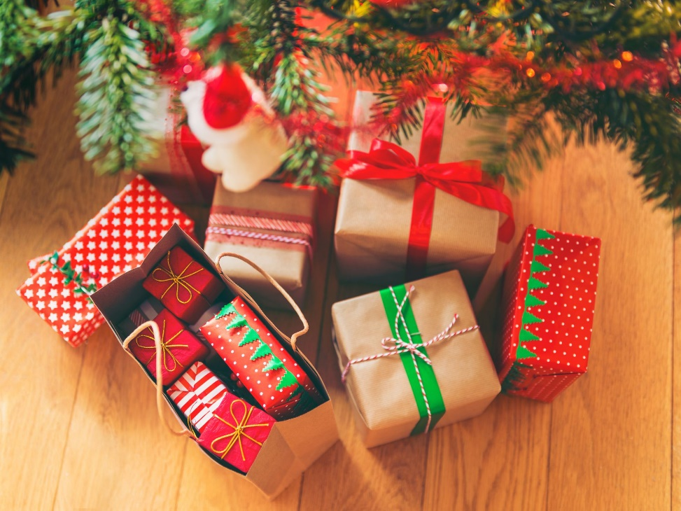
What does Christmas mean to you?
Did anyone say ‘presents’?
Getting presents is great but it can also bring you a lot of joy when you give to others.
Let’s watch this story all about why Christmas is about more than what you receive.

