Slide 1





Classroom Collective Worship
Spring 1 - 2022
your self your learning your future your community your world

Slide 2

Looking Forward
Week 1: 10th January

Slide 3

Story Time
When I Grow Up
by John Hales

Slide 4
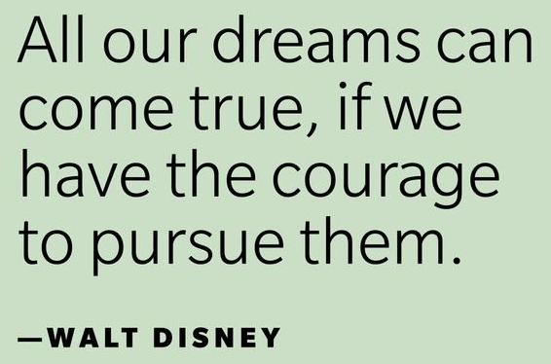
Thursday is Make Your Dreams Come True day.
What are your dreams for the future?
What would you like to be when you grow up?
What would you like your
life to be like this year,
over the next few years
and when you’re a grown
up?

Slide 5
What steps do you think you need to take to make your dreams come true?
What could you try to do before the end of this school year to help?
Is there anything you need to stop doing so that you have a better chance of achieving your dreams?

Slide 6

Think about these words from the song When I Grow Up from the musical Matilda.
Just because you find that life's not fair, it
Doesn't mean that you just have to grin and bear it.
If you always take it on the chin and wear it
Nothing will change!
Just because I find myself in this story,
It doesn't mean that everything is written for me.
If I think the ending is fixed already,
I might as well be saying
I think that it's OK!
And that's not right!
Watch the children from the show performing the song for the Queen here.

Slide 7

Challenge Injustice
Week 2: 17th January

Slide 8

Story Time
I am Martin Luther King Jr.
By Brad Meltzer
Today is Martin Luther King Jr day
Or share a KS1/2 Twinkl powerpoint

Slide 9
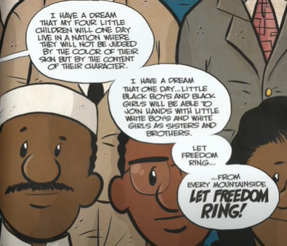
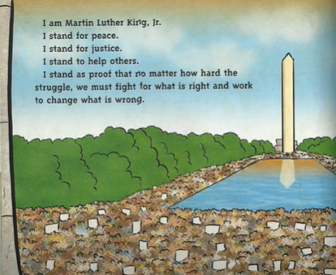
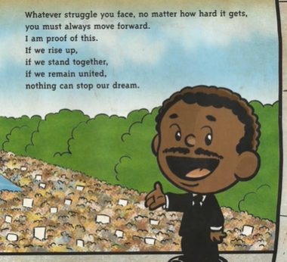
Martin Luther King Jr was someone who challenged injustice.
What injustice did he challenge?
How did he do this?
Why did he do this?
INJUSTICE is a situation where the rights of a person, or a group, are ignored. They are treated unfairly as a result.

Slide 10
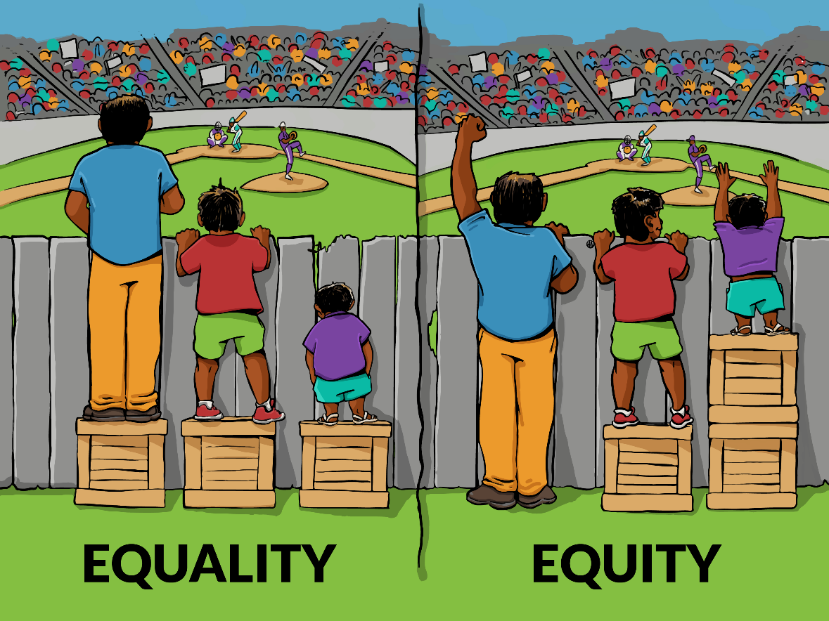
How many different types of injustice can you think of?
INJUSTICE is a situation where the rights of a person, or a group, are ignored. They are treated unfairly as a result.
Race
Religion
Gender
Age
Disability
Sexuality
Wealth
Make sure you know what these all mean

Slide 11
We’ve learnt about different kinds of injustice.
Think of some examples where someone may be treated unjustly/unfairly.
What could you do to help in these situations?

Slide 12

Back to Nature
Week 3: 24th January

Slide 13
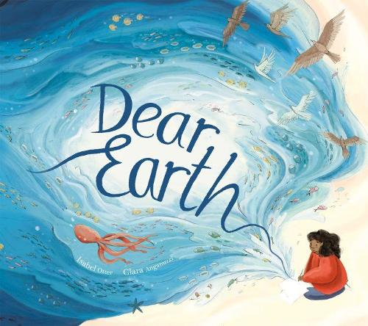
Story Time
Dear Earth
by Isabel Otter
Read by the author

Slide 14
The fresh air, the sounds of wildlife and the weather, and the closeness to trees, flowers and other plants…
Did you know that being out in nature is proven to be good for your mental health?
What mindfulness activities have you enjoyed in nature?
Take some deep breaths, relax and enjoy this video of photographs from nature.

Slide 15
Did you know that Allestree park is going to be the UK’s biggest rewilding project? It will
‘enable nature to do what it does best - lock up carbon, slow the flow of water, improve air quality and provide an amazing wild place where both people and wildlife can thrive.’
Read more here and here.
Why is this something we should be proud to have in our city? How will it benefit us?

Slide 16
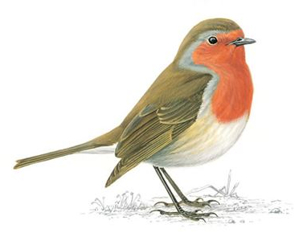
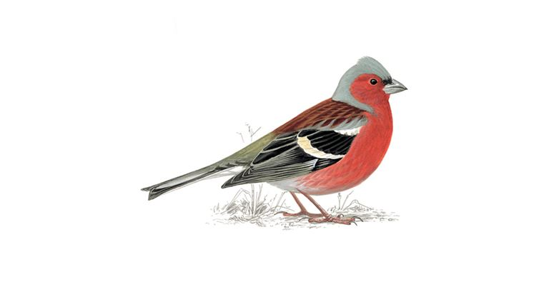
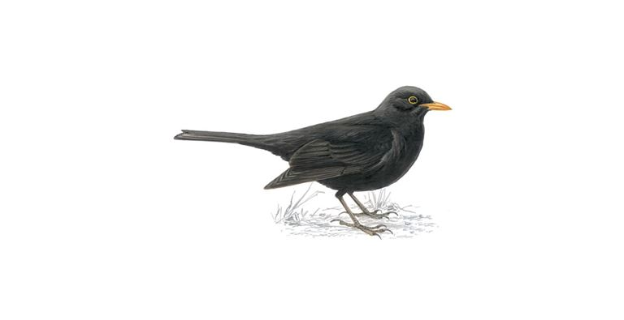
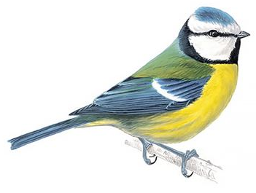
This weekend, it is the Big Garden Bird Watch. You watch your garden and record the birds you see during one hour. Doing this could be very peaceful. You could do it with your family and submit your results to the RSPB website.
Have a look at this website to identify some common garden birds and hear their calls. Maybe you can find your class bird’s song too.

Slide 17
Festivals
Week 4: 31st January

Slide 18
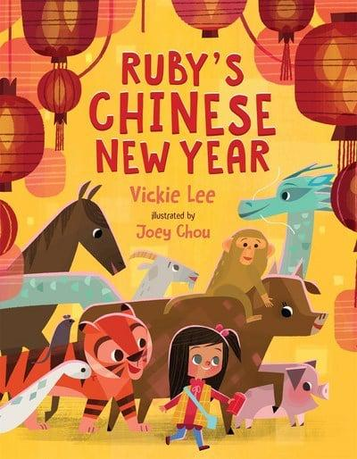
Story Time
Ruby’s Chinese New Year
by Vickie Lee

Slide 19
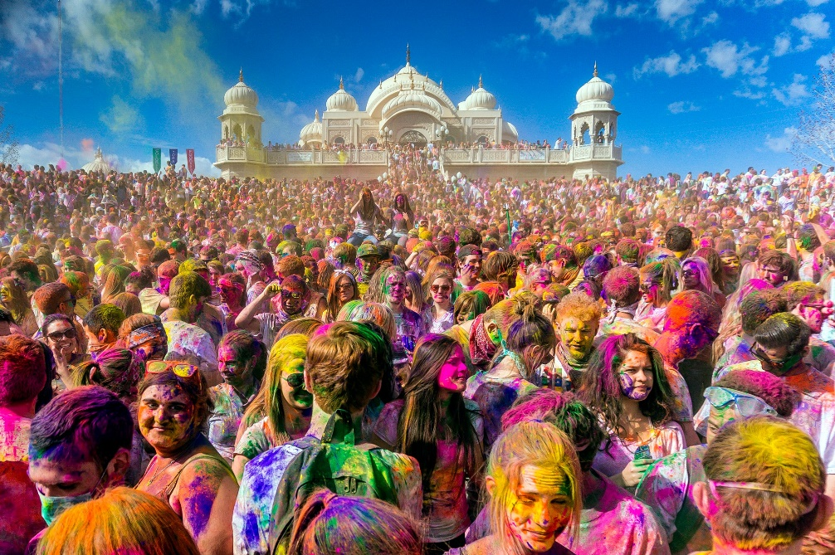
Holi is Hindu festival on 14th March. It celebrates new colours appearing, new beginnings, inclusiveness and joy over evil.
Here’s a story about Holi.

Slide 20

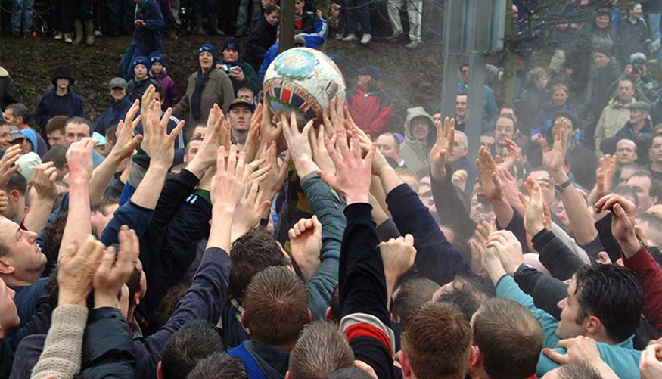
You have probably heard of Pancake Day/ Shrove Tuesday/ Mardi Gras. The day after is Ash Wednesday, the start of Lent for Catholics. Find out more here and here.

Slide 21
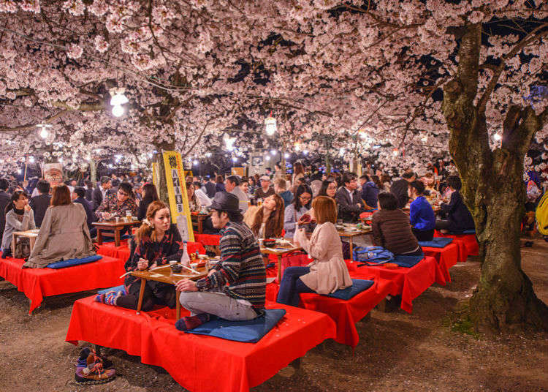
What festivals do you and your family celebrate?
Find out here about some more springtime festivals coming up over the next few months around the world.

Slide 22
Respect and Relationships
Week 5: 7th February

Slide 23
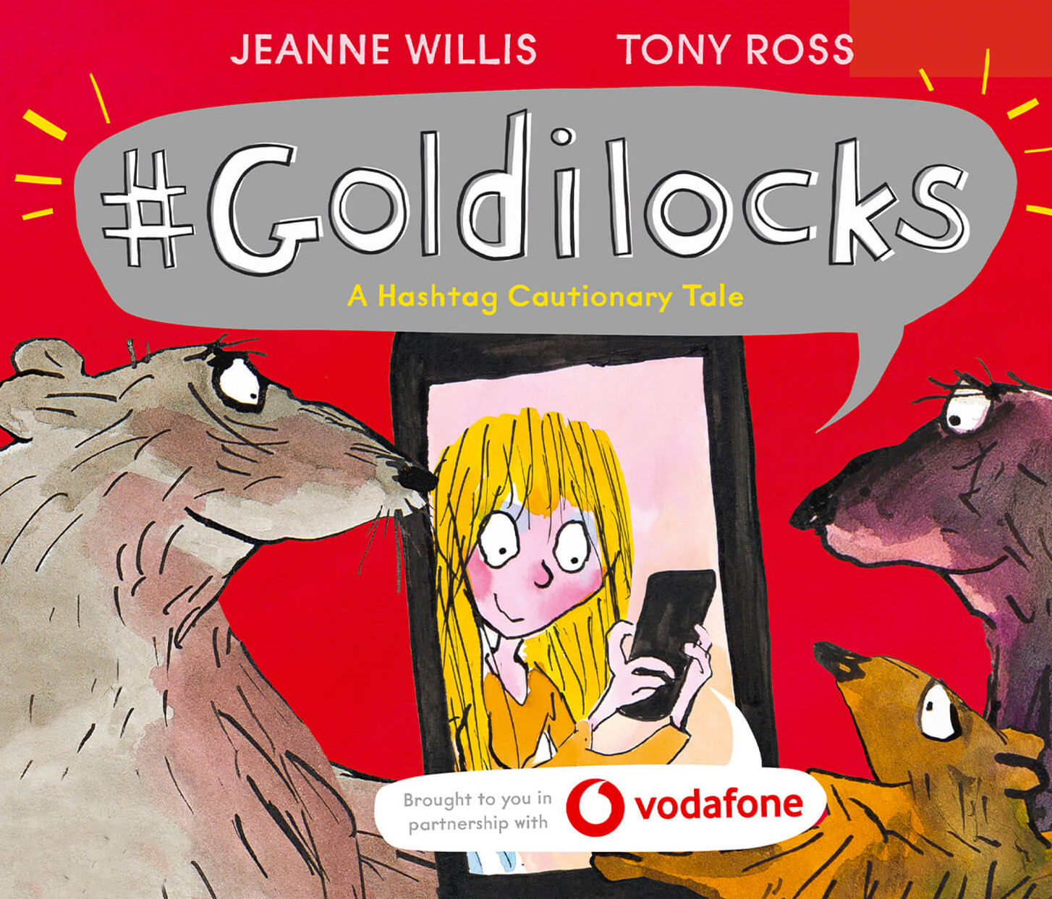
Story Time
#Goldilocks
by Jeanne Willis

Slide 24
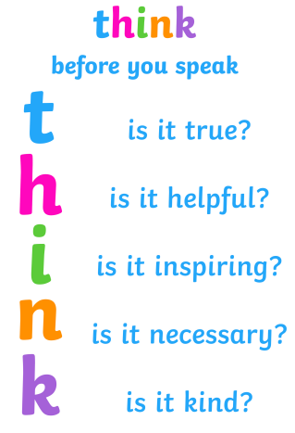
Today is Safer Internet Day. This year’s theme is:
All Fun and Games? Exploring respect and relationships online
What does this poster mean and how does it link to the things YOU do online?
type

Slide 25
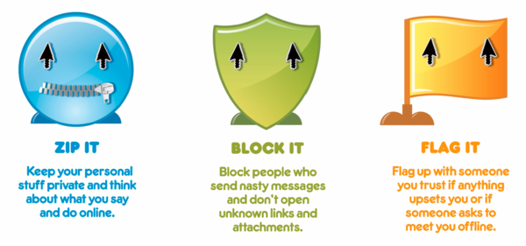
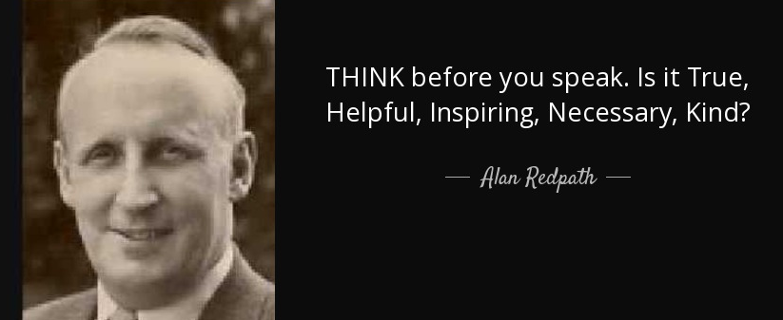
Discuss these statements
I know what to do if someone is disrespectful to me online.
Things written online can’t upset people.
Pictures and videos can’t hurt people’s feelings.
If I don’t know the person I’m talking to, it doesn’t matter what I say to them.
I can share information about myself online freely to help me make friends.

Slide 26
Who should you show respect to?
EVERYONE!
What can you do (in real life) to show respect towards others?
Adults at school
Your family
Friends
People you don’t know personally

Slide 27

Love and Compassion
Week 6: 14th February

Slide 28

Story Time – 2 short stories
Love from the Crayons
by Drew Daywalt and Oliver Jeffers
I am Love
by Susan Verde

Slide 29
In the Bible, there are 4 Greek words for different types of love.
Eros – romantic love like the love between people who get married
Storge – family love like the affectionate bond that grows between parents and children, and brothers and sisters
Philia - love for fellow humans including care, respect, and compassion for people in need
Agape – God’s divine love which is perfect, unconditional, sacrificial, and pure. Jesus demonstrated this kind of divine love in the way he lived and died. The Bible says: "For God so loved the world, that he gave his only Son, that whoever believes in him should not perish but have eternal life." (John 3:16)

Slide 30
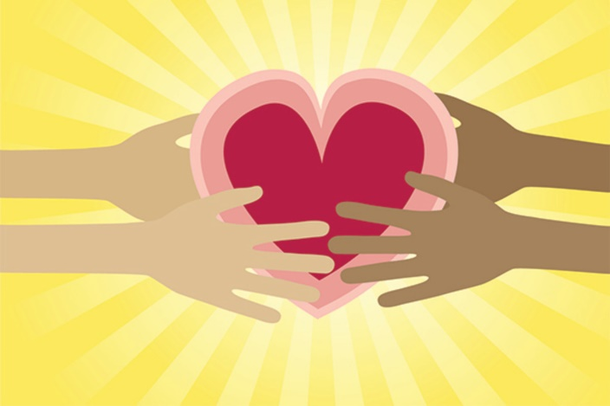
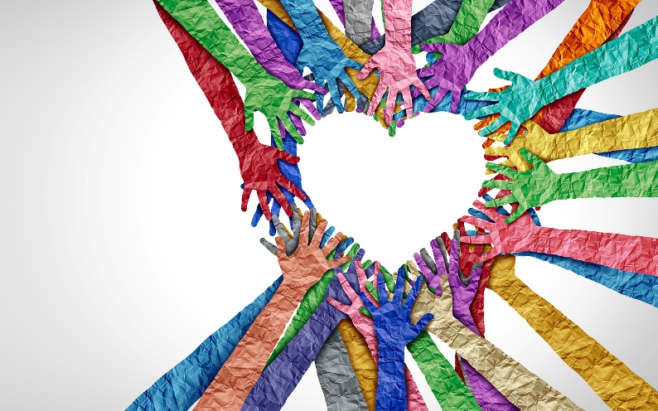
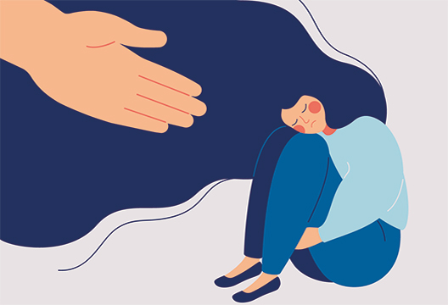
What is compassion?
Compassion is caring about someone enough to do something to help them when they are in need.
Watch this video about what compassion means to Christians and think about how you could show more compassion.

Slide 31
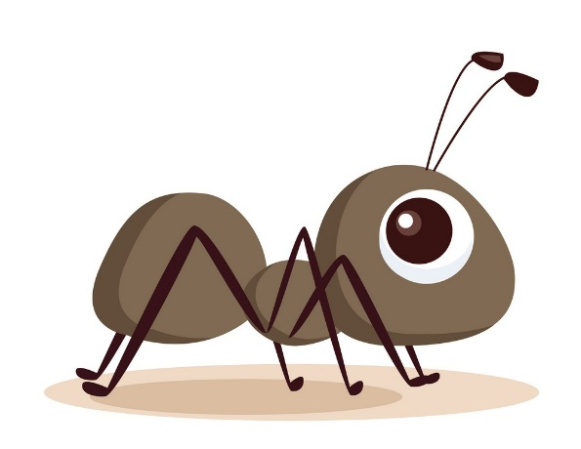
Here is a story called Hey Little Ant, all about compassion. Watch it and then discuss the question at the end.
“But you are a giant and giants can’t
Know how it feels to be an ant
Come down closer I think you’ll see
That you are very much like me.”

