Slide 1

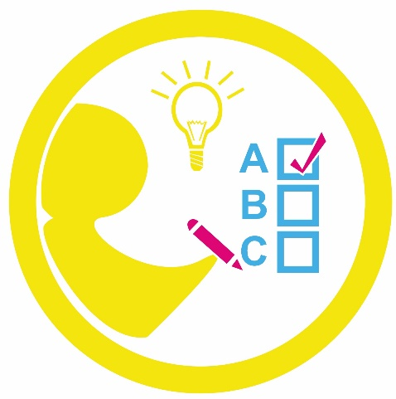



Classroom Collective Worship
Summer 1 - 2022
your self your learning your future your community your world

Slide 2
Earth Day
Week 1: 25th April

Slide 3

Last Friday was Earth Day! This week, we’re going to learn about climate change and what we can do to fight it.
Here is an introduction to what climate change is.
If you have some more time, watch this one.

Slide 4
“You’re never too small to make a difference.” Greta Thunberg
What can YOU do to help fight climate change?
Make a class list of things kids can do.
Here are some websites that might give you some ideas:
Kids National Geographic
American Museum of Natural History
Devon Live – 50 Ways

Slide 5
Yesterday we learnt lots of things we can do to help flight climate change.
One thing we can do is plant and care for trees. Last term, we planted lots of new trees at Ashgate in the KS1 field and the forest school area. We all need to work together to look after them. How can we do that?
Play this quiz all about climate change.

Slide 6

Ramadan
Week 2: 2nd May

Slide 7
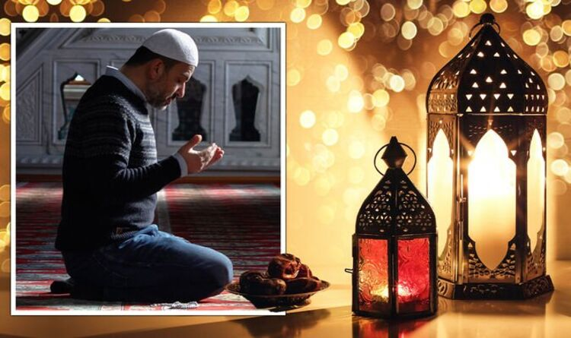
Sunday marked the end of the month of Ramadan.
Does anyone know what Ramadan is?
Who celebrates it?
What is the celebration about?
Watch this video to learn more.

Slide 8
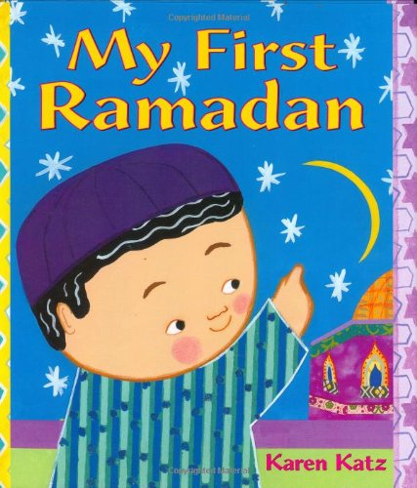
Watch this story called My First Ramadan by Karen Katz.

Slide 9
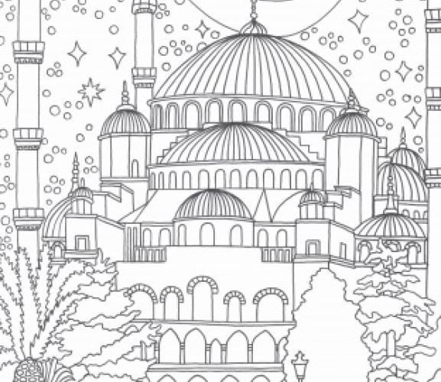
Have a go at some Ramadan mindfulness colouring today.
Link to print colouring sheets
While you colour, listen to some relaxing Islamic music.

Slide 10


Resilience
Week 3: 9th May

Slide 11
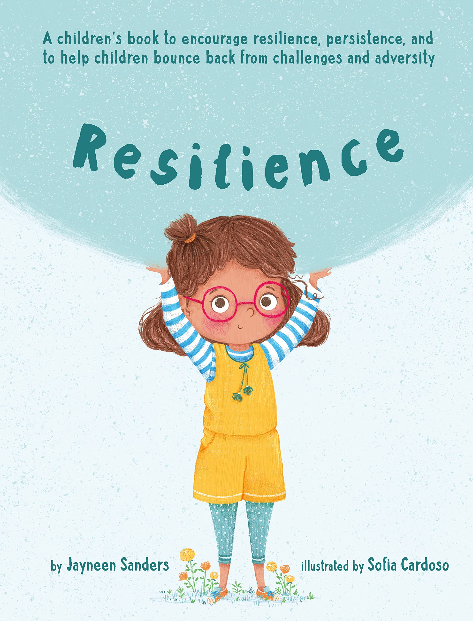
What is resilience?
This story shows lots of times you will have had to show resilience ever since you were very small.

Slide 12
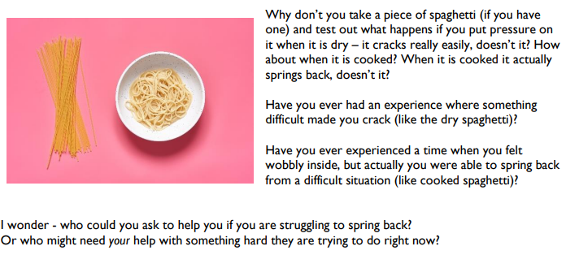

Slide 13
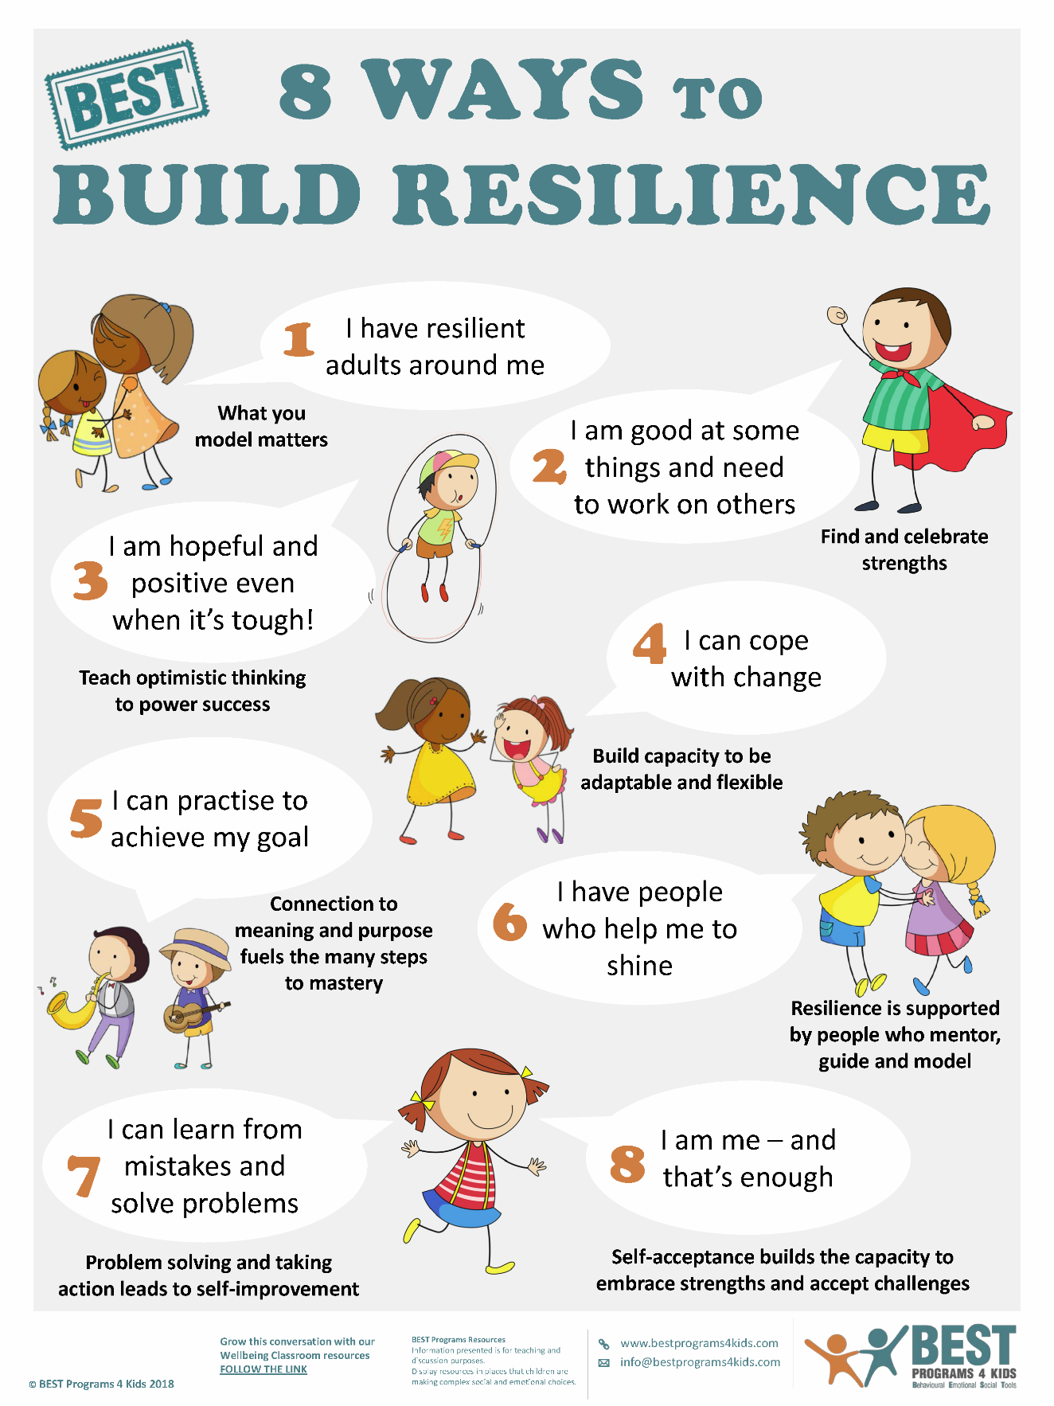
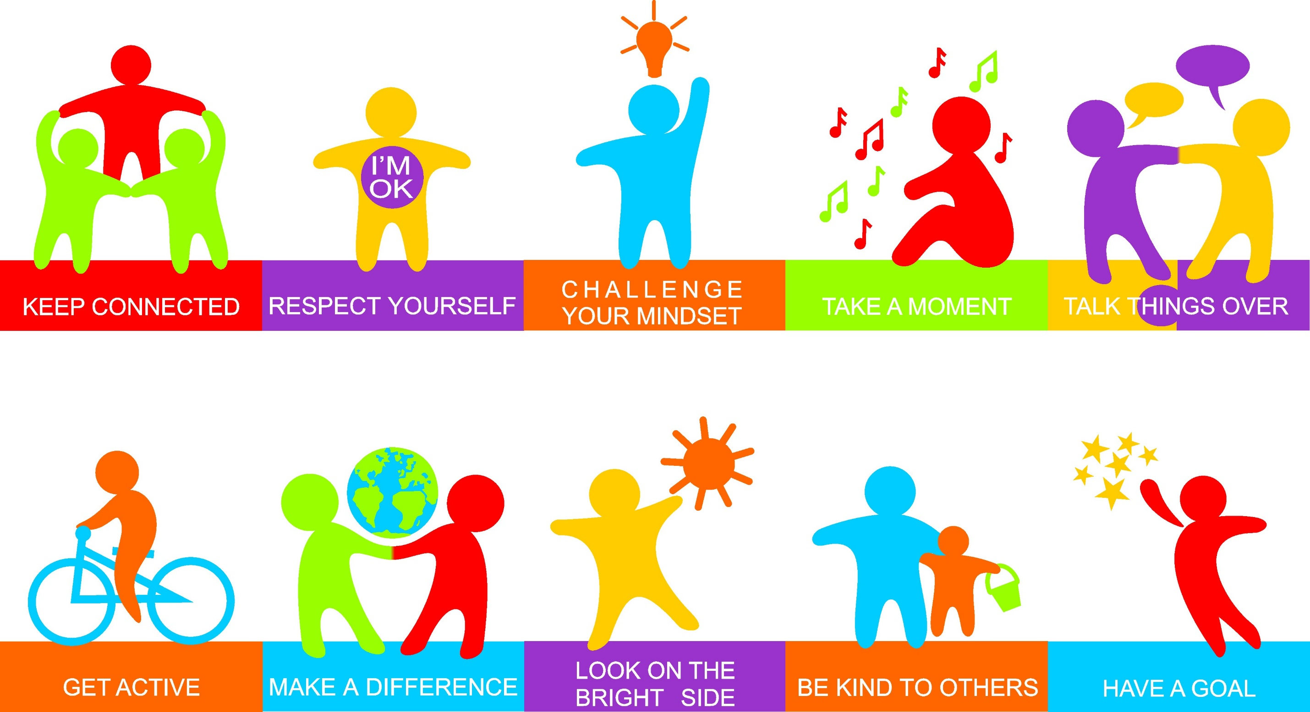
When have you had to be resilient?
When have you found it hard to be resilient?
How could you become more resilient?
Click on to see some advice.

Slide 14

Regulation
Week 4: 16th May

Slide 15
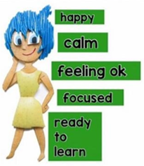
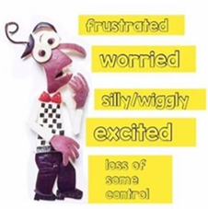
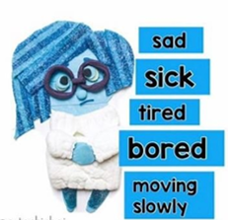
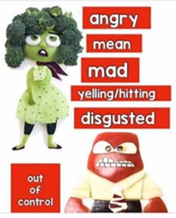
Can you remember our 4 zones of regulation and which feelings fit where?
Ready Steady
Calm Down
Thinking
Cool Off
Remember there are no BAD feelings. It’s OK to feel any feeling.
The important thing is learning how to deal with it and get ‘back to green’.

Slide 16

Regulation is very important when trying to deal with your feelings.
At school we will often have to self-regulate which means gain control of your feelings by yourself. We need to fill up a tool box with lots of tools to help us regulate our feelings.
Here are some breathing tools you may like to learn:
Rainbow relaxation
Body scan
5,4,3,2,1 method
Five finger breathing
Belly breathing
There are lots of other ‘tools’ involving drawing, writing, creating, talking, exercise, nature, distraction, playing…

Slide 17
Discuss these situations. 1. How is the person feeling? 2. What zone are they in? 3. What ‘tools’ could they use to get ‘back to green’?
1. Someone pushed in front of Billy in the line.
2. Someone on Abbie’s table is being noisy and distracting.
3. Harry is stuck on his work.
4. Jess is picked last for a team in PE.
5. Kira had an argument with her sister before school.
6. Abdul has just been kicked on purpose.
7. Ella just got a really easy question wrong in front of everyone.
8. Pav’s cat is very ill.

Slide 18


Teamwork
Week 5: 23rd May

Slide 19

Saturday is the Champions League Final so this week we’re going to be thinking about teamwork.
What ‘teams’ are you in?
sports teams musical groups your class Ashgate your family
How does it feel to be a part of a team when things are going well?
How does it feel to be a part of a team when things are going badly?

Slide 20


What makes a good team?
Did you think of any of these?
Communication
Cooperation
Compromise
Dedication
Shared goals
Patience
Clear roles
Respect for each other
Thinking about your class as a team, how could the teamwork be improved?

Slide 21
In the Bible (1 Corinthians 12), it says
For the body does not consist of one member but of many. If the foot should say, “Because I am not a hand, I do not belong to the body,” that would not make it any less a part of the body. And if the ear should say, “Because I am not an eye, I do not belong to the body,” that would not make it any less a part of the body. If the whole body were an eye, where would be the sense of hearing? If the whole body were an ear, where would be the sense of smell? But as it is, God arranged the members in the body, each one of them, as he chose. If all were a single member, where would the body be? As it is, there are many parts, yet one body.
The eye cannot say to the hand, “I have no need of you,” nor again the head to the feet, “I have no need of you.” On the contrary, the parts of the body that seem to be weaker are indispensable…But God has so composed the body, giving greater honour to the part that lacked it, that there may be no division in the body, but that the members may have the same care for one another. If one member suffers, all suffer together; if one member is honoured, ^{p}all rejoice together.
This means that all God’s people are a team in which every part is important just like every part of the body has a job to do. We are one and we are strongest when we work together.
Here’s a story about working together (start from 1 minute).

