Slide 1





Classroom Collective Worship
Summer 2 - 2022
your self your learning your future your community your world

Slide 2
The Queen
Week 1: 6th June

Slide 3
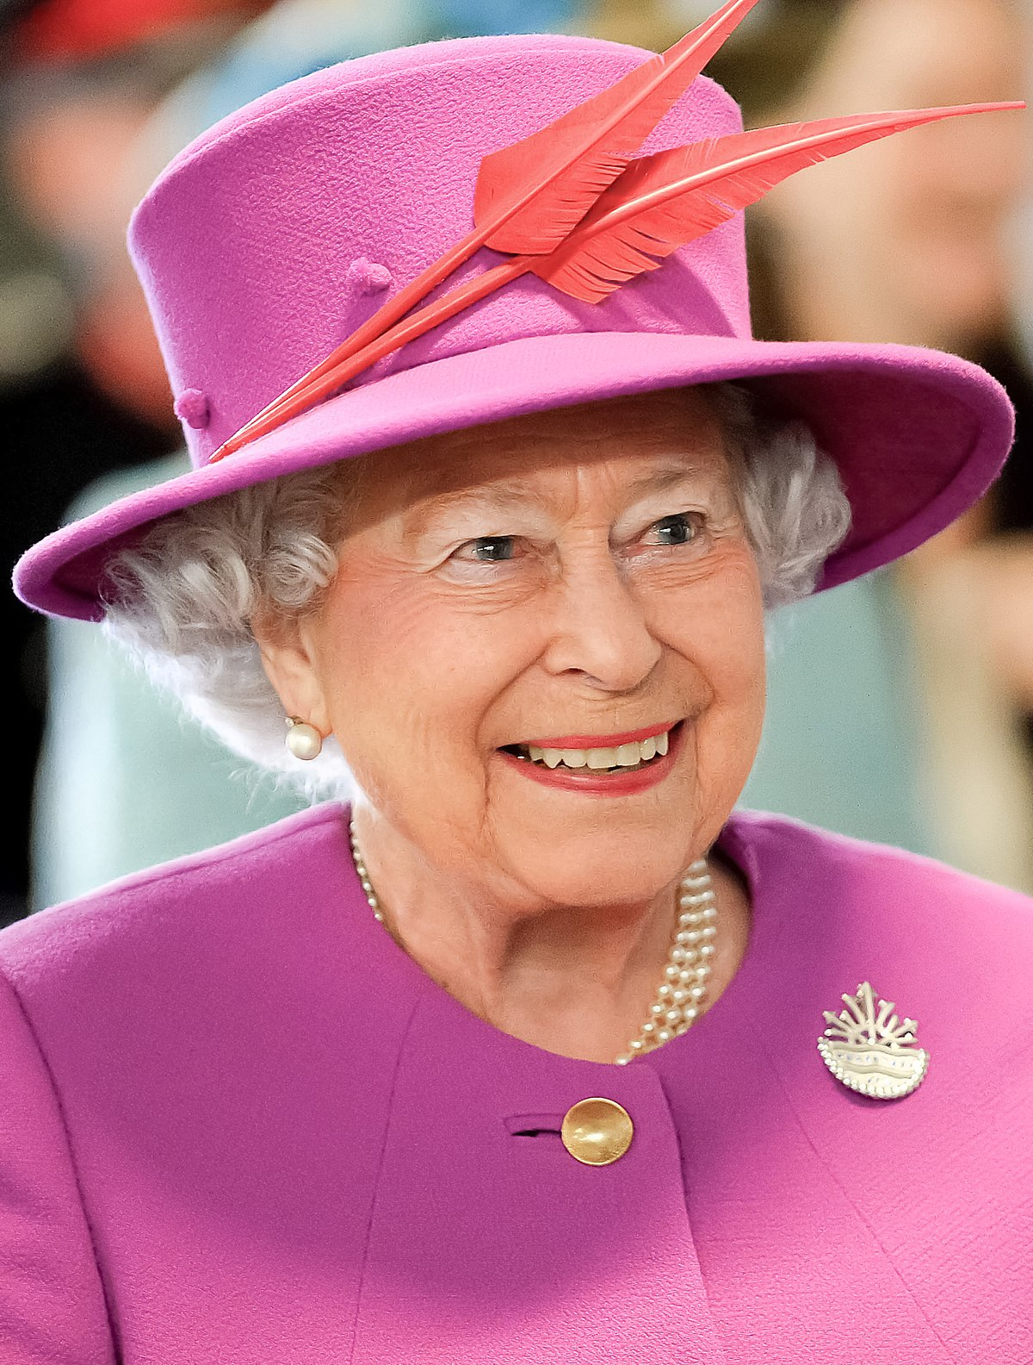
We have all celebrated the Queen’s Platinum Jubilee.
What do you know about her?
Let’s find out some fun facts about Queen Elizabeth II.
Click here.

Slide 4
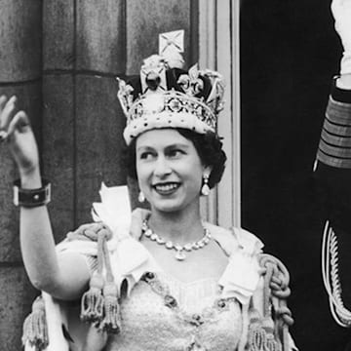
The Platinum Jubilee is celebrating 70 years since Queen Elizabeth’s coronation – when she officially became Queen.
This video shows you a bit of what that special day was like. You will also hear her talking about becoming the Queen.

Slide 5
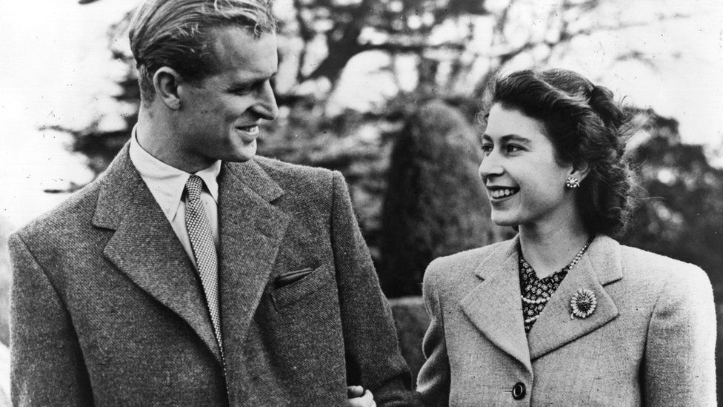
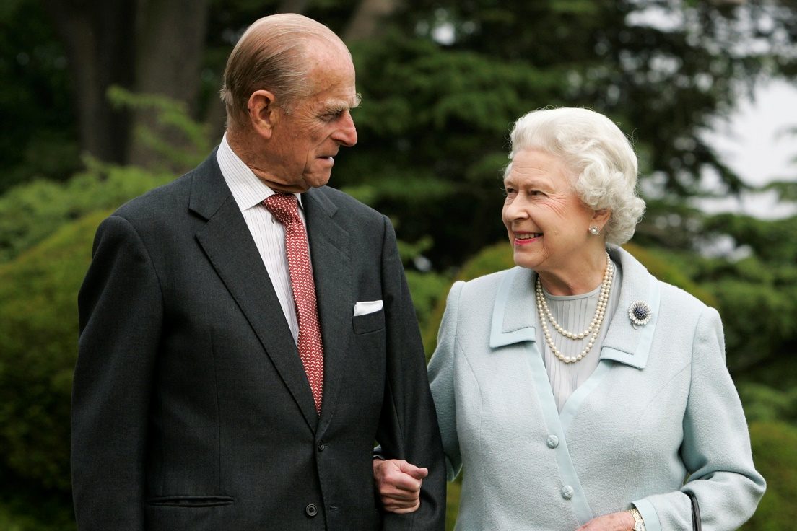
What does it really mean to be a Queen or King?
What could be the good things about it?
What might be the bad things about it?
Do you think you would like to be a Queen or King?
Queen Elizabeth and Prince Philip

Slide 6
Eating Healthily
Week 2: 13th June

Slide 7
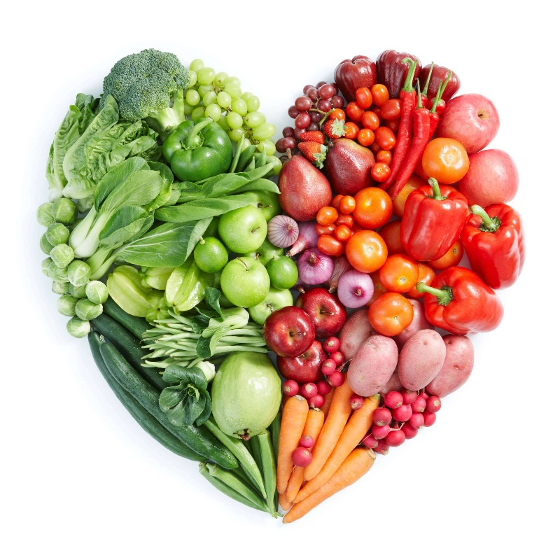
What are your 3 favourite foods?
This week is Healthy Eating week.
What healthy foods do you know?
What unhealthy foods do you know?
Watch this video to introduce the importance of a balanced diet?

Slide 8
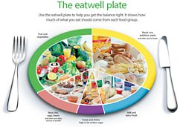
Choose a few of these videos to watch to learn more about different types of food involved in a healthy, balanced diet.
Fruit and Vegetables 3:16
Starchy Carbohydrates 2:32
Protein 2:03
Diary 1:41
Food we need to eat less often 1:47

Slide 9

The Bible tells Christians that their body is a temple where the Holy Spirit lives. The writer, Paul, means that God says people should respect and look after their bodies to keep them healthy and pure, just like we would respect and look after a real temple.
Other than healthy eating, how can we look after our bodies?

Slide 10
What is a Refugee?
Week 3: 20th June

Slide 11
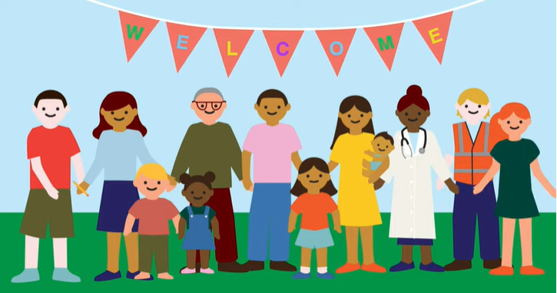
Monday was World Refugee Day.
Do you know what a refugee is?
Learn a bit about refugees by watching this video.
Recap: what do refugee children need and how can you help?

Slide 12

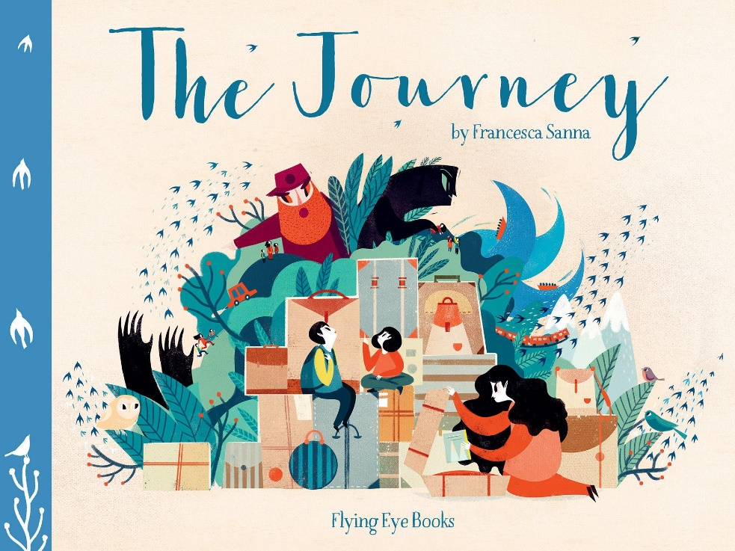
Listen to this story called My Name is Not Refugee by Kate Milner
Or this one called The Journey by Francesca Sanna (for older children)

Slide 13
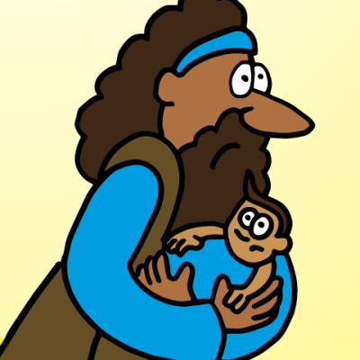
Did you know that Jesus was a refugee? Have you any idea where he had to flee from?
Listen to this story to find out.

Slide 14

Changing Your Mindset
Week 4: 27th June

Slide 15
This week we’re thinking about changing our mindset. When you try something new…
With a fixed mindset
Feel frustrated
Feel embarrassed
Fear new things
Get angry
Give up
With a growth mindset
Enjoy new things
Embrace challenges
Solve problems
Become resilient
Learn from mistakes
Watch this video about not giving up!

Slide 16
Look at these fixed mindset statements and think of a growth mindset statement you could use instead.
This is too hard
I need to practise
I can’t do this
I can’t do this yet
I give up
I’ll try a different way
She’s better than me
Everyone has different talents
I don’t know how
I can learn how
I’m afraid to make a mistake
Mistakes are how I can learn
Some brain science.

Slide 17

Have you ever struggled to learn how to do something new?
This story is about changing your mindset about failing or finding something hard. It’s all about ‘Yet’.

Slide 18

Helping Others
Week 5: 4th July

Slide 19
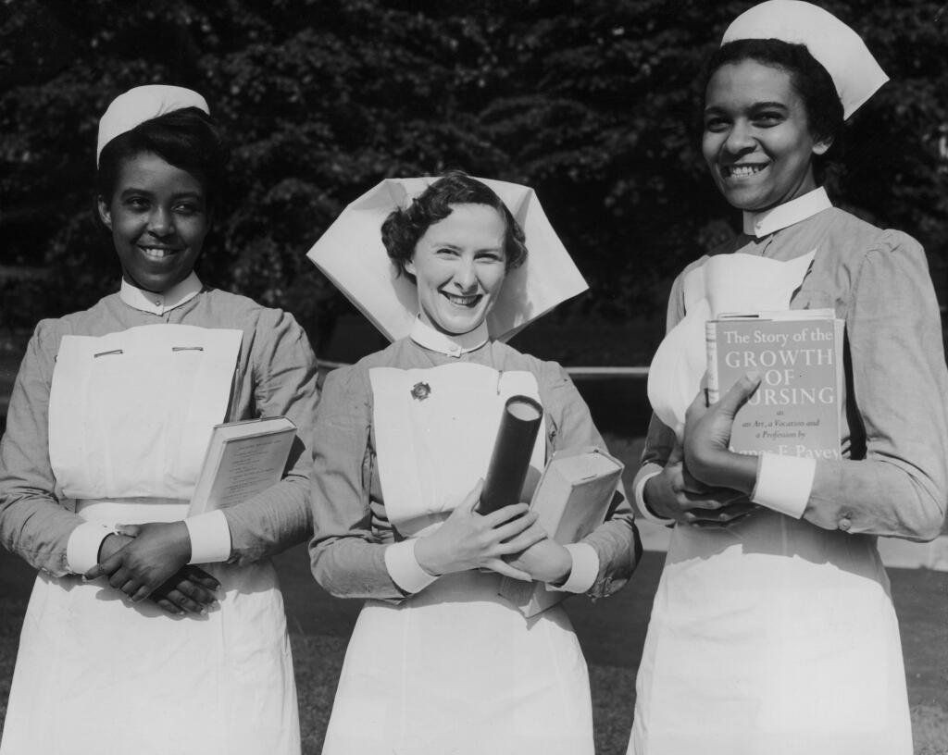
Today marks the 74th anniversary of the NHS.
What does NHS stand for? What does the NHS do for you and for others in the community?
Here is a rap all about the history of health care in Britain.

Slide 20
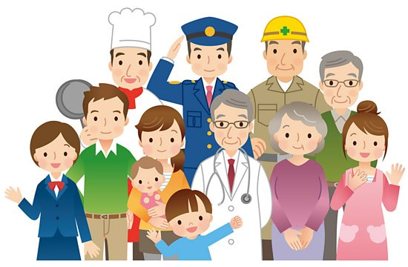
Make a class list of all the people who help you. Think about your family, your school community and the wider community.
Do you ever thank these people?
Who will you try to thank this week?

Slide 21
Think about these people and how you could help them.
Your teacher
A new child in school
Other adults in school
The midday supervisors
Your brother or sister
A new arrival in the UK
Your mum or dad
Your friend

Slide 22
Changes
Week 5: 11th July

Slide 23
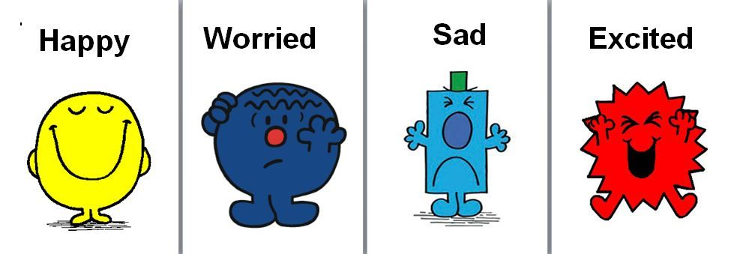
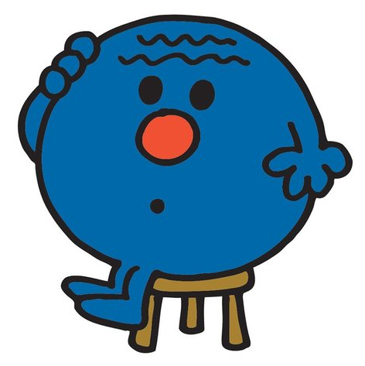
What are your favourite memories from this year?
Next year will bring some changes.
How are you feeling about next year?
What are you looking forward to?
Is anything worrying you about next year?
If you are worried, who could you talk to?

Slide 24


When you move on to a new stage in life, how do you want to be remembered?
You have a whole year to make a reputation for yourself. What sort of reputation do you think you have earned this year?
Is there anything you might do differently next year to improve your reputation?

Slide 25


A story about a boy with lots of excuses about not returning to school.
A KS2 story about the first day somewhere new.

