Slide 1
Gertie the Guinea Pig maths.
Look carefully at the questions.
Check - How many carrots does Gertie have.
How many does she eat?
Count back on the number line to see how many are left.
Write the answers in the circle.
Now try the paper questions.

Slide 2
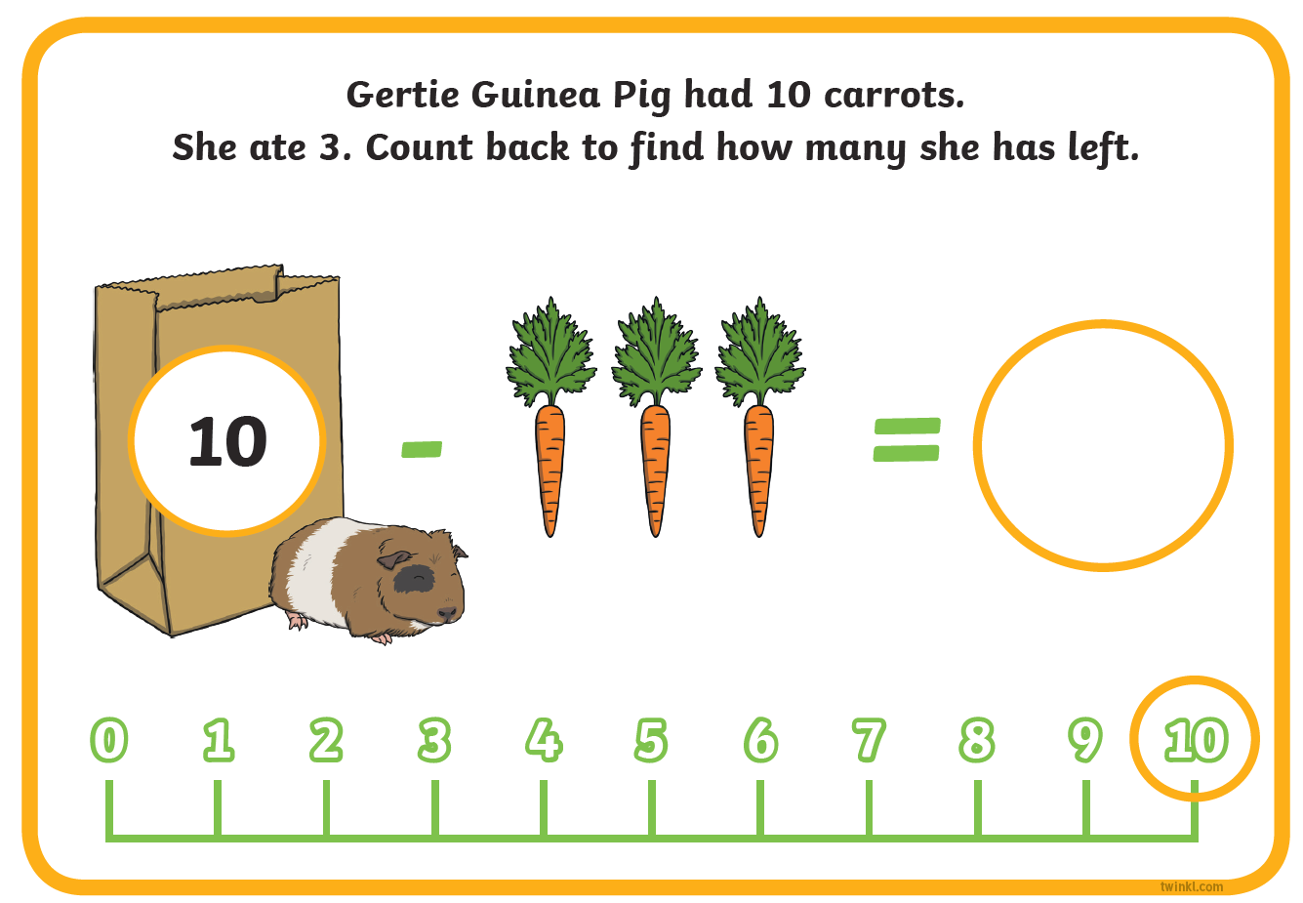

4
-1
-1
-1
-1

Slide 3
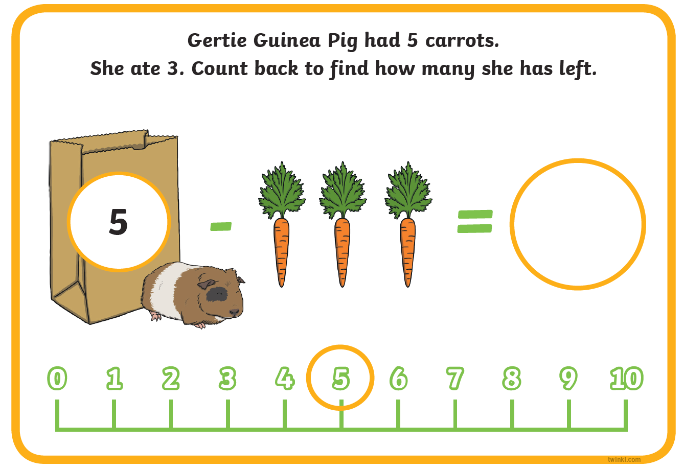
2
-1
-1

