Slide 2
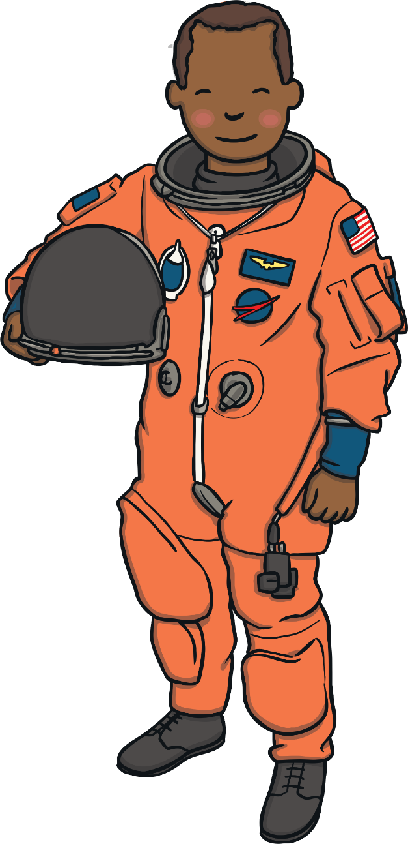

Hello children!
It is nearly time for me and my astronaut friends to take off into space.
Would you like to help us?
See if you can join in and say the numbers in the
countdown to help the rockets launch into space.

Slide 3
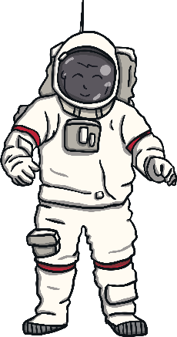



start countdown
Lift
Off!
8
7
6
5
4
3
2
1
0

Slide 4
start countdown
Lift
Off!
10
9
8
7
6
5
4
3
2
1
0

Slide 5
start countdown
Lift
Off!
₁₃
₁₂
₁₁
₁₀
₉
₈
₇
₆
₅
₄
₃
₂
₁
₀

Slide 6
start countdown
Lift
Off!
₁₅
₁₄
₁₃
₁₂
₁₁
₁₀
₉
₈
₇
₆
₅
₄
₃
₂
₁
₀

Slide 7
start countdown
Lift
Off!
₁₆
₁₅
₁₄
₁₃
₁₂
₁₁
₁₀
₉
₈
₇
₆
₅
₄
₃
₂
₁
₀

Slide 8
start countdown
Lift
Off!
₁₈
₁₇
₁₆
₁₅
₁₄
₁₃
₁₂
₁₁
₁₀
₉
₈
₇
₆
₅
₄
₃
₂
₁
₀

Slide 9
start countdown
Lift
Off!
₁₉
₁₈
₁₇
₁₆
₁₅
₁₄
₁₃
₁₂
₁₁
₁₀
₉
₈
₇
₆
₅
₄
₃
₂
₁
₀

Slide 10
start countdown
Lift
Off!
₂₀
₁₉
₁₈
₁₇
₁₆
₁₅
₁₄
₁₃
₁₂
₁₁
₁₀
₉
₈
₇
₆
₅
₄
₃
₂
₁
₀

Slide 11
Thank you
for helping me and the other astronauts with the countdown.
Super counting!

