Slide 2







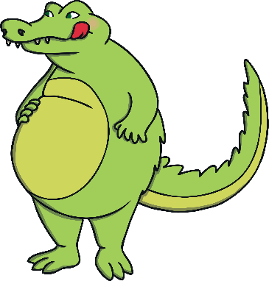


Remember It
Chomp is a greedy crocodile.
He likes to eat the greatest number.
Which plate would Chomp eat?
Plate A
Plate B

Slide 3


What Would Chomp Do?
The greater than (>), less than (<) and equals (=) symbols help us to compare numbers, like this:
3
<
1
2
=
2
1
<
3
3 is greater than 1.
2 is equal to 2.
1 is less than 3.

Slide 4





What Would Chomp Do?
Here, Chomp is saying the plate on the left is greater than the plate on the right.
Here, Chomp is saying the plate on the left is less than the plate on the right.
Remember, the crocodile’s open jaw always points towards the greater number.

Slide 5
What Would Chomp Do?
What happens if the values are the same?
?
24
=
The plates have the same value.
One is not greater than or less than the other.
They are equal.
We would say ‘is equal to’.

Slide 6
What Would Chomp Do?
Which plate would Chomp eat?
Plate A
Plate B
Can you explain your answer?

Slide 7
What Would Chomp Do?
Chomp would eat plate B.
Plate A
Plate B
5 is less than 15.

Slide 8


What Would Chomp Do?
Which plate would Chomp eat?
Plate A
Plate B
Can you explain your answer?

Slide 9

What Would Chomp Do?
Chomp would eat plate A.
Plate A
Plate B
44 is greater than 39.

Slide 10
What Would Chomp Do?
Which plate would Chomp eat?
49
59
Plate A
Plate B
Prove it.

Slide 11

What Would Chomp Do?
Chomp would eat plate B.
49
59
Plate A
Plate B
49 is less than 59.

Slide 12
What Would Chomp Do?
Which plate would Chomp eat?
64
sixty-four
Plate A
Plate B
How do you know?

Slide 13
What Would Chomp Do?
Chomp would not choose one over the other.
=
64
sixty-four
Plate A
Plate B
Sixty-four is equal to 64.

Slide 14


Comparing Numbers
=
greater than
less than
equal to
Can you use <, > or = to compare numbers?

Slide 15

Comparing Numbers
Can you use <, > or = to compare numbers?
44 25
>
?

Slide 16
Comparing Numbers
Can you use <, > or = to compare numbers?
41 65
<
?

Slide 17
Comparing Numbers
Can you use <, > or = to compare numbers?
39 39
=
?

Slide 18
Comparing Numbers
Can you use <, > or = to compare numbers?
81 78
>
?

Slide 19
Comparing Numbers
Can you use <, > or = to compare numbers?
99 100
<
?

Slide 20
Comparing Numbers
Can you use <, > or = to compare numbers?
80 80
=
?

Slide 21
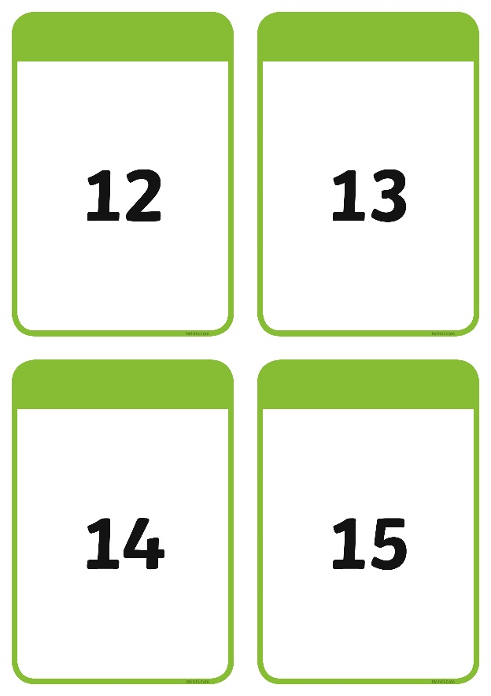
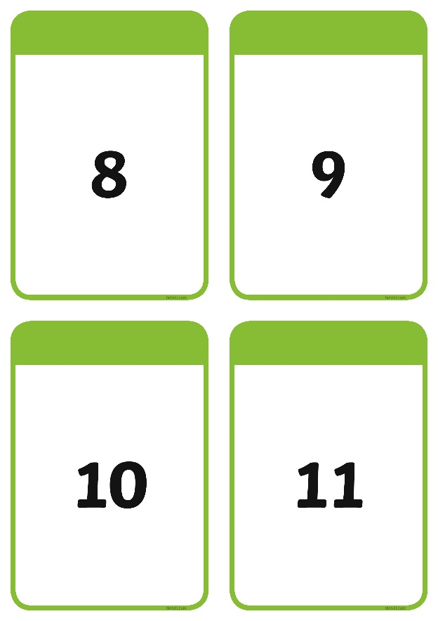
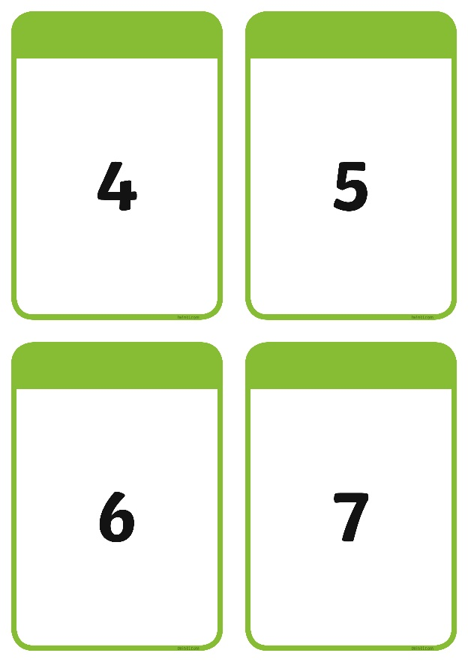
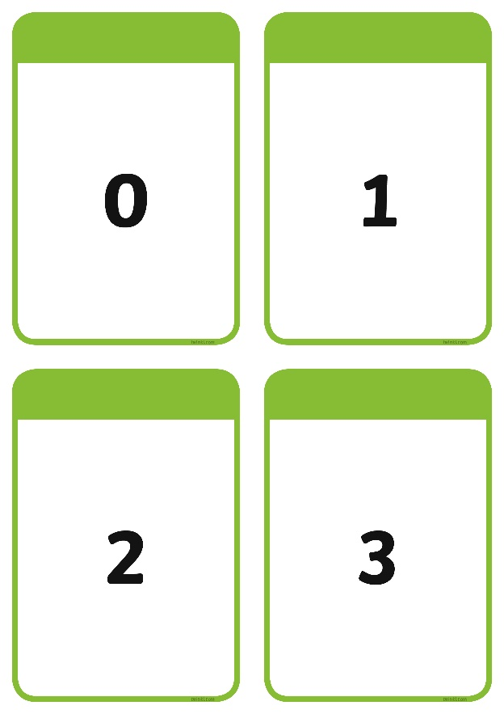

Comparing Cards
OPTIONAL ACTIVITY: Pick two number cards, then choose the correct
symbol to compare them.

