Slide 2

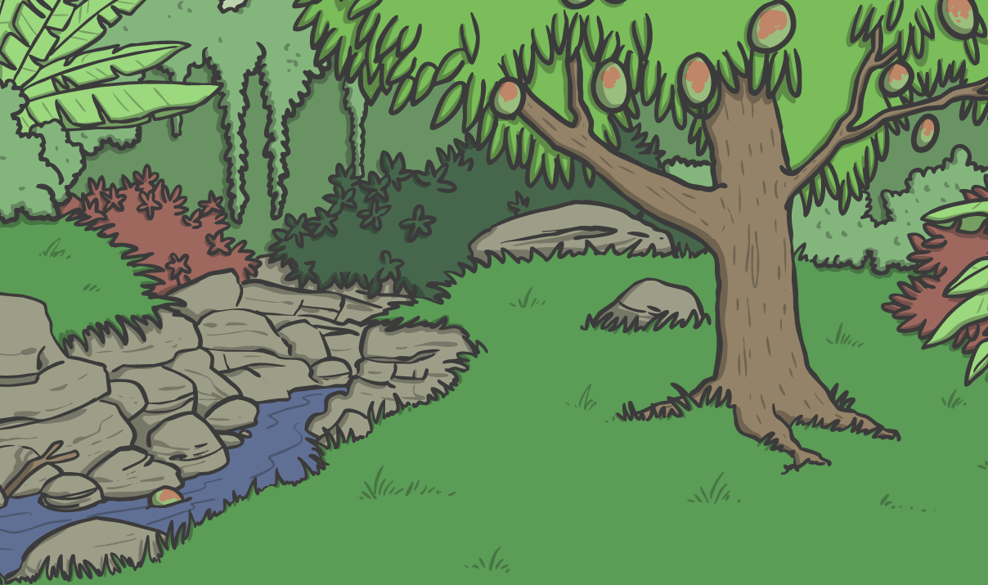
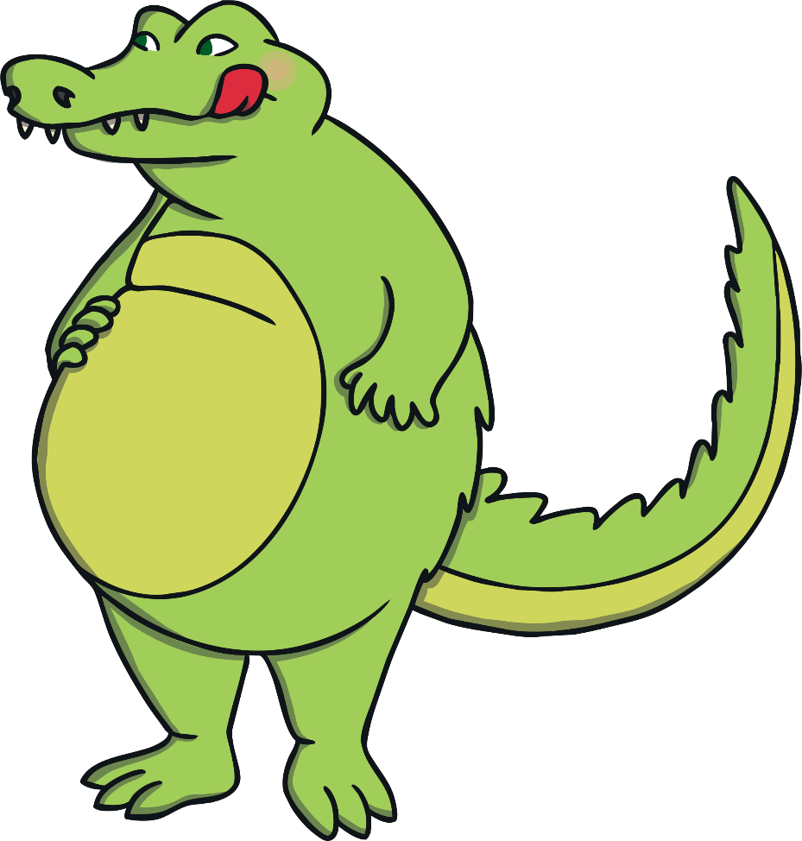
Chomp the Greedy Crocodile
I am a greedy crocodile. I like to eat as much as I can!
Hello, I’m Chomp.

Slide 3



Chomp the Greedy Crocodile
Which plate would I eat?
Why?

Slide 4




Chomp the Greedy Crocodile
Let’s check our answer.
15 is greater than 6.
Here are 15 beans.
Here are 6 beans.
5
6
7
8
9
10
11
12
13
14
15
16
Here is 6.
Here is 15.

Slide 5


Chomp the Greedy Crocodile
Which plate would I eat?
Why?

Slide 6



Chomp the Greedy Crocodile
31 is greater than 24.
Let’s check our answer.
Here is 24.
Here is 31.
1
2
3
4
5
6
7
8
9
10
11
12
13
14
15
16
17
18
19
20
Here is 24.
21
22
23
24
25
26
27
28
29
30
Here is 31.
31
32
33
34
35
36
37
38
39
40

Slide 7
Chomp the Greedy Crocodile
61
49
Which plate would I eat?
Why?

Slide 8
Chomp the Greedy Crocodile
61 is greater than 49.
Let’s check our answer.
61
49
Here is 61.
Here is 49.
41
42
43
44
45
46
47
48
49
50
Here is 49.
51
52
53
54
55
56
57
58
59
60
Here is 61.
61
62
63
64
65
66
67
68
69
70

Slide 9


Chomp the Greedy Crocodile
Observe how the different values sit within the different signs.
1
<
3
2
=
2
3
>
1
1 is less than 3.
2 is equal to 2.
3 is greater than 1.

Slide 10


Chomp the Greedy Crocodile
Look at the signs that Chomp makes with his jaw.
less than
greater than

Slide 11



Chomp the Greedy Crocodile
Chomp is a greedy crocodile and will always eat the greater number.
Here, Chomp eats the plate on the left because it shows a greater number.
Here, Chomp eats the plate on the right because it shows a greater number.

Slide 12
Chomp the Greedy Crocodile
Here, Chomp is saying the plate on the left is greater than the plate on the right.
Here, Chomp is saying the plate on the left is less than the plate on the right.
Remember, the crocodile’s open jaw always points towards the greater number.

Slide 13

Chomp the Greedy Crocodile
What happens if the plates have the same value?
?
24
=
The numbers on these plates look different, but they have
the same value. This means that they are equal.
Chomp wouldn’t choose one over the other, so the
symbols < and > cannot be used.
Instead we would use = to show that the two numbers are equal.

