Slide 1
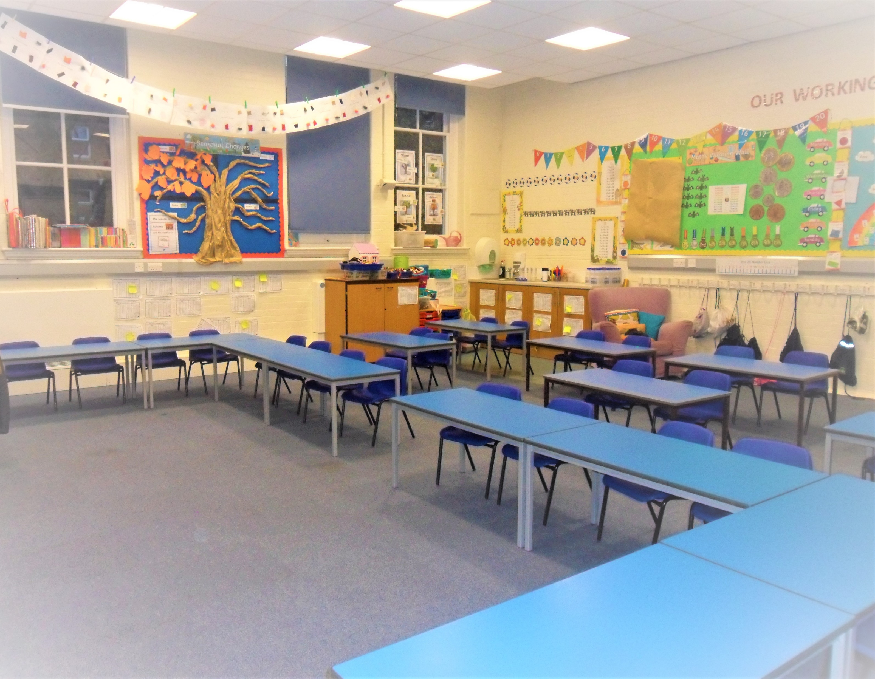
A KS1 Classroom

Slide 2
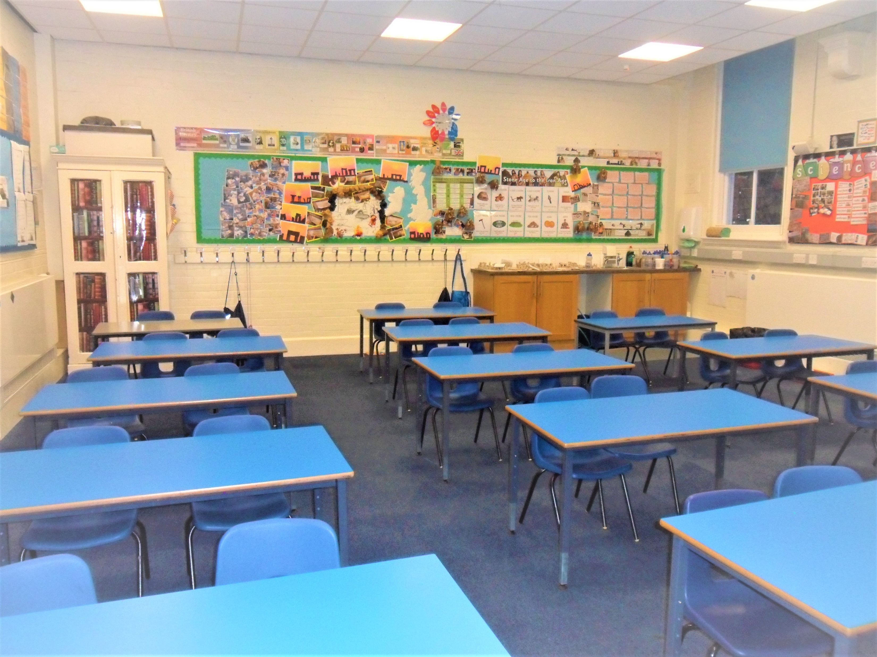
A KS2 Classroom

Slide 3
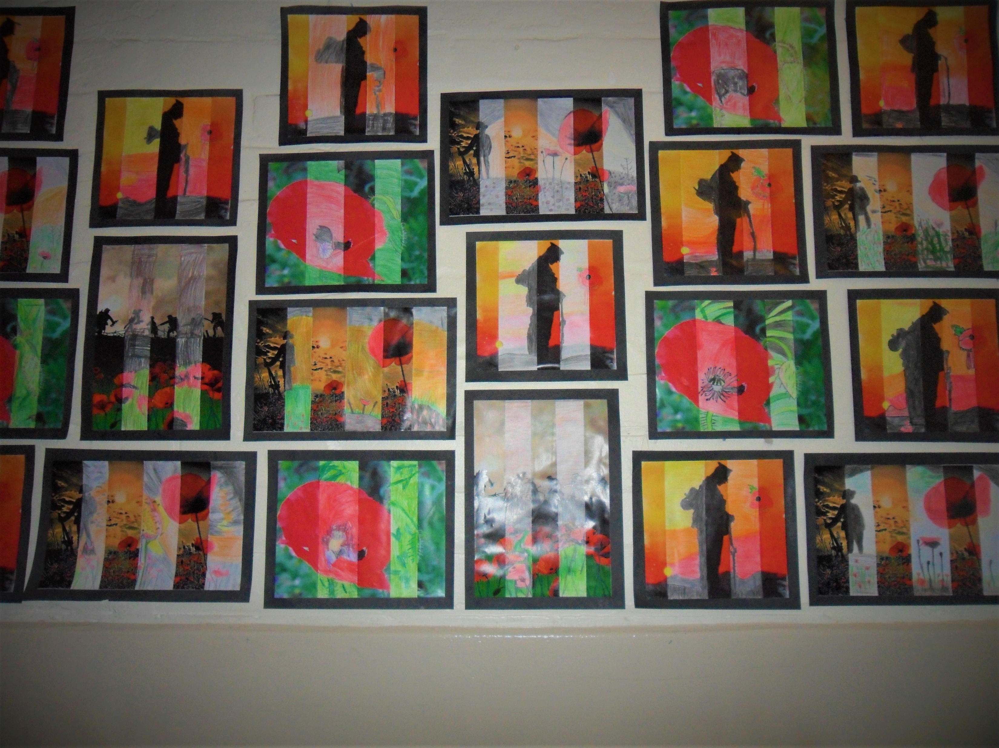
One of our super displays

Slide 4
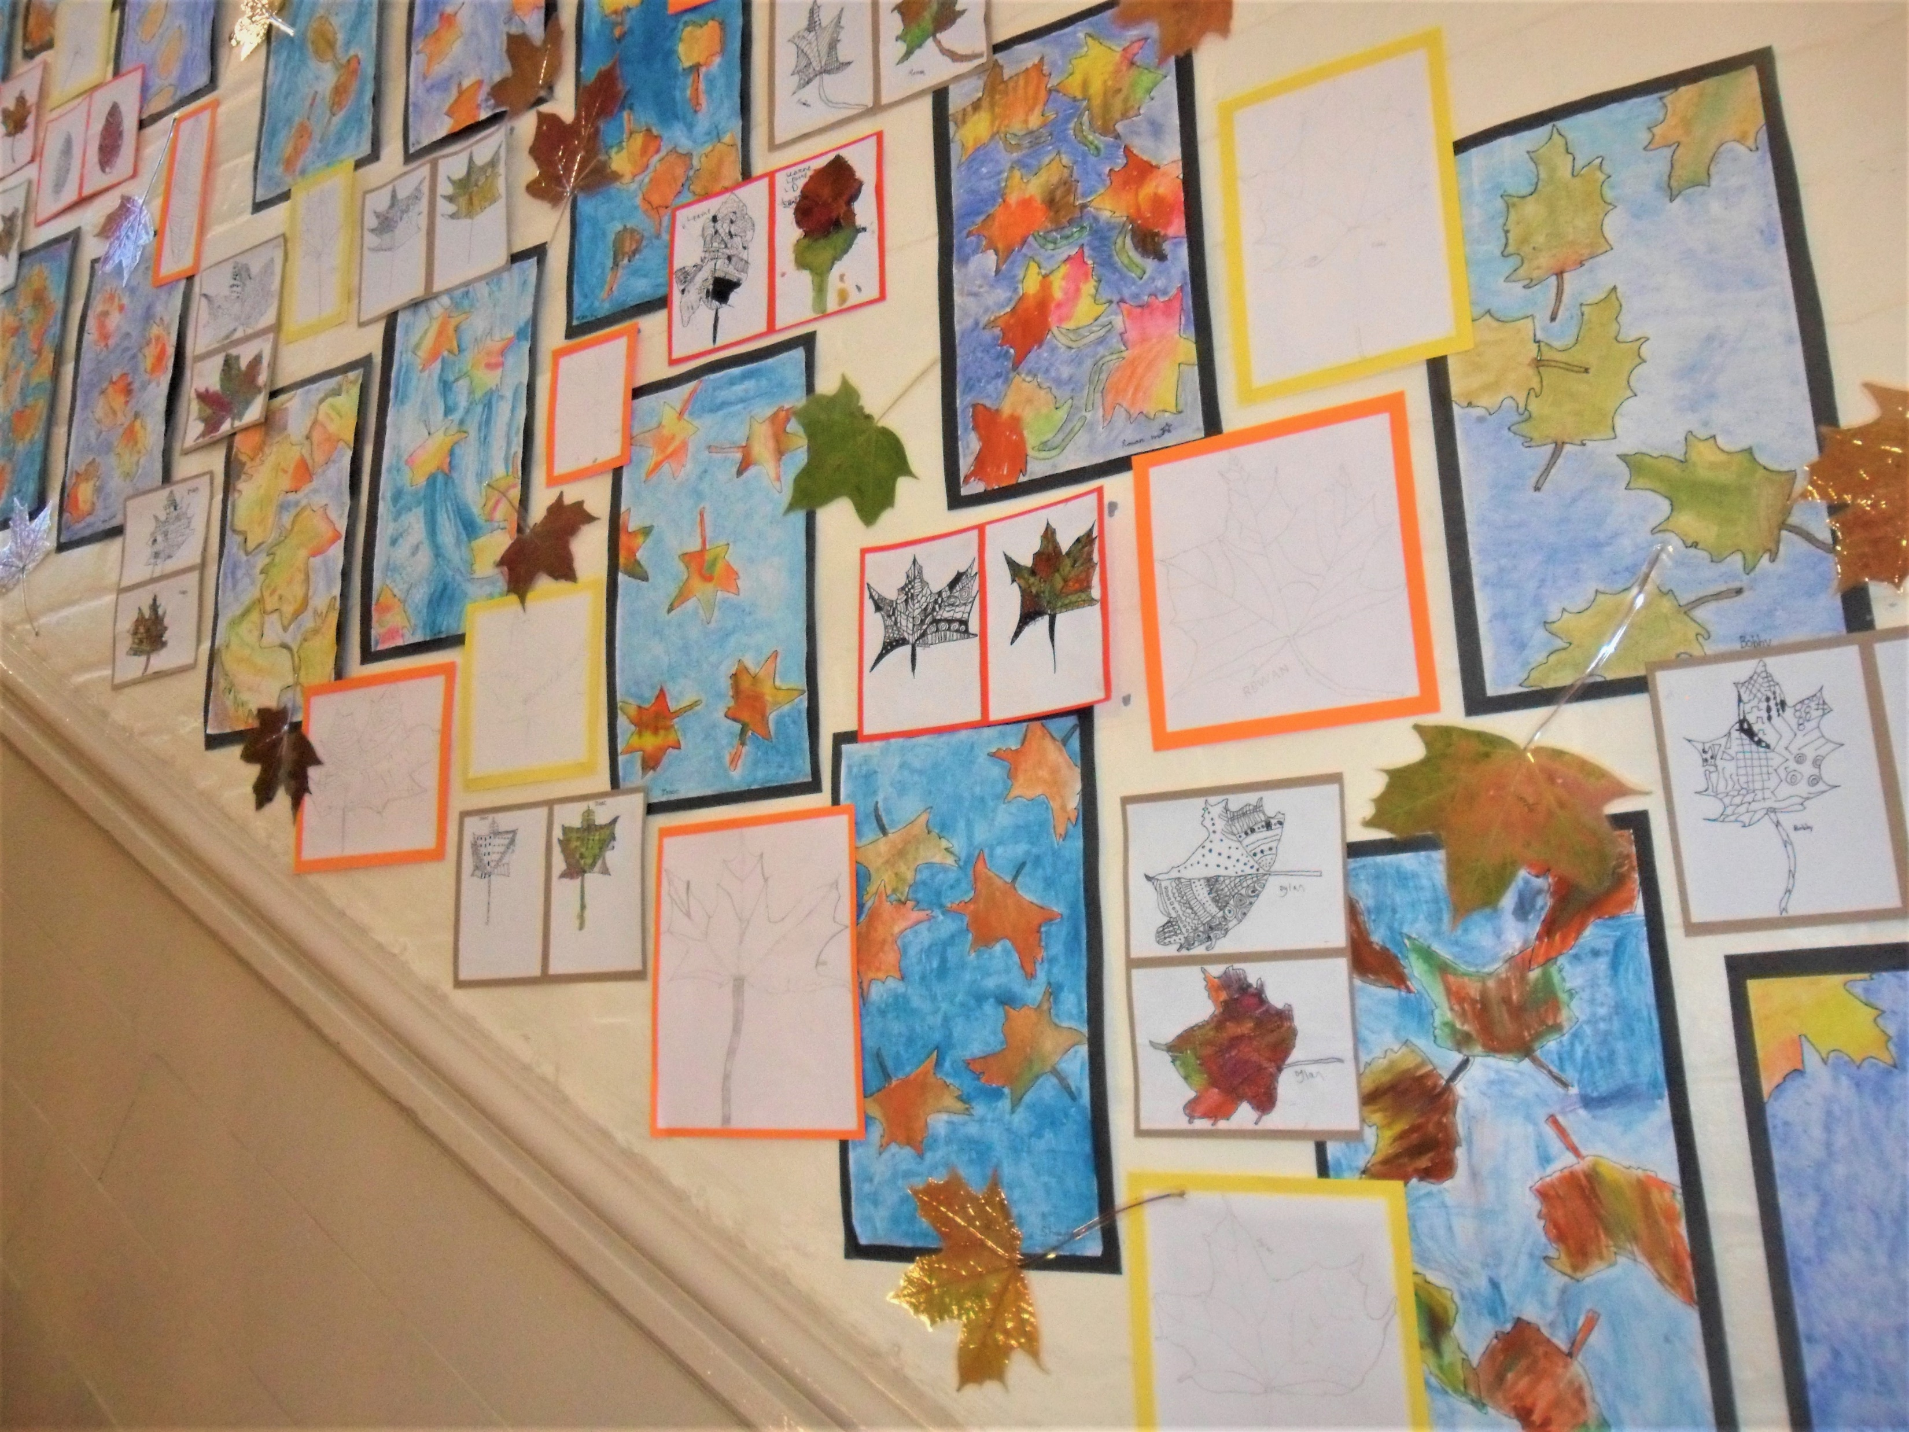
Another wonderful display

Slide 5
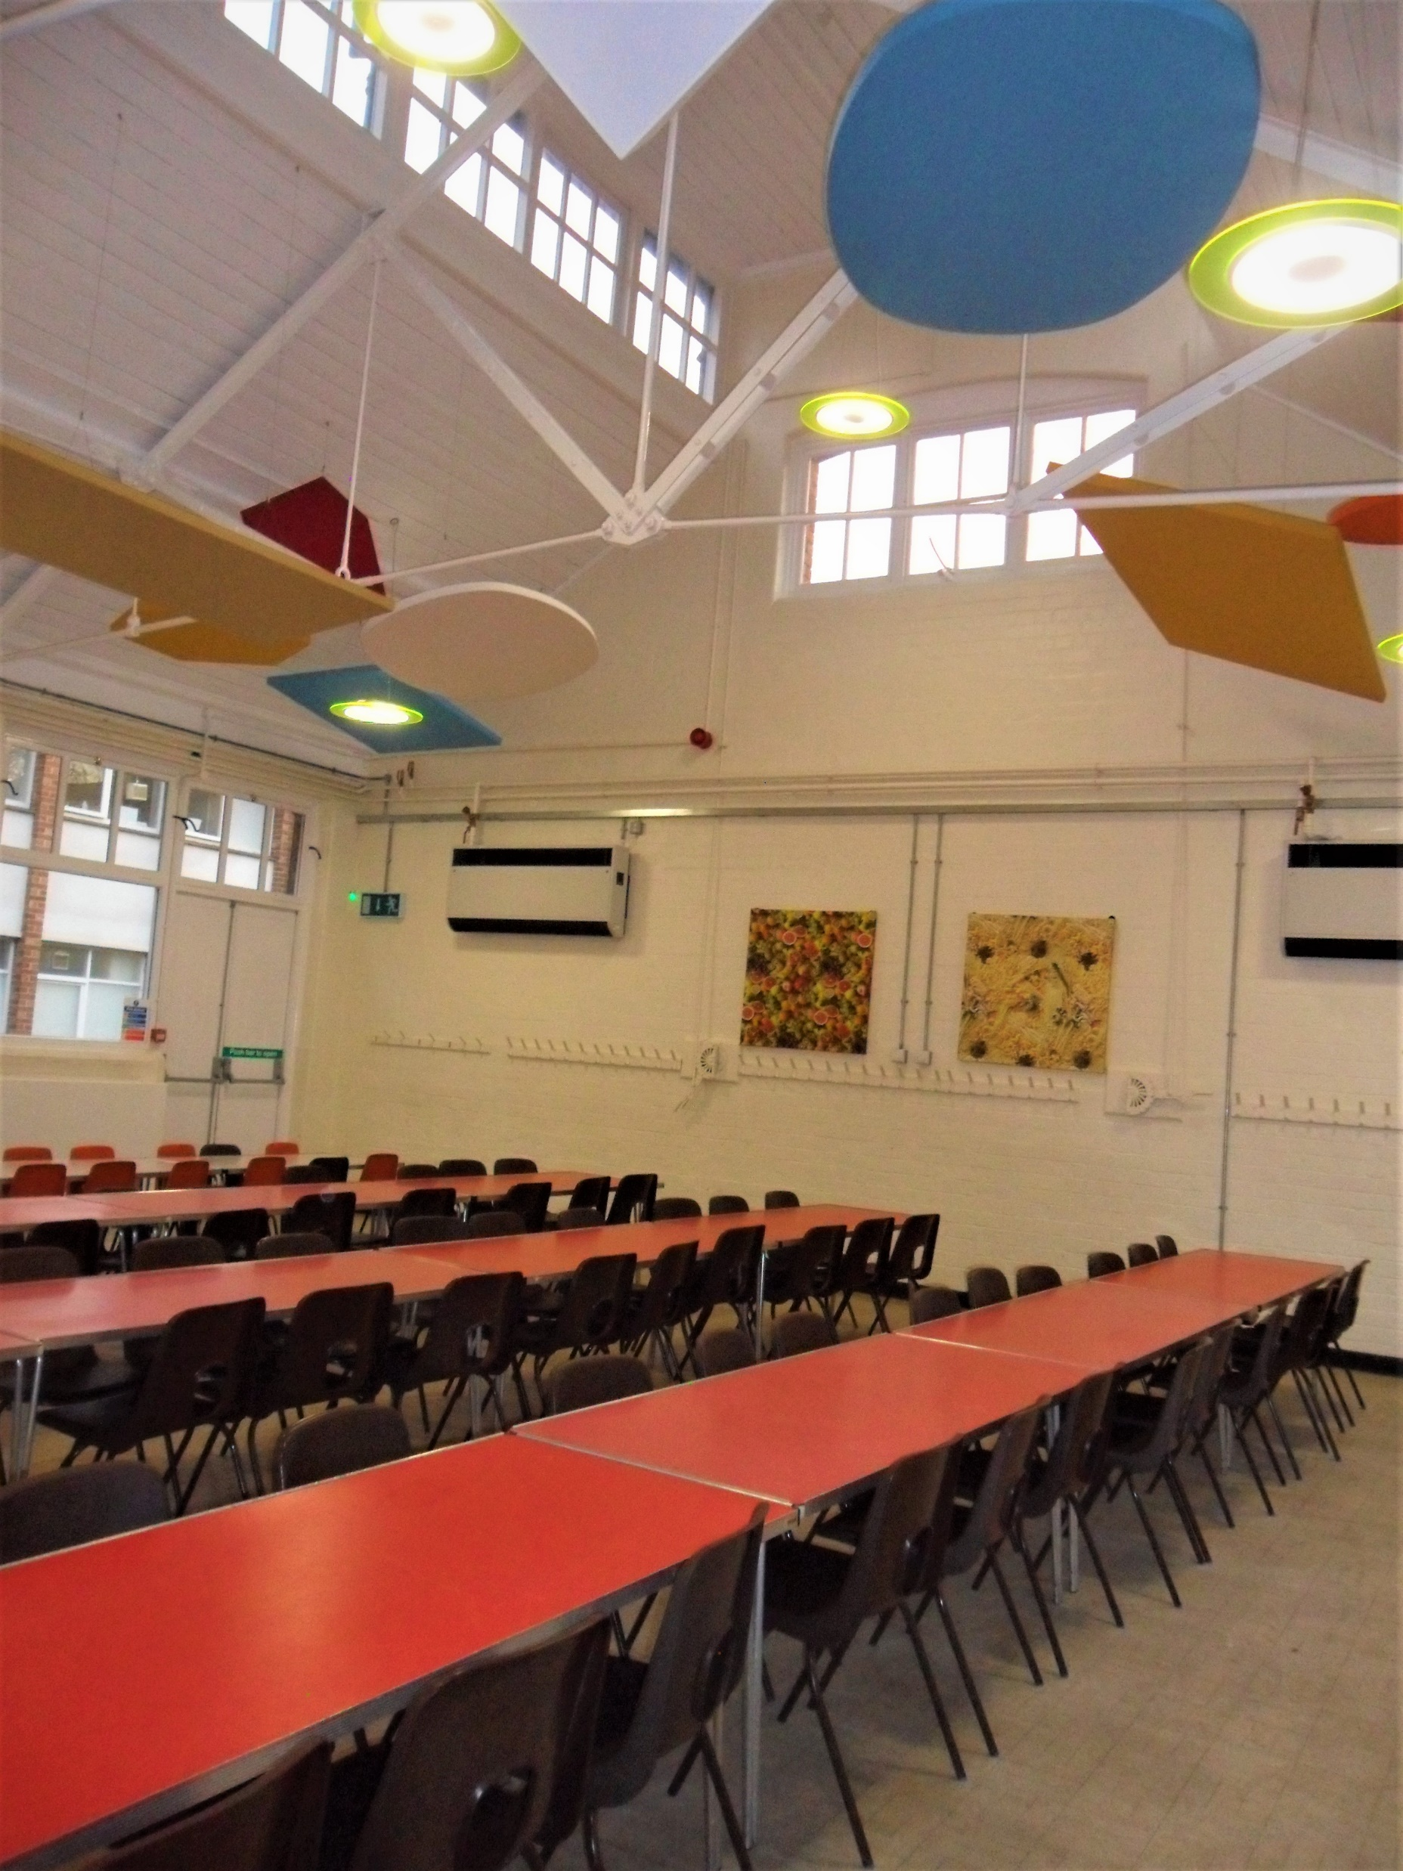
Dining Room

Slide 6
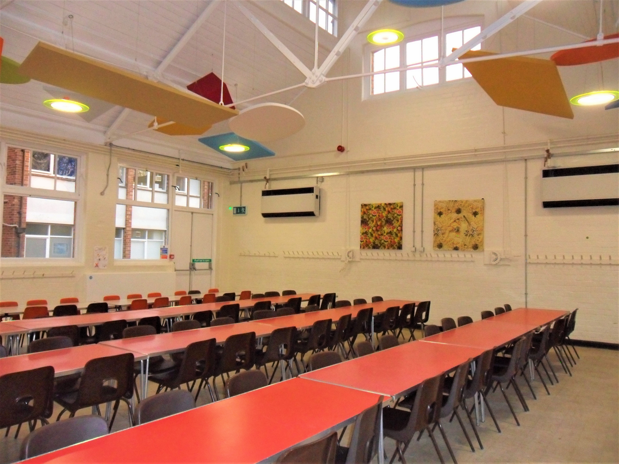
Dining Room

Slide 7
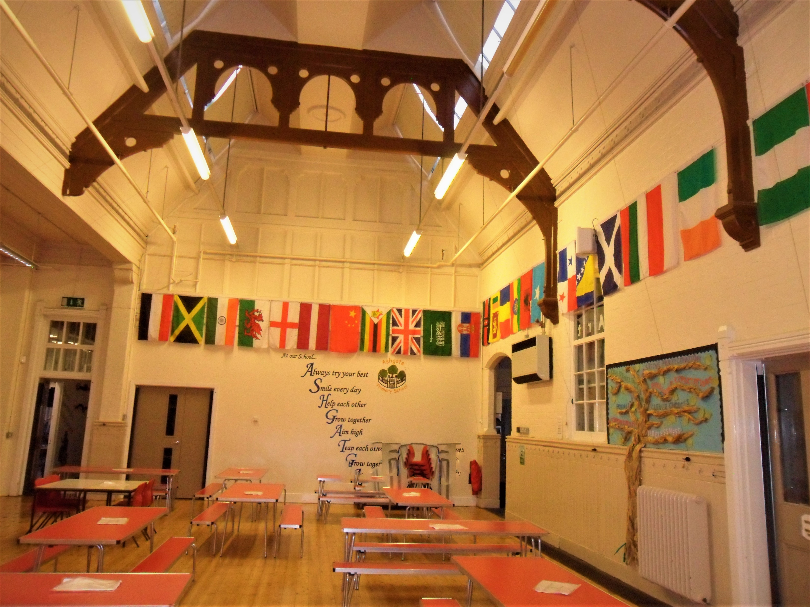
School Hall

Slide 8
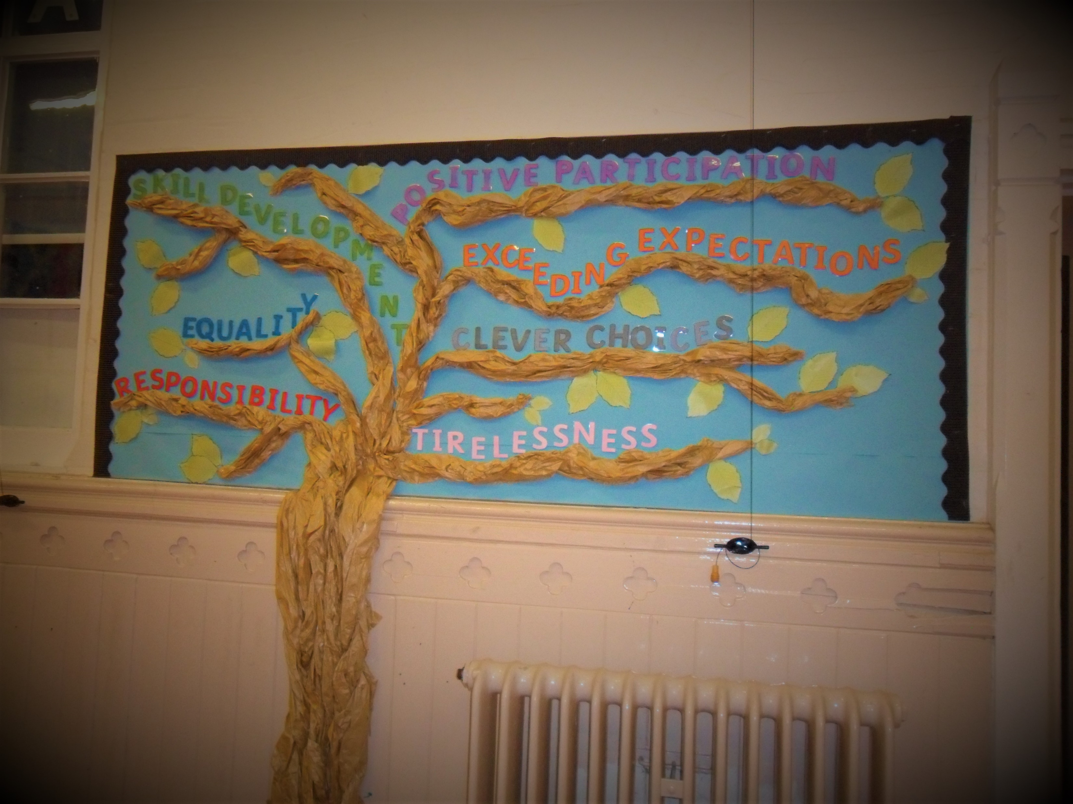
The RESPECT Agenda

Slide 9
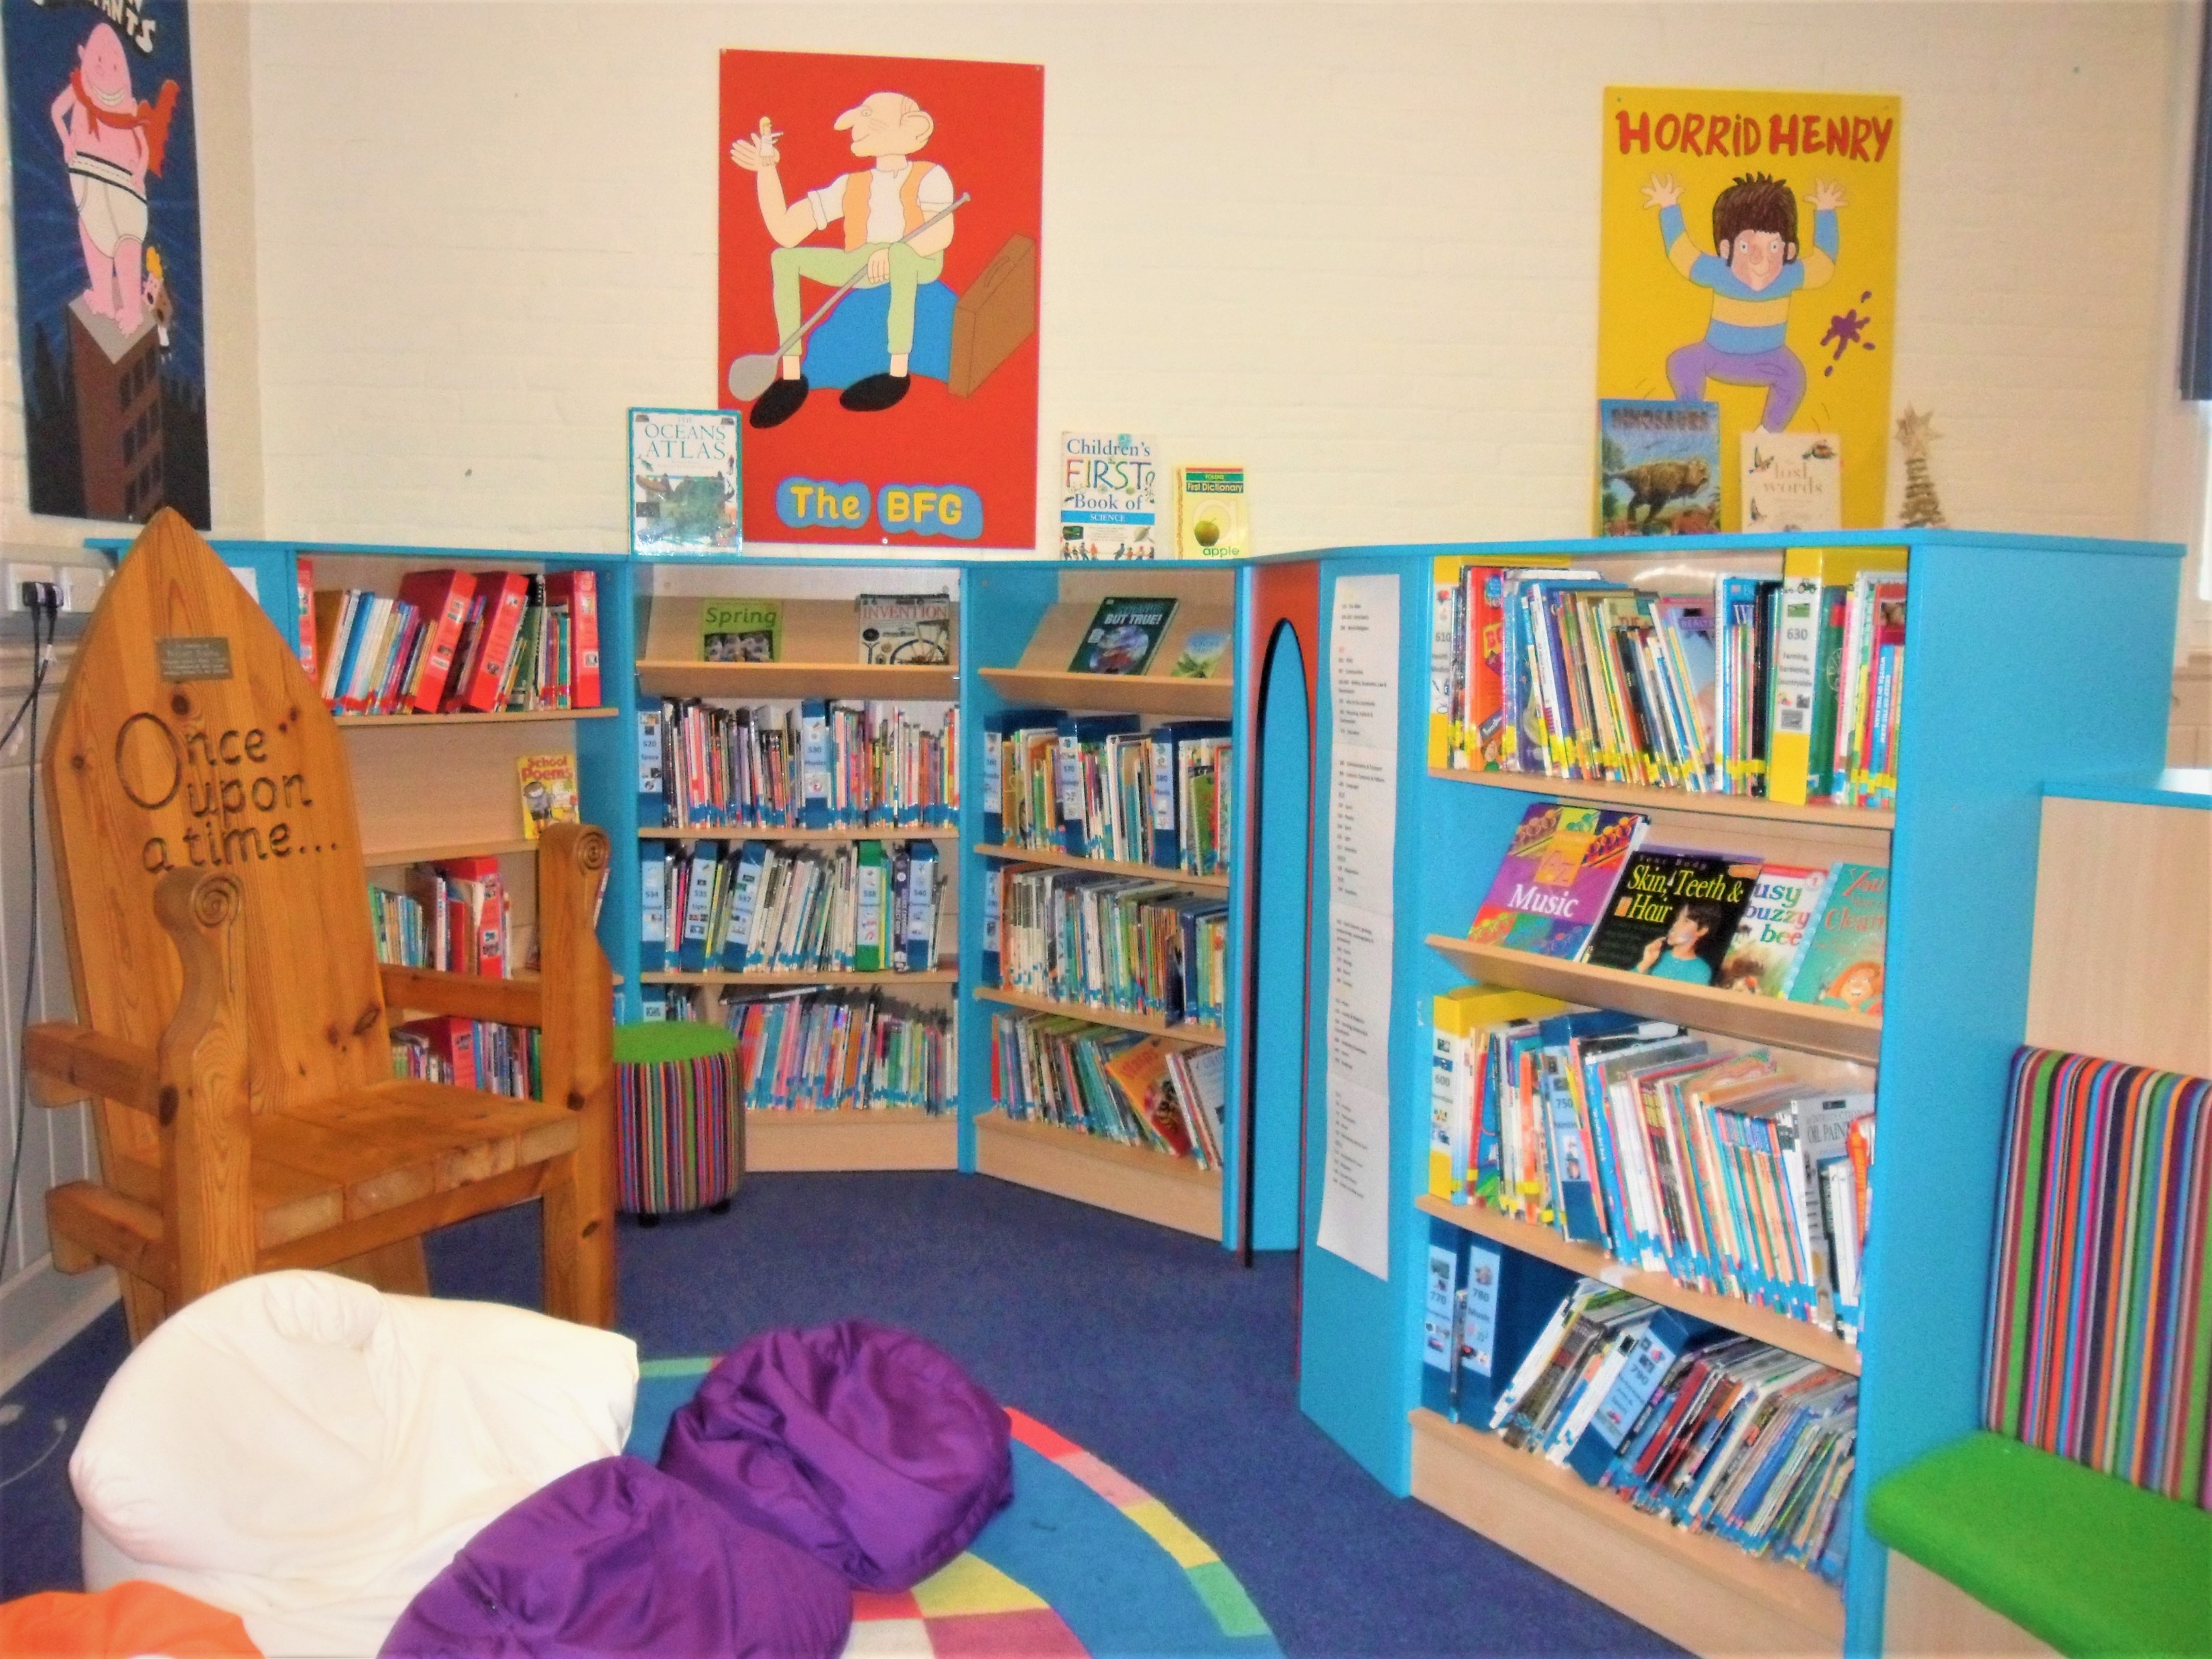
School Library

Slide 10
This is the end of the virtual tour around our school. Thank you for taking the time to look around. If you would like to speak to the staff please contact us by:
Telephone: 01332 343928
Email: office@ashgate.derby.sch.uk

