Slide 1

WELCOME!
Welcome to the tour of our school. We are very proud of what we achieve at Ashgate Primary School.
We welcome you all and invite you to contact us by telephone or email with any questions or queries. If you would like to share any important information about your child that would help us in welcoming your child to our school please also contact us.

Slide 2
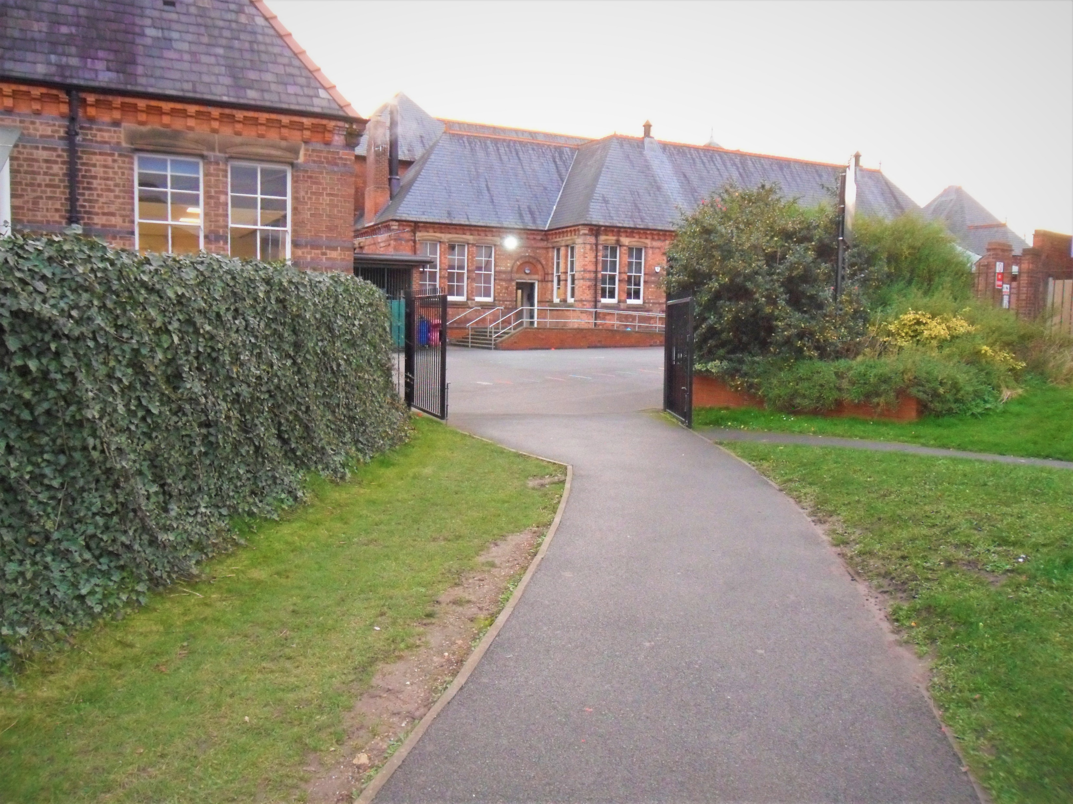
School field entrance

Slide 3
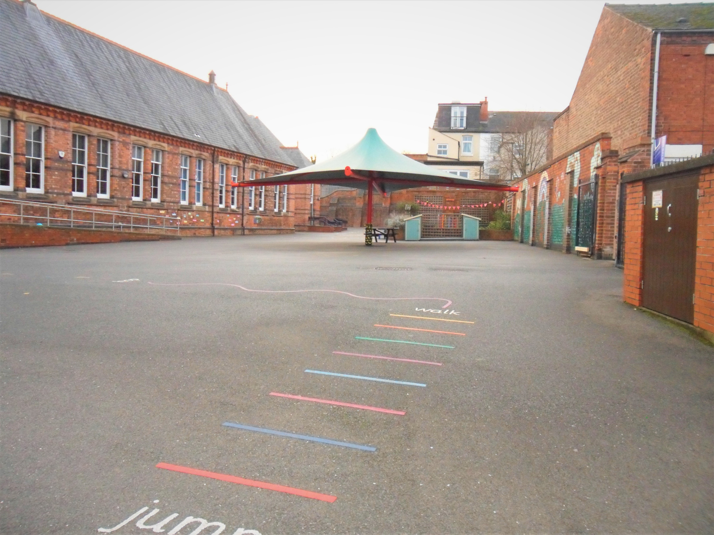
KS1 Playground

Slide 4
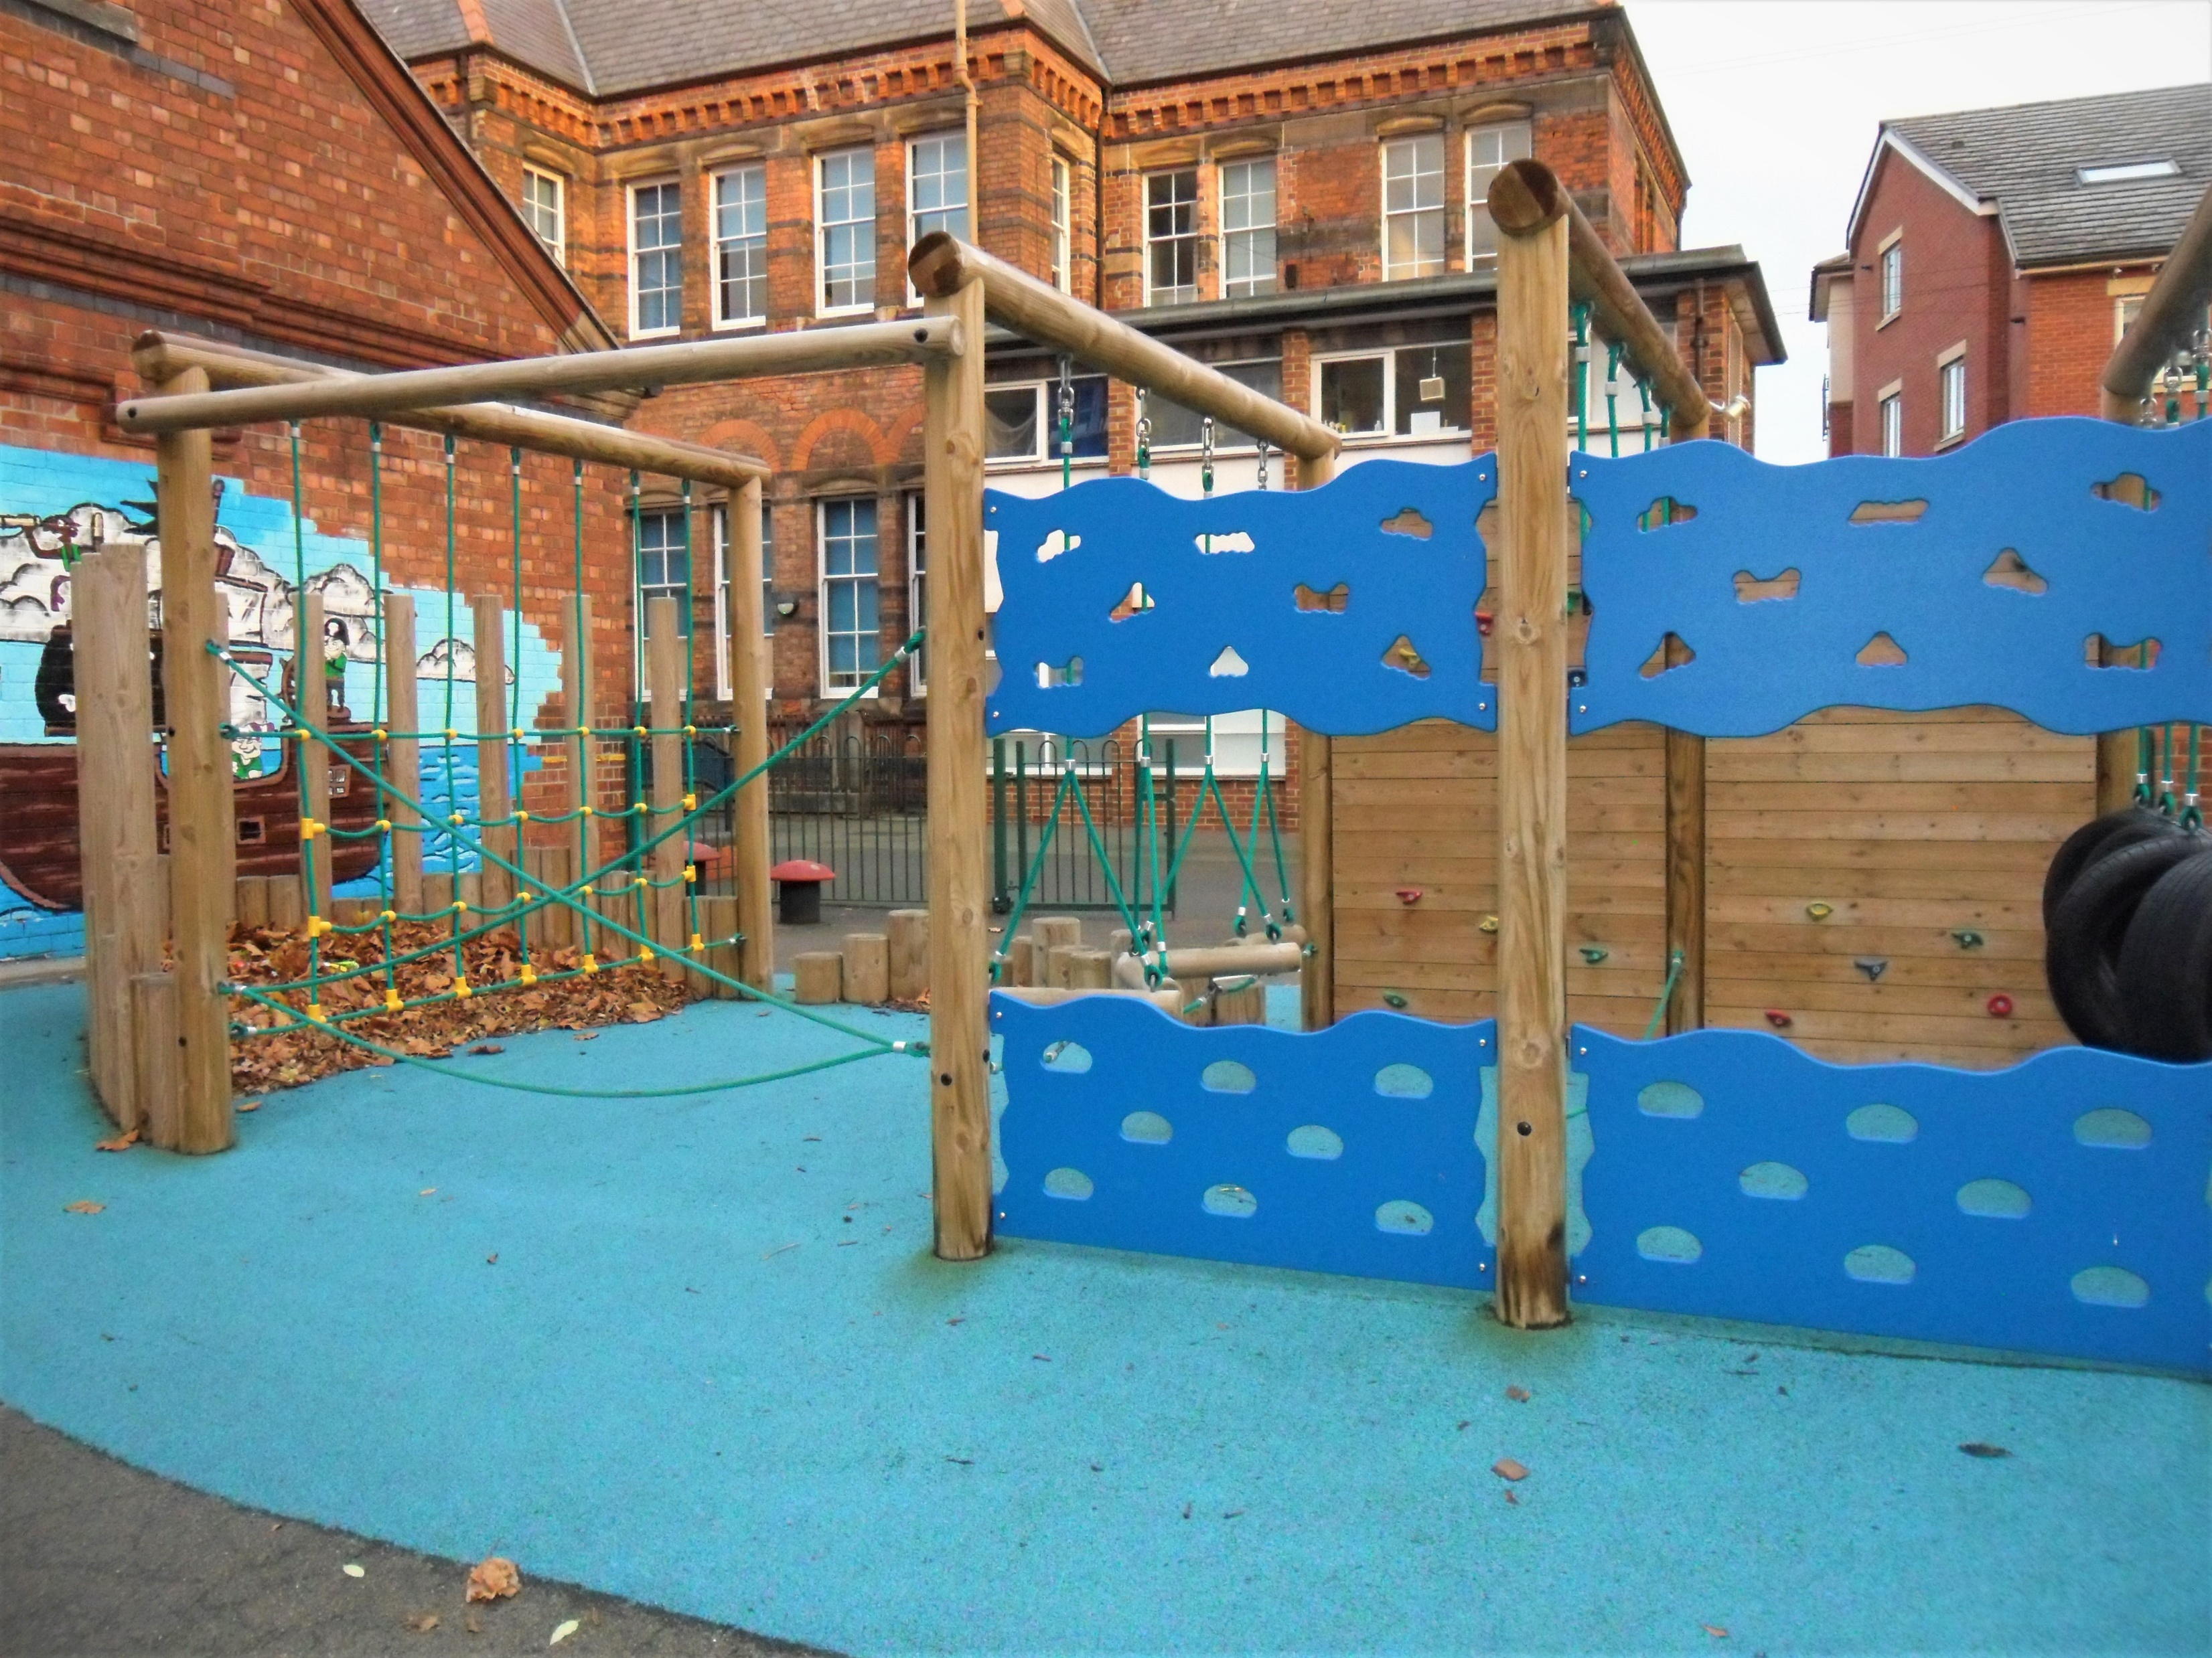
The Pirate Ship

Slide 5
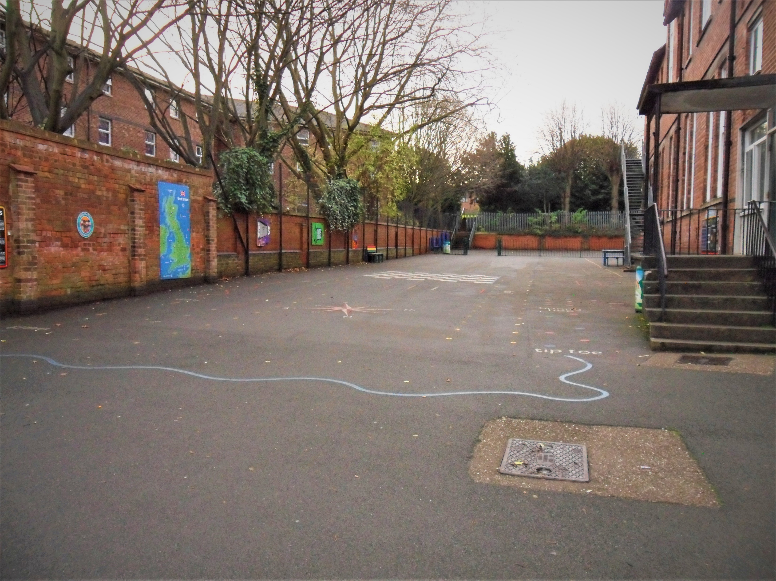
KS2 Playground

Slide 6
This is the end of the virtual tour around our school. Thank you for taking the time to look around. If you would like to speak to the staff please contact us by:
Telephone: 01332 343928
Email: office@ashgate.derby.sch.uk

