Slide 1

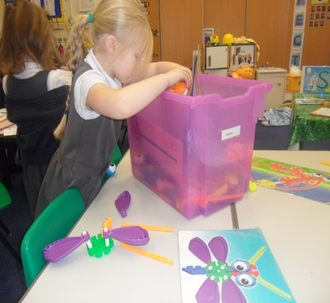
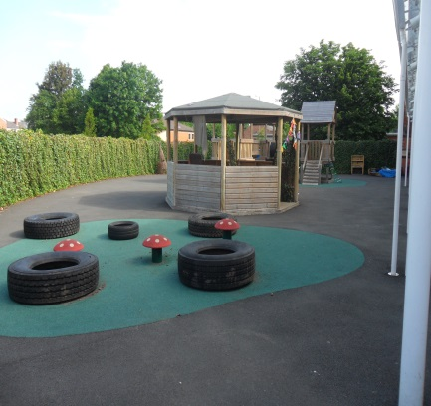
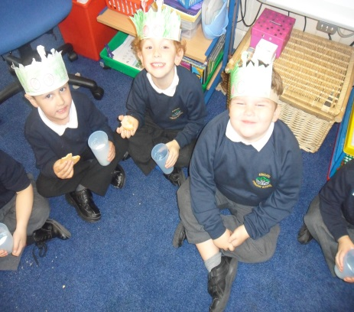
Welcome to Ashgate Primary School Early Years Foundation Stage

Slide 2
Introductions
Head Teacher: Mr Seargent
Deputy Head Teacher: Mrs Forte
Business Manager: Mrs Warburton
Class Teacher: Ms Vobes
Class Teacher: Mrs Winfield

Slide 3
How the staggered start is organised
Each class will do a mixture of morning sessions and afternoon sessions in their class group.
The children will attend part time over the first week of term - week beginning Monday 5th September
From Friday 9th September all children will attend school for full days.

Slide 4
First half day routines
Our usual practice is as follows:
Arrive at 8.45 (morning session) Collect at 11.45
Arrive at 1.20 (afternoon session) Collect at 3.00
Come into the classroom with your child and help them find their coat peg and drawer.
Help your child settle at an activity.
Once your child is happy you can leave.
School will provide a fruit snack and a drink of milk.

Slide 5
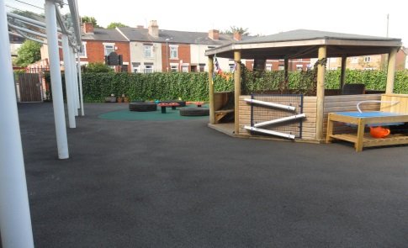
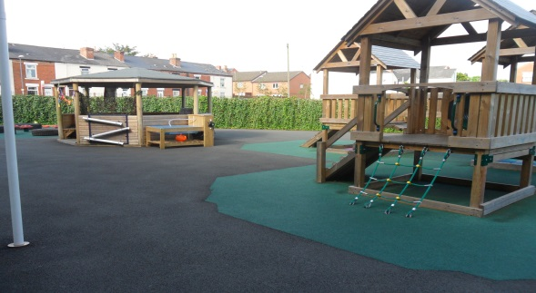
Full day routine from Sept 9th
Our usual practice is:
Gates open at 8.35 wait on EYFS playground.
At 8.45 children line up at their classroom door.
You are welcome to come into school with your child initially. Once they are settled they can come in independently.
Collect your child from EYFS playground at 3.20.

Slide 6
Ready for school
It would be really helpful if your children could do these things independently before starting school!
Put coat on and do it up
Recognise their own name
Manage in the toilet (spare pants & socks can be put in their book bag just in case)
Wash their hands carefully
Tidy their own toys away
Dress themselves without any help
Take turns and share equipment

Slide 7
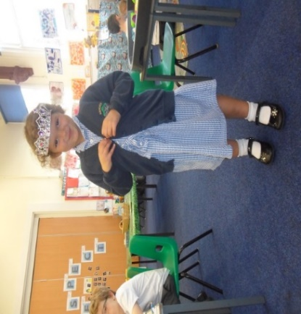
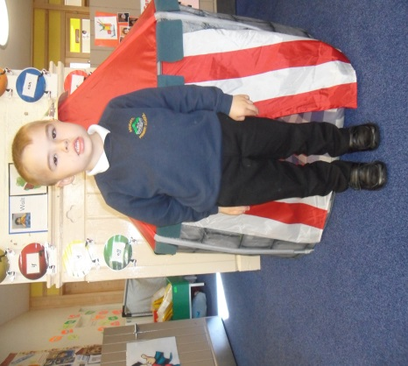
Uniform
Please see leaflet at the school office for prices
Place orders with the school office ASAP
Please NAME ALL ITEMS
Navy blue jumper or cardigan
Black or grey trousers or skirt (black grey & navy)
White or light blue polo shirt
Black shoes (Velcro or easy buckles not laces)
No Jewellery

Slide 8
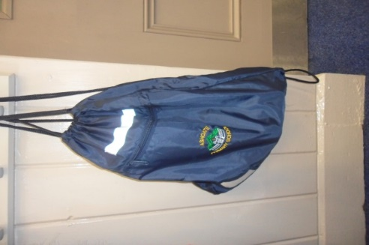
PE Kit
PE Kit is required after the Autumn half term when we begin to introduce formal PE sessions
Children will need:-
White polo shirt, black or navy shorts and black pumps
ALL KIT NAMED PLEASE
In a named PE bag
The kit will stay in school each week and
go home half termly to be refreshed.
Earrings: take out on PE days or if not possible cover with micropore tape.

Slide 9
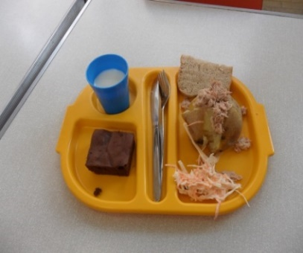
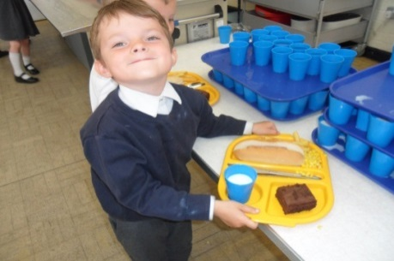
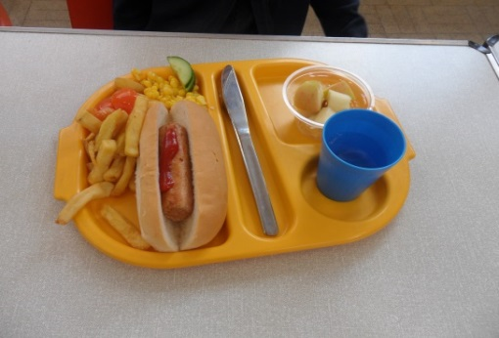
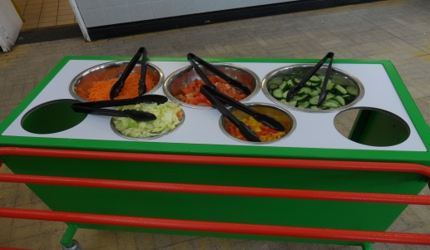
Lunches
Hot dinners under universal free school meals a hot dinner is available for all EYFS and KS1 children)
If you think you would be eligible for a free school meal under the old system please fill out the form as the school will then receive extra funding for your children and it may also effect any additional costs for yourselves during the year such as trips.
There are always vegetarian options and a salad bar available. Please let us know if your child is a vegetarian.
Sandwiches – Children can bring their own healthy packed lunches. Please don’t include any chocolate, sweets or fizzy drinks.
The company that provides the lunches will provide for special dietary requirements. A confirmation from your doctor is required if your child has allergies and requires a special diet.

Slide 10
Medical issues
Inhalers: If your child needs an inhaler please ask your GP for a spare one to be kept in school.
Glasses: as above a spare pair kept in school is very helpful and available from opticians.
Medicines policy – any prescribed medicines to be given at school need to be handed to office and a medical form must be completed.
Headlice: please check hair regularly, notify school if your child has nits/headlice.
Please treat immediately,

Slide 11
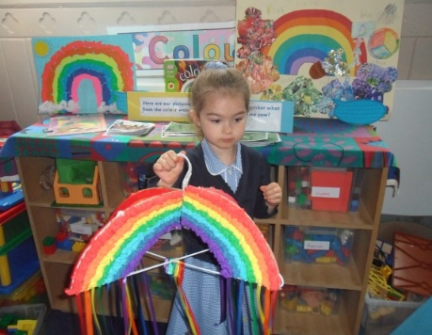
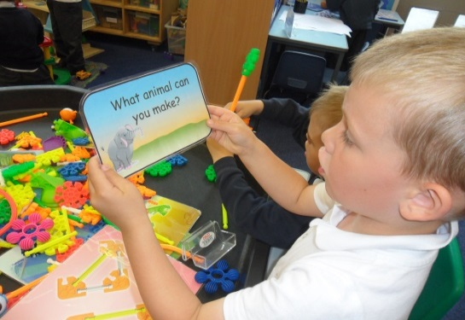
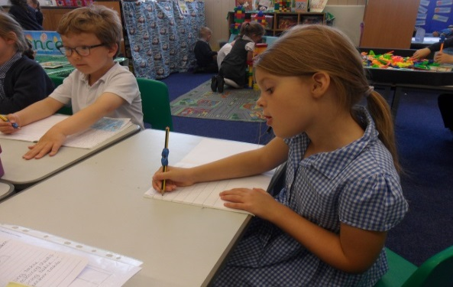
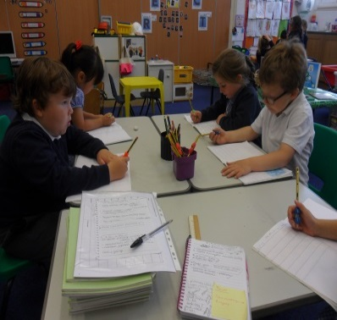
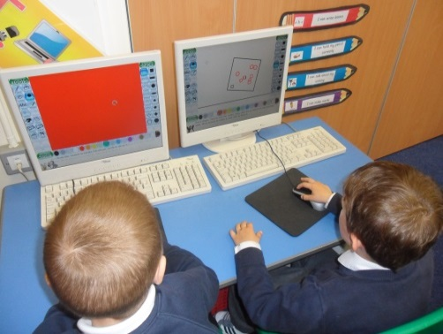
Early Years Foundation Stage Curriculum
We follow Early Years Foundation Stage Profile
with the same 7 areas of learning as Nursery
We have a mixture of practical activities/play based learning with some focus groups and some child initiated learning
Our outdoor environment is part of the classroom!

Slide 12
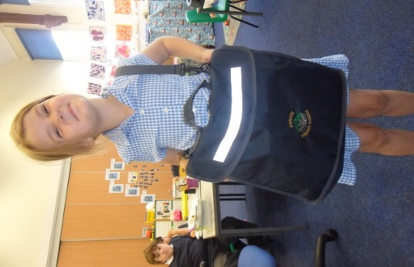
Reading Is Vital!
Your child will bring home the following: a reading
book, reading record book, sound ring and a
word ring
A book bag is required to carry all of the above.
Please hear your child read regularly at home and sign the reading record book to let us know that you have.
Practicing reading at home is essential to help your child make the best progress.
New sounds and words will be added to their rings every Friday once we begin Phase 2 after half term.
Children will begin reading using books with no words to develop their story telling skills and ‘book language.’
Please check the book bag daily for letters and communication
We also make a weekly visit to the school library to chose a book you can read with your child.
On Thursdays we hold Stay and Read sessions at the beginning of the school day. Any reading questions can be discussed then ☺

Slide 13
Communication
Best time to catch us is straight after school for a brief chat
Before school is really busy so okay for just a short message or to pass a note to the teacher.
Appointments need to be made for longer communication
A half termly newsletter with topic and news will be sent home.
Parents evenings are held in the Autumn and Spring Term
End of year written report is sent home in the Summer Term with an opportunity to discuss it.
We will record WOW learning moments on Tapestry and encourage parents to do the same with things the children do and achieve at home!
Please use your Reading Record to keep us up to date with when you are reading!
Absences:- please telephone school early on the first morning
ParentMail:- text messages will be sent via this.
Website:- newsletters and information will be updated on here.
Scopay:- All payments for trips and events will be collected this way.

Slide 14
Further Questions… please send a memo via Tapestry or telephone Mrs Winfield or Ms Vobes if you have any questions.
Thank you.
☺

Slide 15
THANK YOU FOR COMING
We hope that you and your children will enjoy being a part of the Ashgate Primary School family over the coming years.

