Slide 1

WELCOME!
Welcome to the tour of our school. We are very proud of what we achieve at Ashgate Primary School. We welcome you all and invite you to contact us by telephone or email with any questions or queries. If you would like to share any important information about your child that would help us in welcoming your child to our school please also contact us.
We look forward to meeting with you all in person when it becomes possible.
Mrs Winfield and Ms Vobes
EYFS CLassteachers

Slide 2
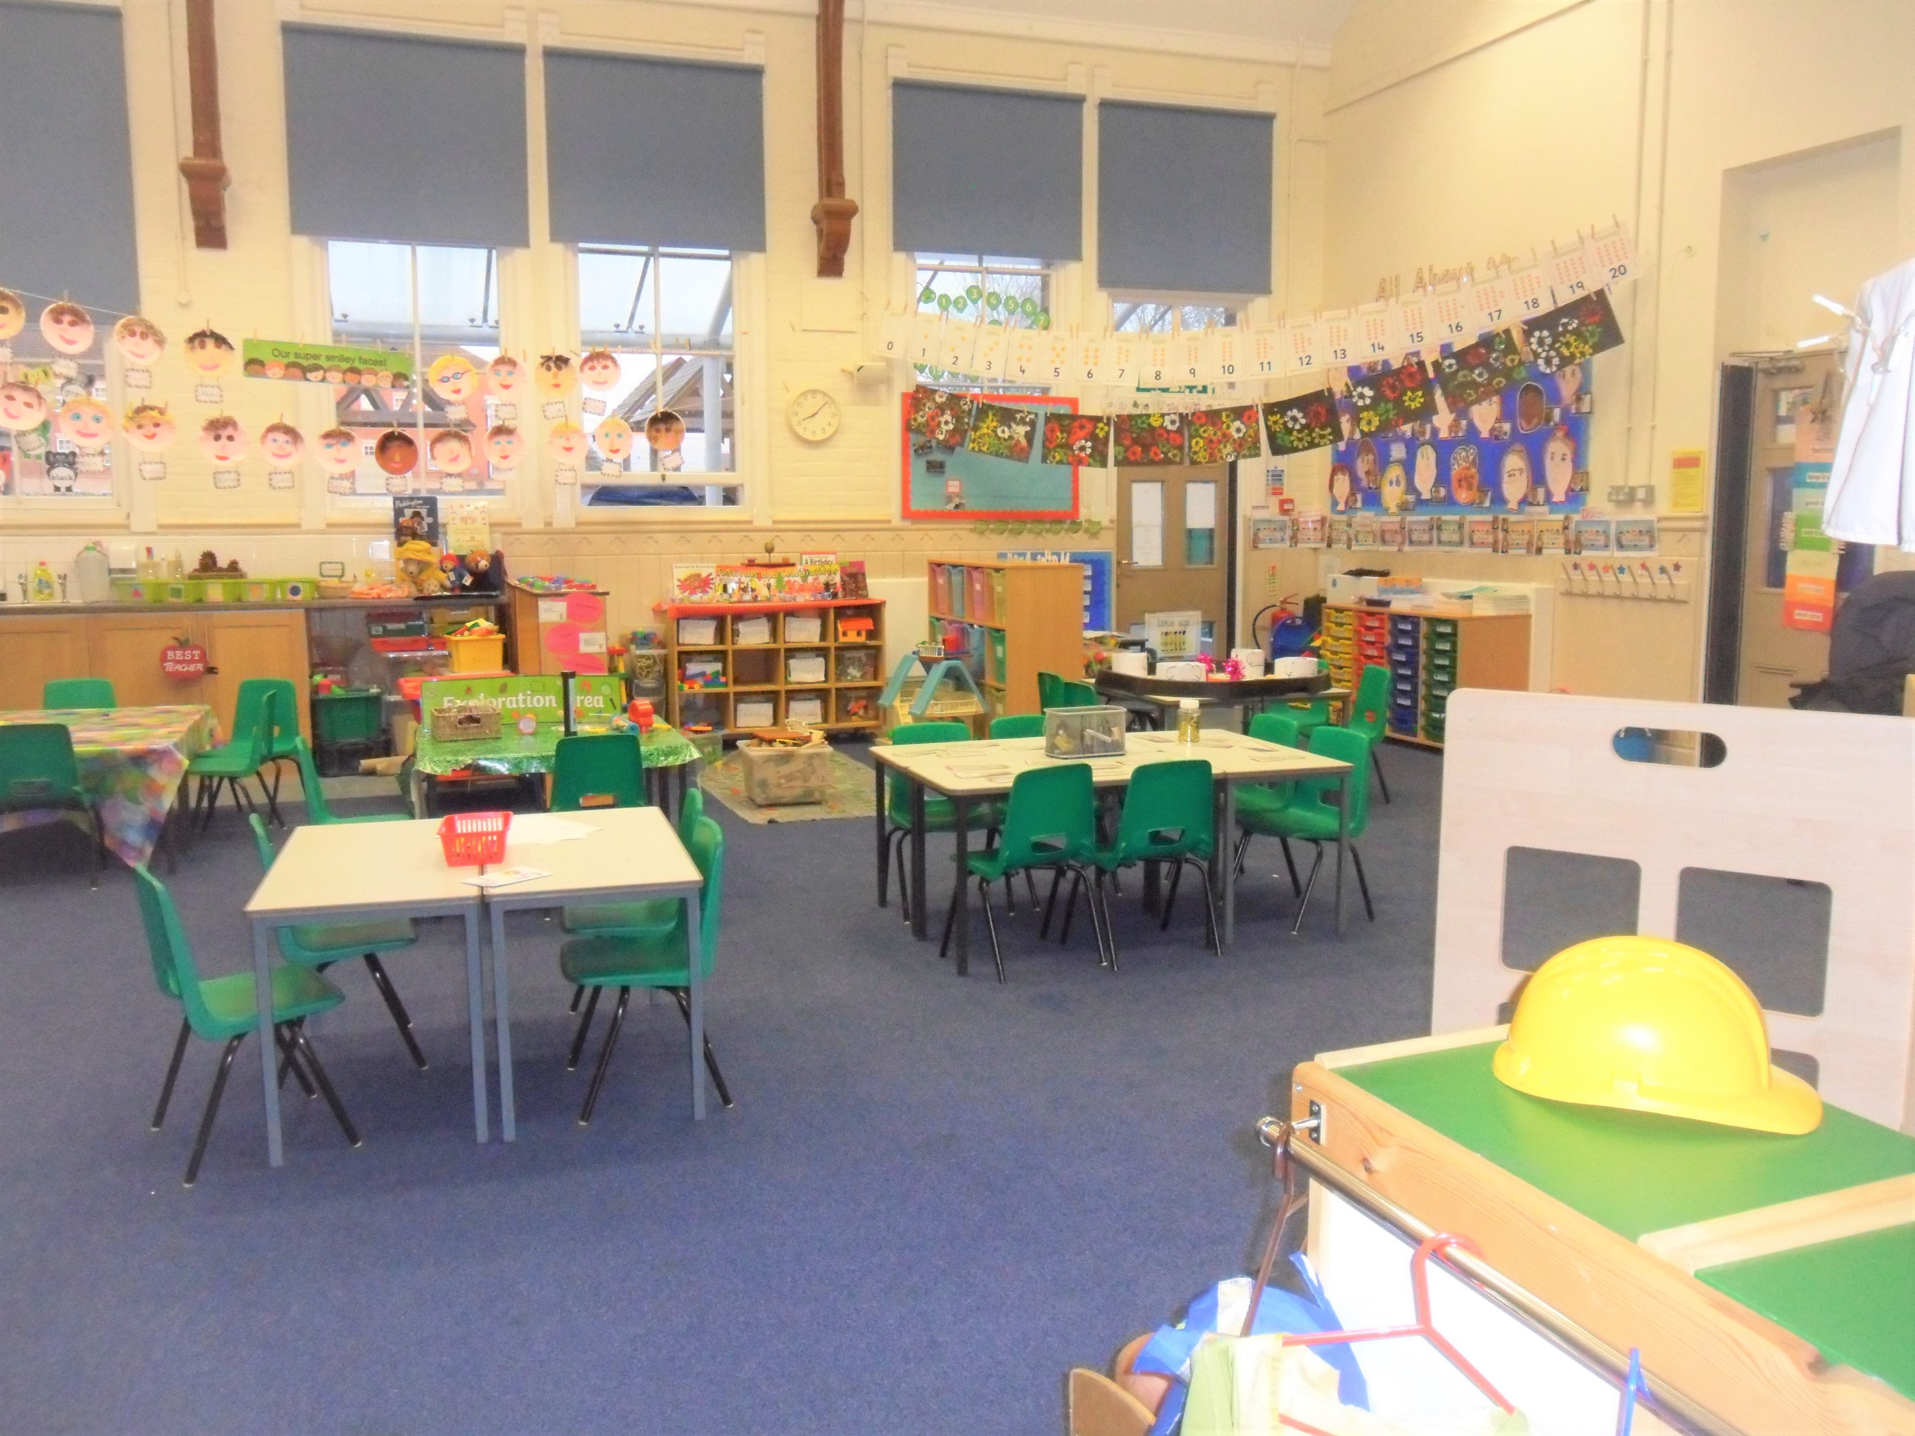
EYFS Classroom

Slide 3
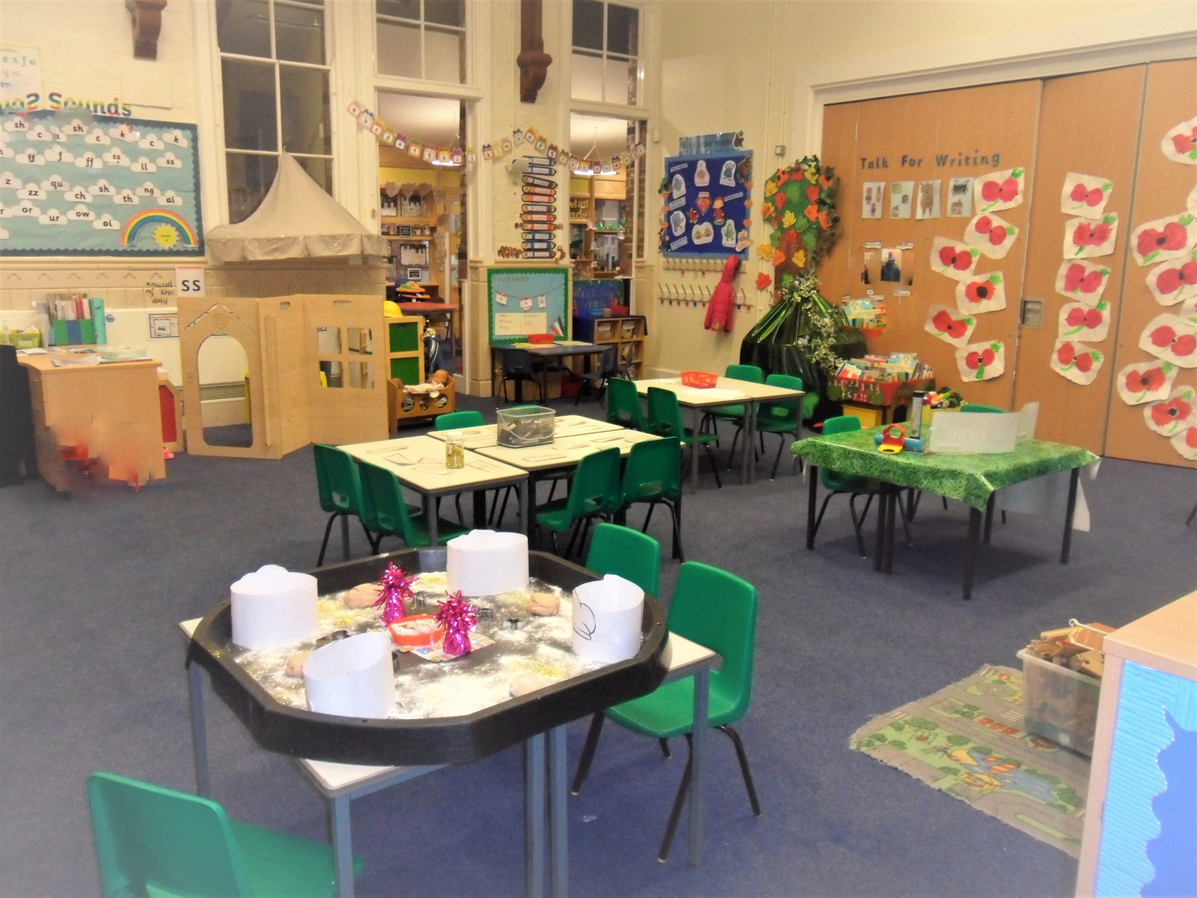
EYFS Classroom

Slide 4
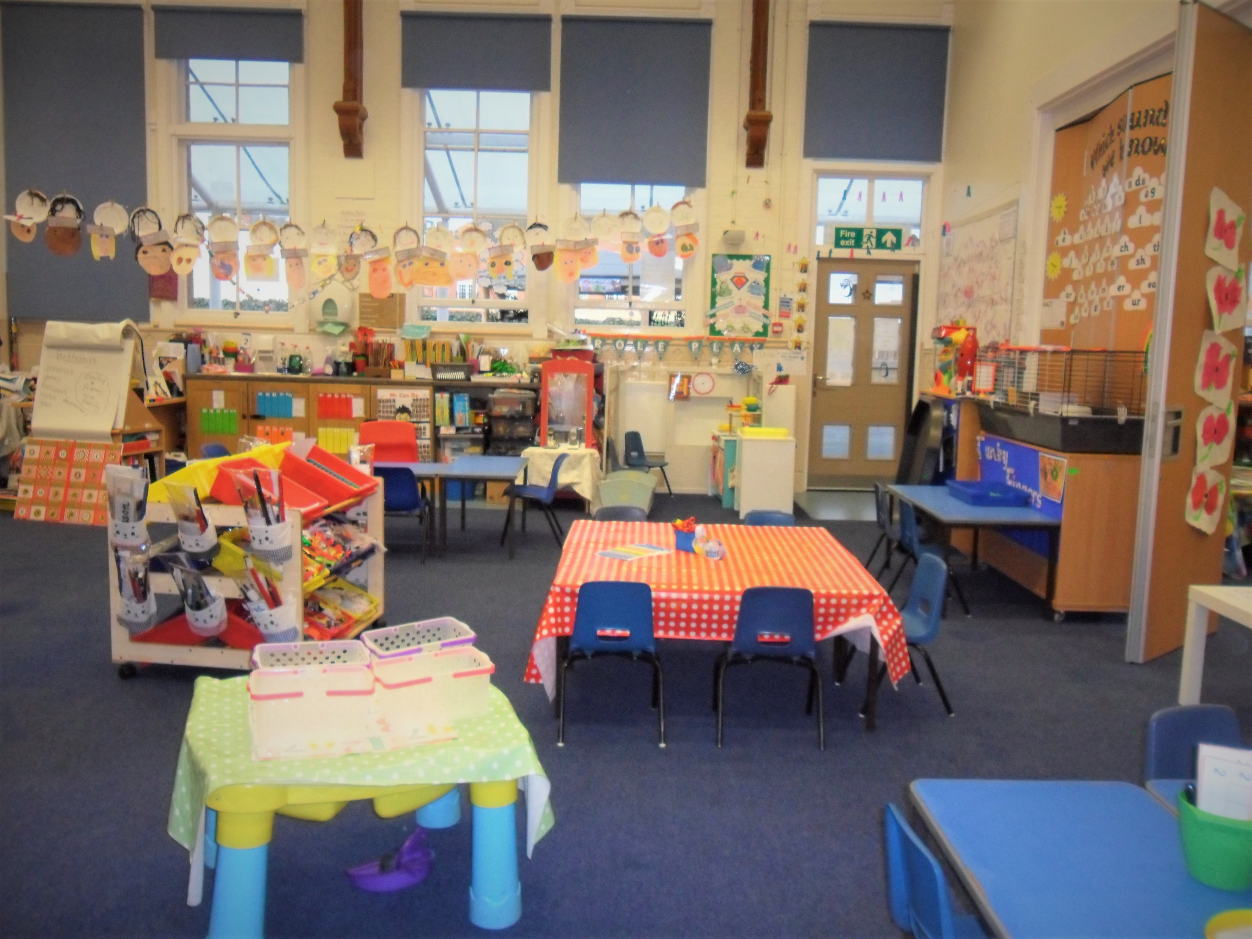
EYFS Classroom

Slide 5
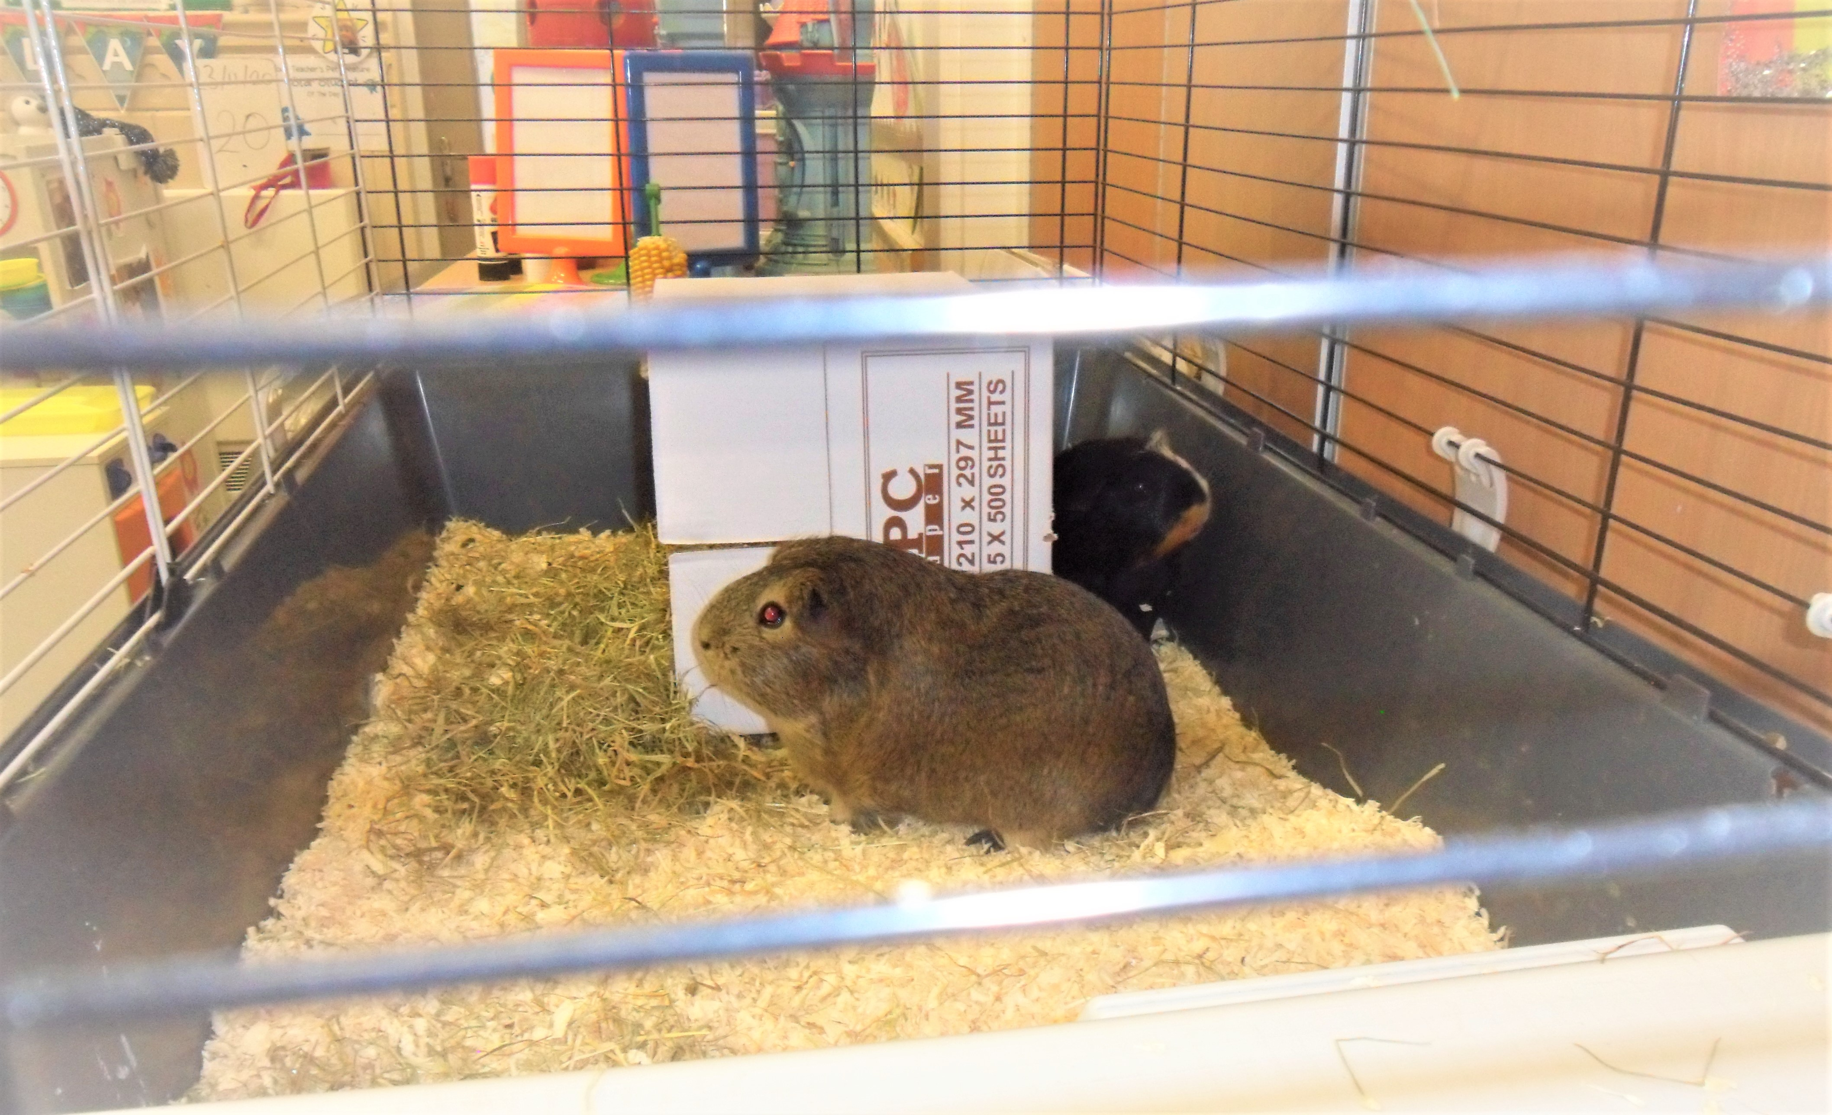
Our EYFS Guinea Pigs

Slide 6
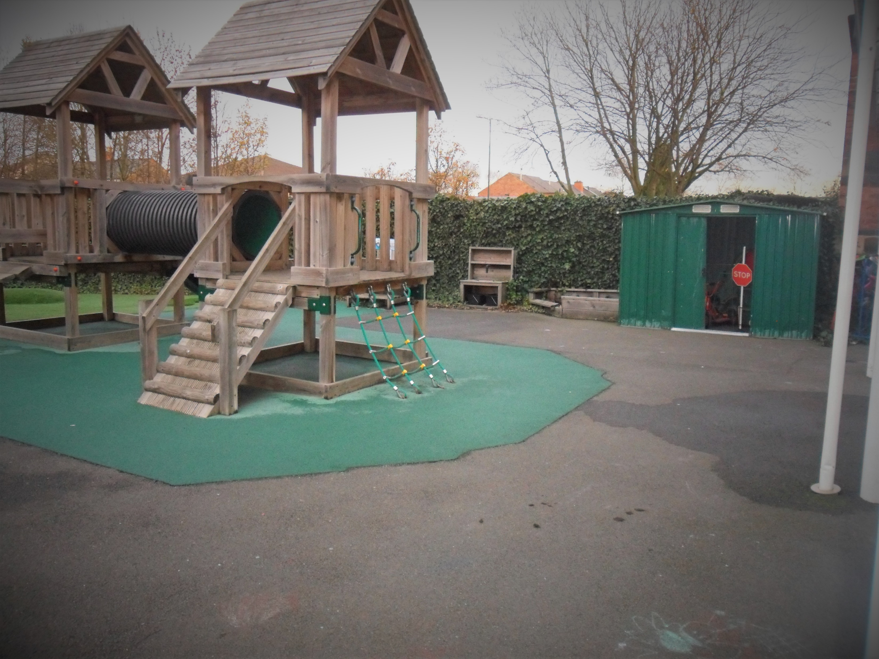
EYFS Outdoor Play Area

Slide 7
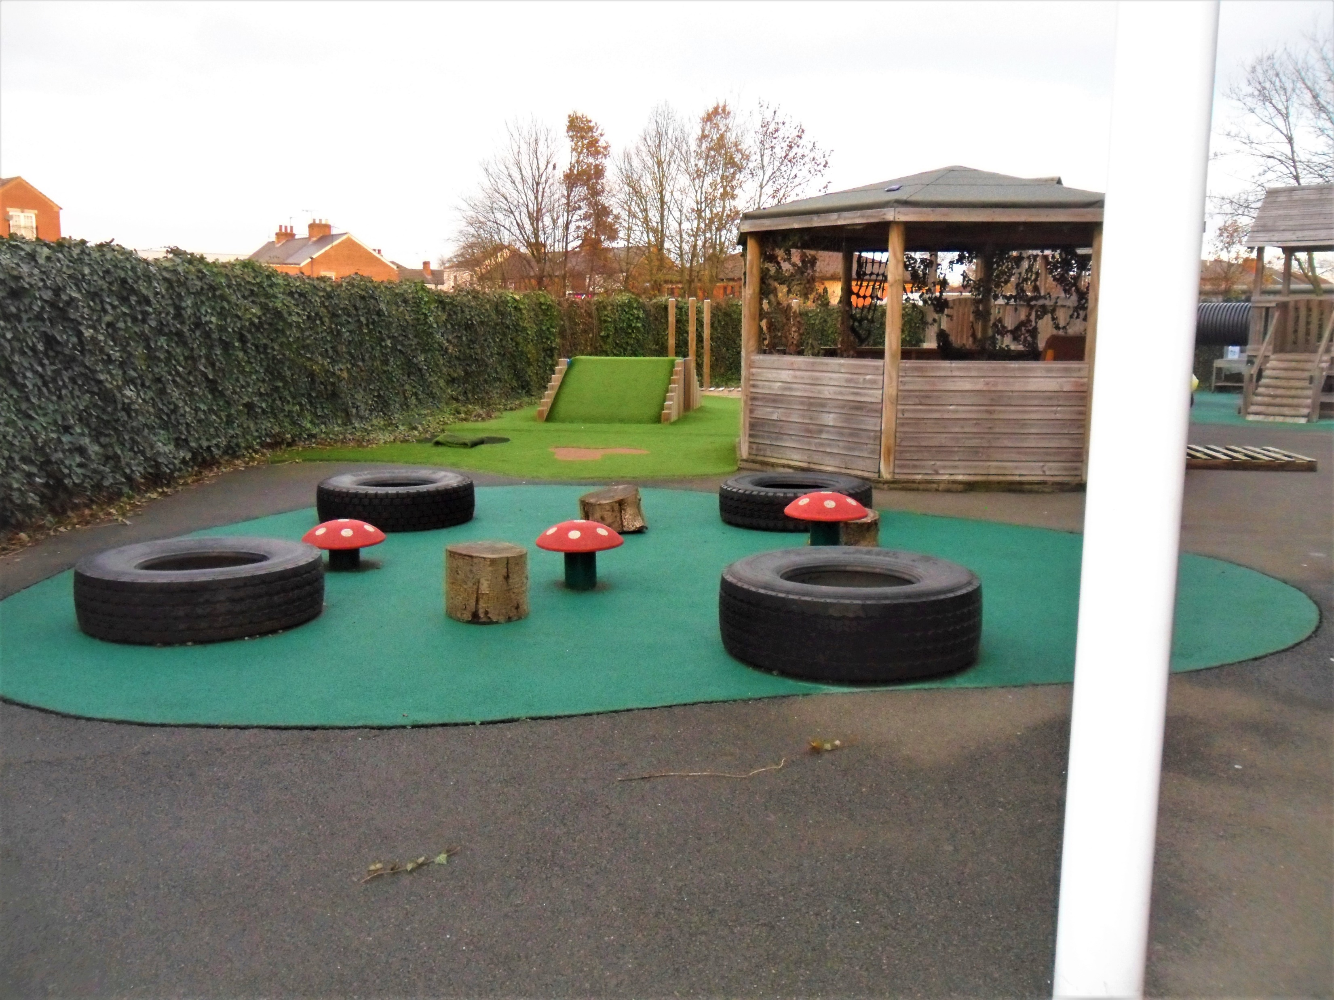
EYFS Outdoor Play Area

Slide 8
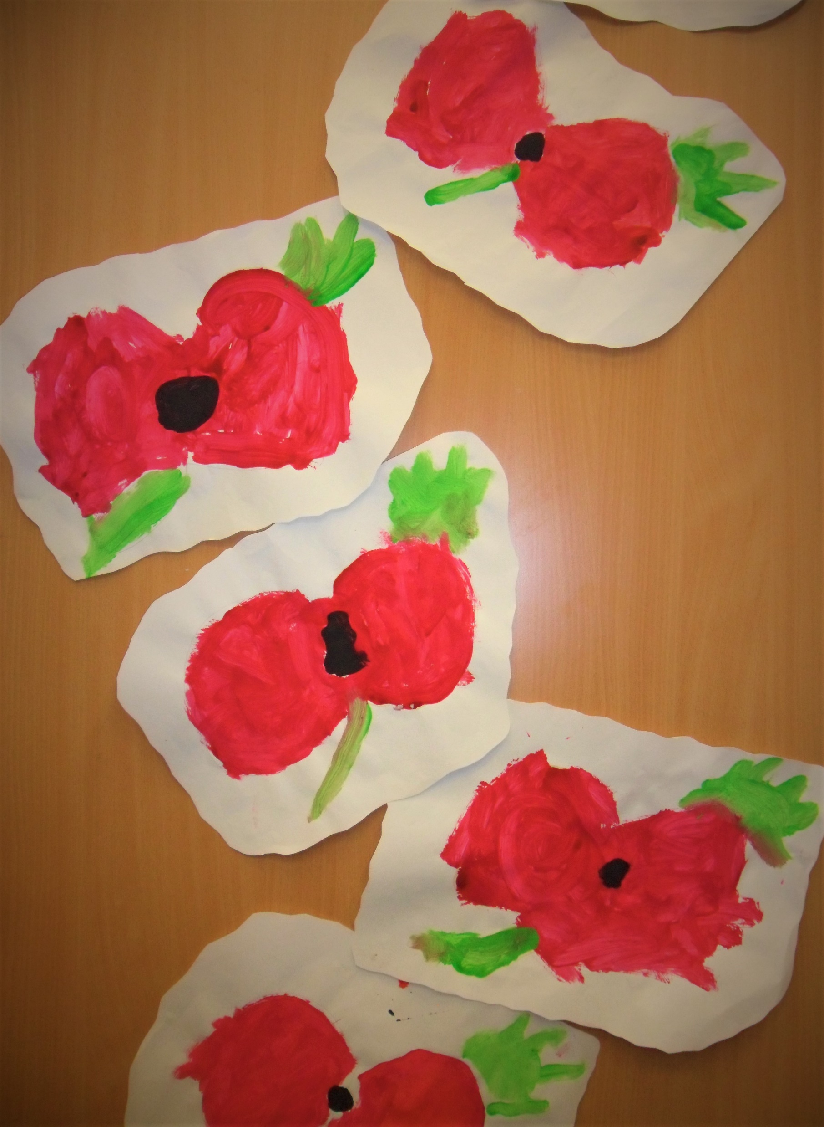
Our Lovely Work

Slide 9
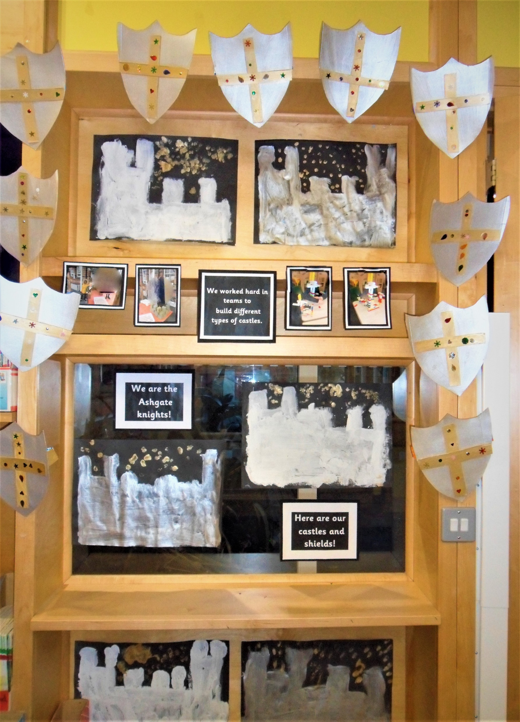
Our Lovely Work

Slide 10
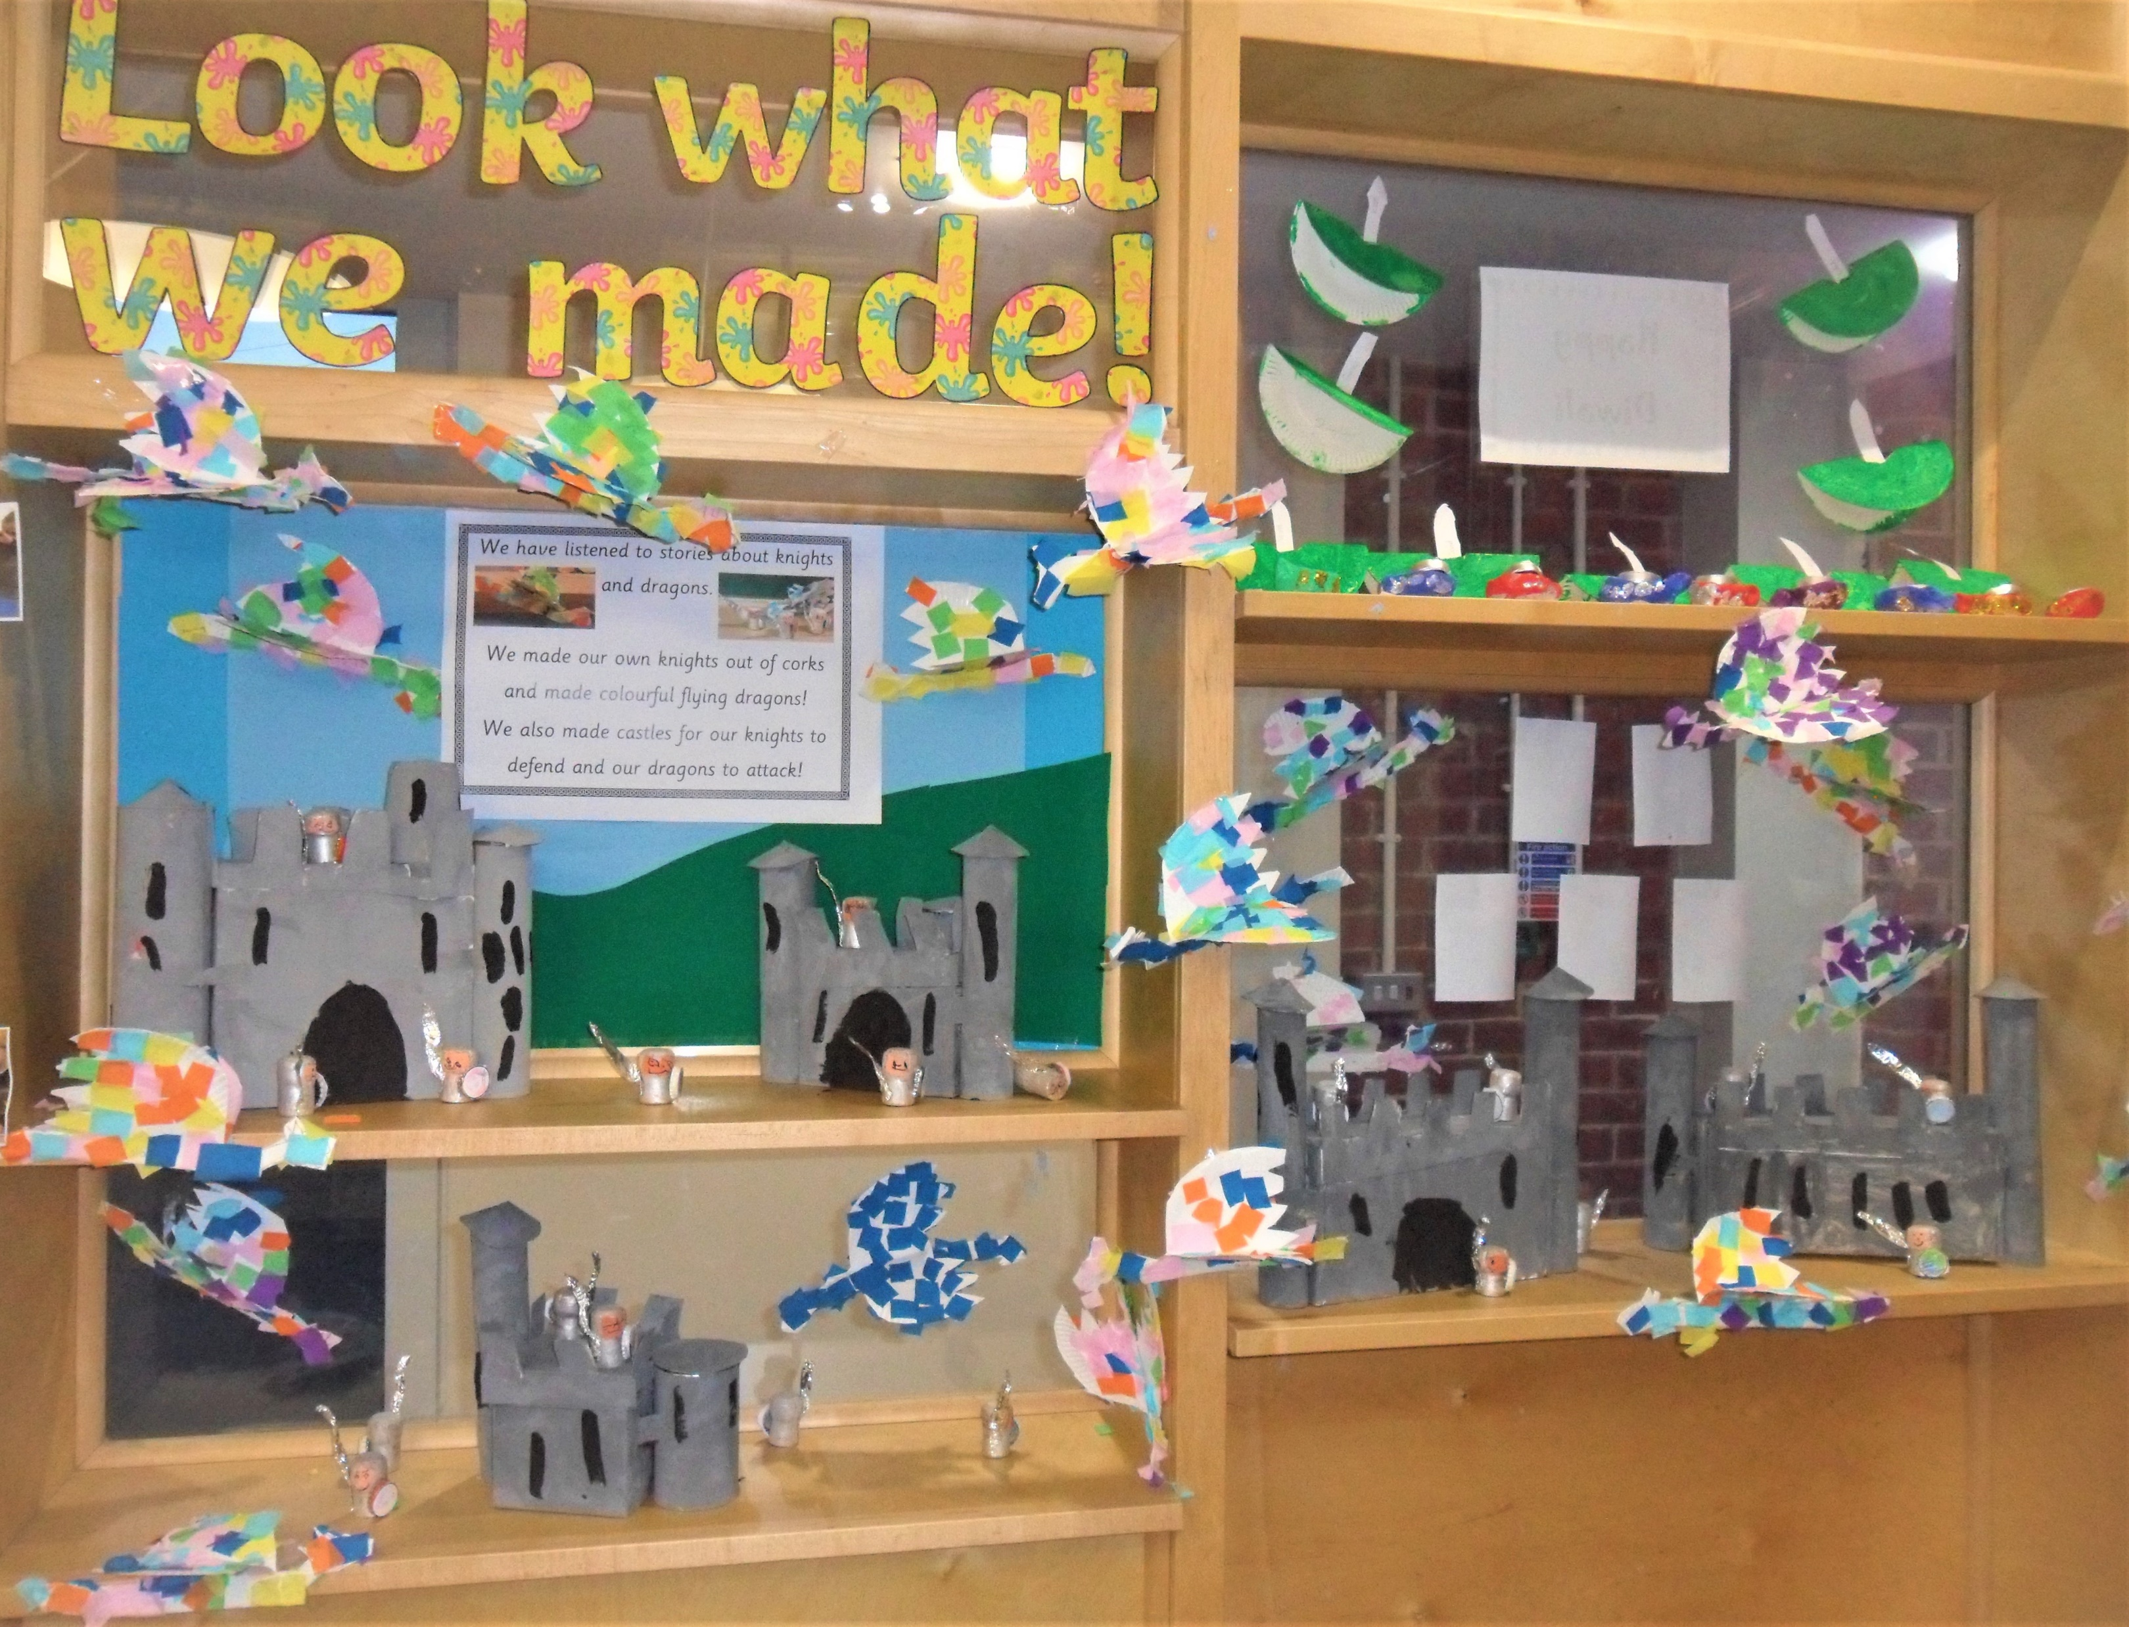
Our Lovely Work

Slide 11
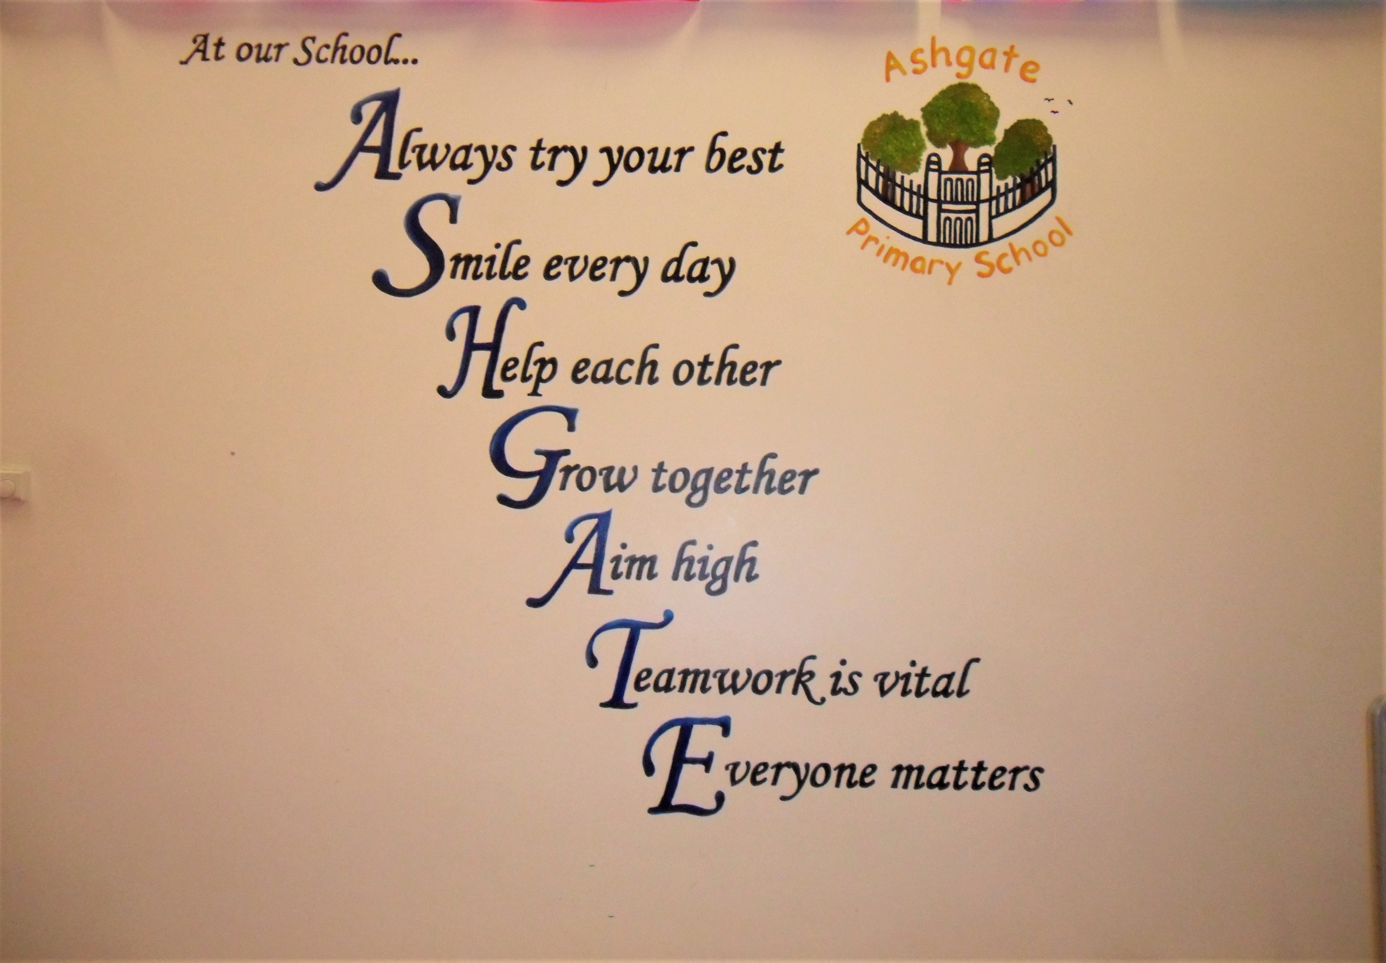

Slide 12
This is the end of the virtual tour around our school. Thank you for taking the time to look around. If you would like to speak to the staff please contact us by:
Telephone: 01332 343928
Email: office@ashgate.derby.sch.uk

