Slide 1


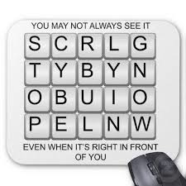

Have Fun – Stay Safe
‘E Safety’ – ‘Cyber Safe’

Slide 2

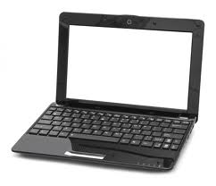



What is ‘Cyber Space’?
The invisible space that we use to link ourselves to the internet or other people using electronic devices

Slide 3
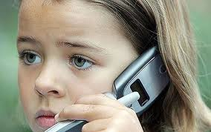
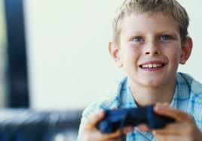
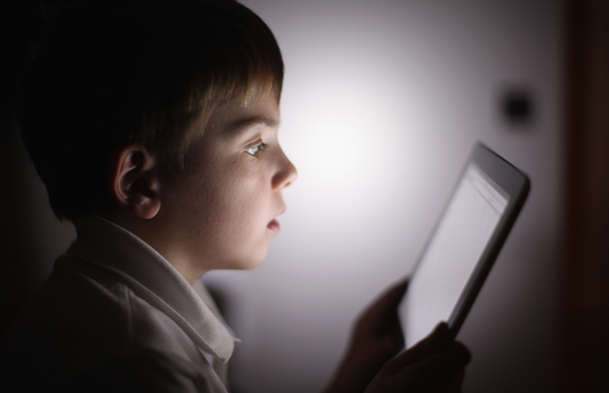

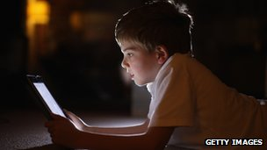

Notes:
----- Meeting Notes (14/10/2013 12:40) -----
How many of you use the following?

Slide 4

Why do we have to worry?
Anyone can access Cyber Space
Anyone can pretend to be someone else
Some people use Cyber Space to harm others by:
Saying unkind things to them
Posting information that is not true
Using it as a way to avoid ‘stranger danger’
?

Slide 5

Who am I?
My name is Edith
I am 8 years old
We like the same things
I live near you
Shall we meet up at the park?
It can be our secret!

Slide 6
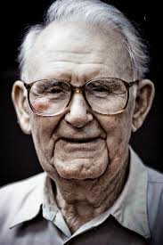
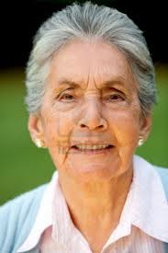

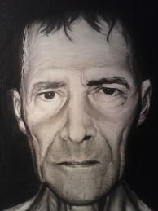

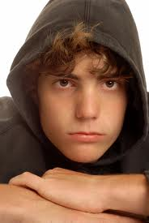
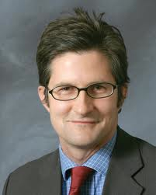
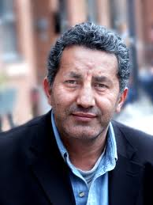

You Don’t Know Who They Are? Edith?

Slide 7

Stranger Danger
The same stranger danger rules apply in Cyber Space
A child is reported missing in the UK every 3 minutes

Slide 8
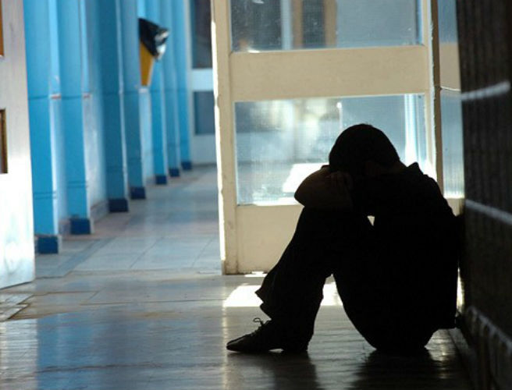
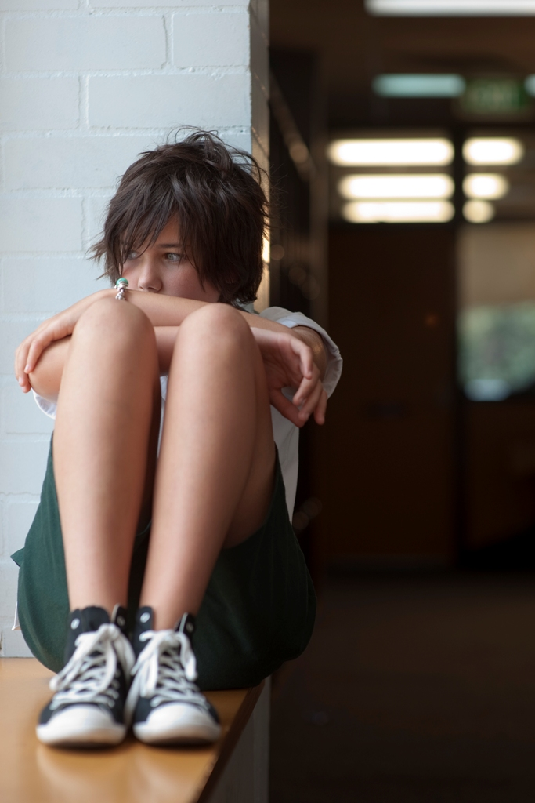
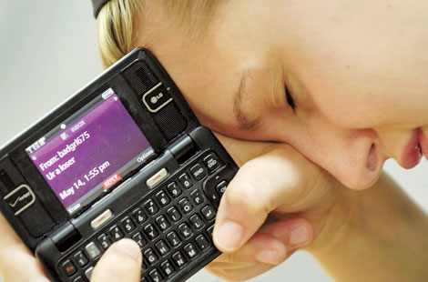
Cyber Bullying
"Cyber bullying" is when a child is:
tormented
threatened
harassed
humiliated
embarrassed
or otherwise targeted

Slide 9
http://www.tes.co.uk/teaching-resource/Combating-Cyberbullying-Suffering-in-Silence-6085349
http://www.tes.co.uk/teaching-resource/Combating-Cyberbullying-Posting-Pictures-without-Consent-6085351

Slide 10


It is illegal
Protection from Harassment Act 1997, which has both criminal and civil provision
Malicious Communications Act 1988
Section 43 of the Telecommunications Act 1984
Communications Act 2003
Public Order Act 1986
Laugh at it or share it – makes you part of it!

Slide 11
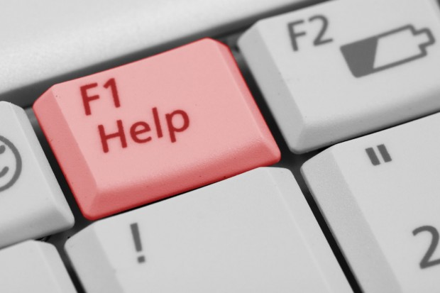
How can you stay safe?
Always think of your personal safety first when using ICT or your mobile phone. Remember it is easy for anyone to lie about who they are online, so you can never really be sure about who you are talking to.
Do not give out any personal information about yourself online to people you do not know. This includes your full name, address, street name, postcode, or school name.
Never give your contact number to anyone who you don’t know.
It’s a good idea to use a nickname rather than your real name.
Don’t meet people that you have only spoken to online. This is no different to getting into a car with someone you don’t know.
Never give out pictures online or over a mobile unless you know the person in real life. It is easy for people to take your pictures and alter them, send them on, or even pretend to be you with them.
Always use private settings whenever you are setting up a social networking page or an Instant Messenger (IM) account. This is so people who you don’t want to see your profile can’t.
Anything you post or upload to the internet is there forever so be very careful what you put online.
Never go onto webcam with people you don’t know in real life. Webcam images can be recorded and copied and also shared with other people.
If you receive any messages or pictures that worry or upset you talk to an adult you trust. You may also report it online, via the thinkuknow website http://www.thinkuknow.co.uk.

Slide 12

Don’t accept Cyber Bullying – Don’t put yourself at risk
TELL AN ADULT YOU TRUST
if you are upset or worried about something that has happened to you.

